Slide 1
The State of Patient Harm: Insights from the HHS Office of Inspector General
Amy Ashcraft, OIG Deputy Regional Inspector General

Slide 2




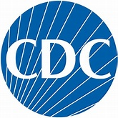




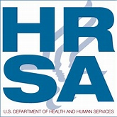

HHS’s Role in Patient Safety

Slide 3

How Safe Are Patients?

Slide 4
OIG Definition – All-Cause Harm
Undesirable clinical outcome—not caused by underlying disease —that was the result of medical care, including the failure to provide needed care
  For each event, we identify:
  A clinical cause (commission or omission)
  Signs and symptoms
  A medical intervention to treat the harm

Slide 5
National Rates of Harm
Based on Nationally Representative Medical Record Reviews
30%
Hospital Pilot (2008)
29%
Inpatient Rehab
(2016)
46%
Long-term Care (2018)
13%
IHS Hospitals
(2020)
25%
Hospitals
(2022)
33%
Nursing Homes
(2014)
27%
Hospitals
(2010)

Slide 6
National Rates of Harm
Based on Nationally Representative Medical Record Reviews
30%
Hospital Pilot (2008)
29%
Inpatient Rehab
(2016)
46%
Long-term Care (2018)
13%
IHS Hospitals
(2020)
25%
Hospitals
(2022)
33%
Nursing Homes
(2014)
27%
Hospitals
(2010)

Slide 7
1. What is driving these numbers?
2. Why didn’t we see improvement?
3. What else can we do?

Slide 8
1. What is driving these numbers?
2. Why didn’t we see improvement?
3. What else can we do?

Slide 9
One in Four Hospitalized Medicare Patients Harmed
Severity
12% Adverse Event
Preventability
43% Preventable
56% Not Preventable
Clinical Type
44% Medication
23% Patient Care
13% Temporary Harm
22% Surgery
11% Infections

Slide 10
Top 5 Reasons for Preventable Events
Substandard treatment or therapeutic care
Substandard or inadequate preventative care
Errors related to medical judgment, skill, or patient management
Inadequate care plans
Inadequate monitoring

Slide 11
1. What is driving these numbers?
2. Why didn’t we see improvement?
3. What else can we do?

Slide 12
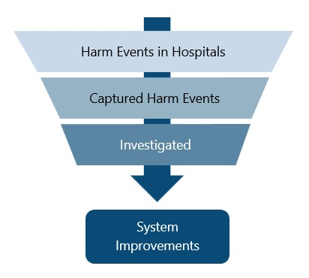
Where Do Patient Safety Efforts Stall?

Slide 13
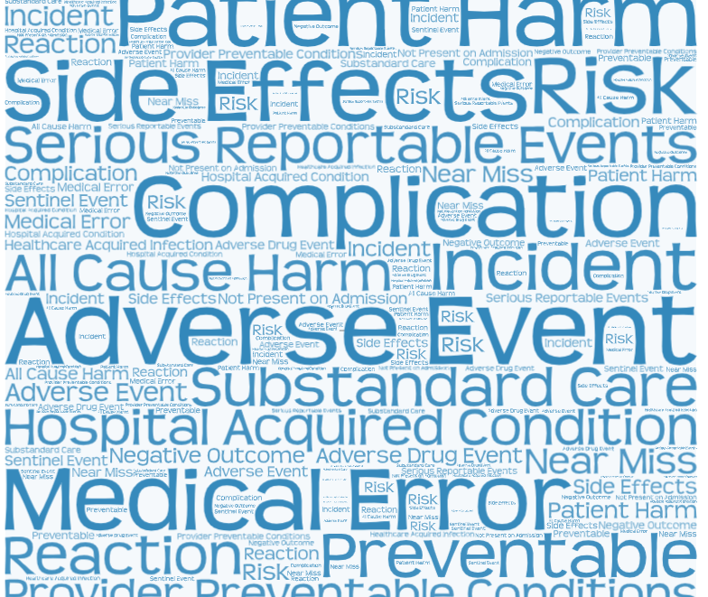
What kinds of harm do you track?
What do you investigate?

Slide 14

Incident Reporting & Surveillance
Capture rate in 2012: 14%
Upcoming OIG report:
  What percent of events do hospitals capture?
  What are the reasons events are not captured?
  What are the outcomes of events that are captured?
Notes:
In 2012, HHS OIG released a report that determined the extent to which hospital incident reporting systems captured patient harm that occurred within hospitals, which we found to be 14%. Given the increased focus on reducing patient harm to advance patient safety across groups (i.e., hospitals, government) in the past years, we at OIG wanted to know if the recent capture rates reflected this. We decided to follow up on the patient harm events that occurred in October 2018 from our 2022 national incidence report and surveyed the hospitals that these events occurred at. We gathered information on these hospitals’ policies and practices regarding how they respond to harm events in general, and we examined the extent to which hospitals captured and addressed those events through investigations and system improvements. From this study, we found a number of concerns associated with hospitals not capturing a portion of these patient harm events. This included hospitals not considering known complications as harm that warranted reporting, and hospitals having different definitions of what is considered reportable harm. Additionally, we found that a portion of harm events may have been known to hospitals but were considered Patient Safety Work Products and therefore protected by the Patient Safety Act. We are aiming to release this report at the end of this year in December.

Slide 15
1. What is driving these numbers?
2. Why didn’t we see improvement?
3. What else can we do?

Slide 16
What Can Hospitals Do?
Track and monitor "all cause harm" to understand if current safety programs are effective
Increase transparency through disclosure to patients and reporting
Make safety a hospital-wide priority and integrate it into every job

Slide 17
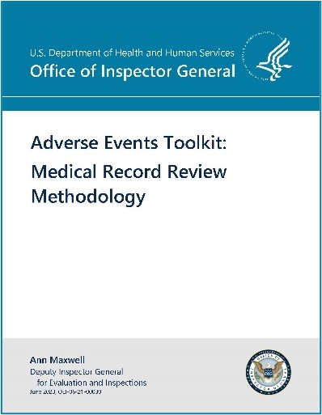
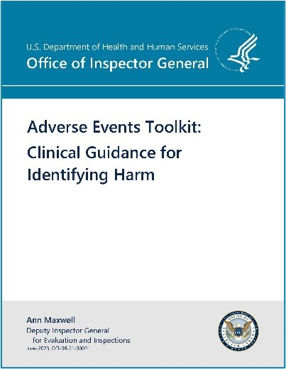
OIG Toolkits

Slide 18
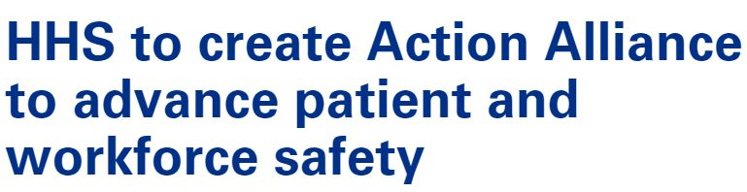
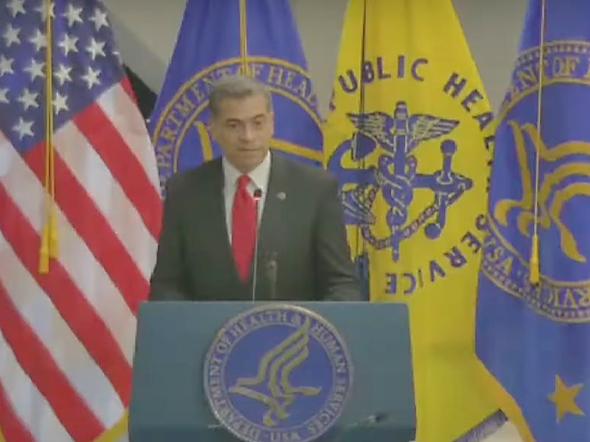
Ongoing HHS Efforts
AHRQ launched the National Action Alliance To Advance Patient Safety.
CMS released new guidance for surveyors to assess hospital compliance to track and monitor patient harm.
CMS developed a new Patient Safety Structural measure for hospitals.

Slide 19
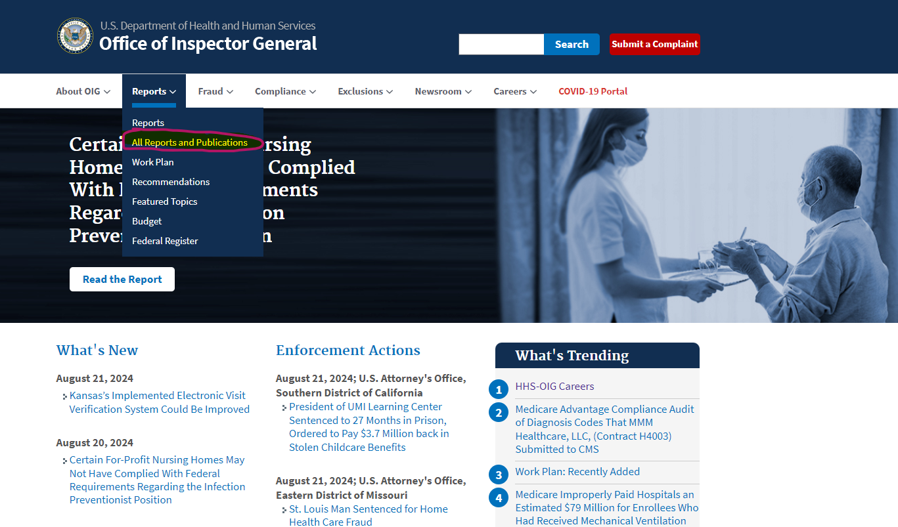
https:/oig.hhs.gov

Slide 20

Thank you!
Contact me at: Amy.Ashcraft@OIG.HHS.GOV

