Slide 1
The National Action Alliance for
Patient and Workforce Safety
Craig Umscheid, MD, MSc
Director, Center for Quality Improvement and Patient Safety, AHRQ
PSMF Annual Meeting
September 6, 2024

Slide 2
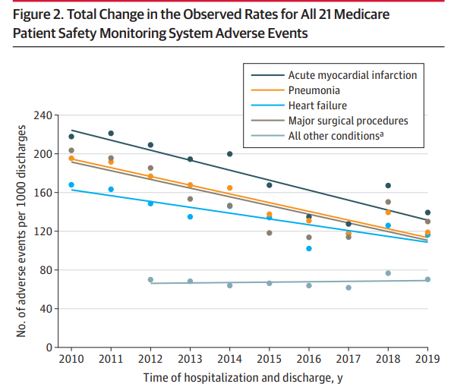
Prior to the COVID-19 Pandemic:
Patient Safety Incidents Were Declining
Examined adverse events (AEs) for ~300,000 adult inpatients in US, from 2010 to 2019
Data from the Medicare Patient Safety Monitoring System (supported by AHRQ)
Reductions in AEs for those admitted for:
  acute myocardial infarction
  pneumonia
  major surgical procedures
  heart failure
Eldridge et al., JAMA. 2022; 328(2): 173-183.

Slide 3
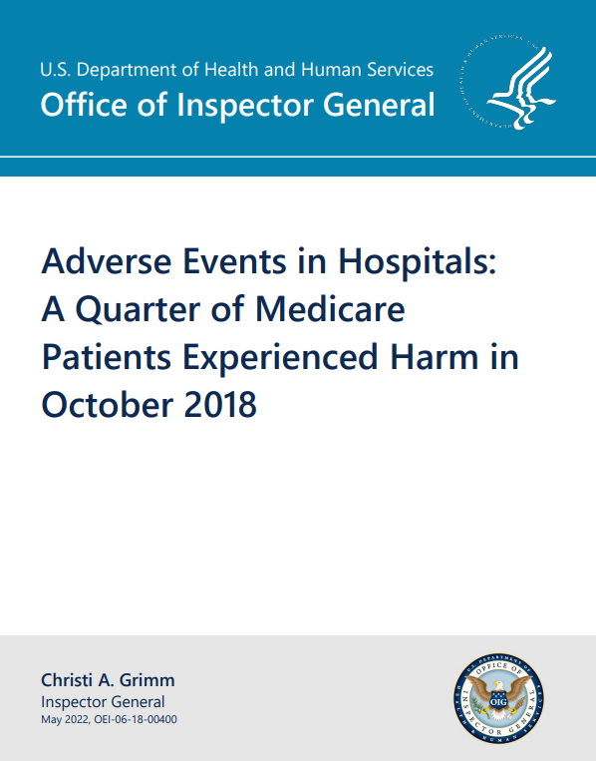
Despite Improvements, Patient Safety Issues Persist, and were Exacerbated by Pandemic
HHS Office of Inspector General Report from May 2022
  Analyzed Medicare inpatients from Oct 2018
  25% experienced harm
  10% experienced preventable harms
  27% experienced harm in similar analysis in Oct 2008
Bates et al. NEJM. 2023; 388(2):142-153.
  Hospitals in Massachusetts in CY2018
  24% admissions with adverse event
  7% admissions with preventable adverse events
  1% admissions with serious preventable adverse events
Fleisher et al. NEJM. 2022; 386(7): 609-611.
  CLABSIs decreased 31% in 5 years before pandemic
  CLABSIs increased 28% in Q2 2020 compared with Q2 2019
https://oig.hhs.gov/oei/reports/OEI-06-18-00400.pdf
Notes:
Colleagues at CMS published a perspective in NEJM lamenting how our progress over 5 years prior to pandemic was all but erased

Slide 4

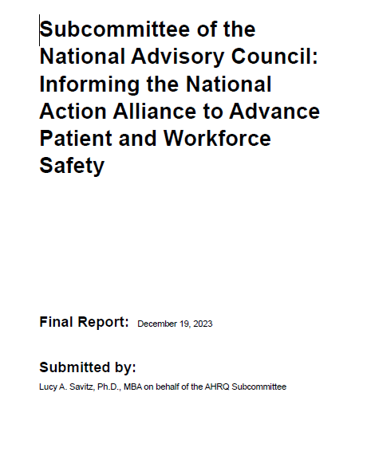
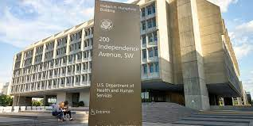
Recommitting to Safety
Nov. 2022
Jan. 2023
Mar. 2023
Apr. – Nov. 2023
HHS Webinar Series
Nov.
2023
Mar.
2024
Sec.
Becerra’s Call to Action
RFI Results
NAC
Sept. - Dec. 2023
SNAC Convenes
NAC
National Action Alliance Launch

Slide 5

Five Aims of the National Action Alliance for Patient and Workforce Safety
Advance Organizational Safety Strategies Using Safety Self-Assessments​
    Focus on four safety foundational areas: culture, patient engagement, workforce safety, learning systems
    Commit to safety self-assessments​
    Enact safety strategy​ based on identified gaps
Empower the Patient’s Voice in Safety Strategy​
    For example:
    Safety event submissions​
    Inclusion in event review​
    Input on safety initiatives​
    Communication and resolution programs​
Support Healthcare Workforce by Making Healthcare Safer by Design​
    Address five high-priority safety engineering needs​
Support Healthcare Workforce by Strengthening Safety Competencies​
    Develop, adopt, and report​ for all team members​
Facilitate Learning and Research Network​
    Encourage learning and sharing across network​
    Spotlight change leaders​
    Promote robust measurement​
    Research to address high-priority needs
Total Systems Approach to Safety
Informed by Safety Self-Assessments
Strengthen safety competencies
Safety by design
Empower the
patient’s voice
Learning and Research
Learning and Research Network

Slide 6
Using the 2020 National Action Plan for Safety to Inform Safety Self-Assessments
Culture, Leadership, Governance
  Regular safety culture surveys
Patient and Family Engagement
  Actively engaged PFACs
Workforce Safety
  Explicit worker safety strategy
Learning Healthcare Systems
  Defined safety competencies for all workers
https://www.ihi.org/initiatives/national-steering-committee-patient-safety/national-action-plan-advance-patient-safety
Notes:
Examples of assessment items in each of the foundational areas

Slide 7
National Action Alliance: Organizing to Achieve Safe Care Everywhere, Zero Preventable Harm for All
Other Healthcare Community Partners
Target
50% Reduction in Patient and Workforce Harm
by 2026
National
Steering Committee
Federal
Partners
Healthcare Provider Organizations Across All Settings
https://www.ihi.org/networks/initiatives/national-steering-committee-patient-safety

Slide 8



Organizing to Achieve Safe Care Everywhere, Zero Preventable Harm for All
Healthcare Provider Organizations
  Facilitate commitment to safety self-assessment
  Recruit high-performers to serve as change leaders
Engineering Safe Practices Group
  Identify high-priority opportunities to engineer safety into healthcare delivery
  Work collaboratively to identify and implement solutions
Safety Competencies Group
  Collaborate with professional groups to review safety competencies for their trainees and professionals
  Work collaboratively to address any gaps identified

Slide 9
Engineering Safe Practices Affinity Group Members
Name | Affiliation
Oriana Beaudet, DNP RN, PHN, Vice President of Nursing Innovation | American Nurses Association
Pascale Carayon, PhD, Professor Emerita, Department of Industrial & Systems Engineering | University of Wisconsin-Madison, Wisconsin Institute for Healthcare Systems Engineering
Chris DeRienzio, MD, Senior Vice President, Chief Physician Executive | American Hospital Association
Rollin J. “Terry” Fairbanks, MD, MS, Senior Vice President and Chief Quality & Safety Officer | MedStar Health, Institute for Quality & Safety
Lillee Gelinas, DNP, RN, CPPS, FAAN, Assistant Professor, Medical Education & Health Systems Science; Patient Safety Director, Texas College of Osteopathic Medicine | The University of North Texas Health Science Center
Ayse Gurses, PhD, MS, MPH, Director of Armstrong Institute Center for Health Care Human Factors and Professor of Anesthesiology & Critical Care Medicine | Johns Hopkins University, Malone Center for Engineering in Healthcare
Anjali Joseph, PhD, Endowed Chair in Architecture & Health Design | Clemson University, Spartanburg Regional Health System
Scott Lucas, PhD, PE, Vice President of Device Safety | ECRI Institute
Elizabeth Mort, MD, MPH, Vice President and Chief Medical Officer | The Joint Commission
Christine Sinsky, MD, Vice President for Professional Satisfaction | American Medical Association
Rupa S. Valdez, PhD, MS, Associate Professor of Public Health Sciences & Engineering Systems and Environment | University of Virginia, Department of Public Health Sciences & Department of Systems and Information Engineering
Kayla Waldron, PharmD, MS, BCPS, Director of Medication Use and Quality Improvement | American Society of Health System Pharmacists
Notes:
Federal Partners:
David Hunt, MD, ONC
Martha Betz, PhD, FDA

Slide 10
Patient Safety Competencies Affinity Group Members
Name | Affiliation
Lisa Howley, PhD, M.Ed., Senior Director for the Transformation of Medical Education | Association of American Medical Colleges
Greg Ogrinc, MD, MS, Senior Vice President, Certification Standards and Programs | American Board of Medical Specialties
Steve Singer, PhD, Vice President of Education & Outreach | American Colleges for Continuing Medical Education
Kevin B. Weiss, MD, MPH, Chief Sponsoring Institutions and Clinical Learning Environments Officer | Accreditation Council for Graduate Medical Education
Molly Lowe, MPH, Director of Content Strategy | American College of Healthcare Executives
Patricia A. McGaffigan, RN, MS, CPPS, Vice President | Institute of Healthcare Improvement
Stephanie Mercado, CAE, CPHQ, Chief Executive Officer | National Association for Healthcare Quality
Cheryl Peterson, MSN, RN, Vice President of Nursing Programs | American Nurses Association
Joan Stanley, PhD, NP, FAAN, FAANP, Chief Academic Officer | American Association of Colleges of Nursing
Notes:
Federal Partners:
Amy Kolwaite, CDC
Ed Yackel, VHA

Slide 11
Engaging the National Action Alliance Engine to Power
Safe Care Everywhere, Zero Preventable Harm for All
By 2026, Reduce Harms by 50% from Peak of Pandemic
Outcomes
Outcomes
Outcomes
Learning Health Organizations
Best Practice Implementation
Learning from Network
Research
Support
Aligned with VBP
Opportunity
Opportunity
Opportunity
National Action Alliance Engine
National Webinars
Implementation Initiatives
Tools and Resources
Funding Opportunities
Measures and Safety Dashboard
HHS Tools
Other Vetted Tools
Identify needs through baseline safety self-assessments
Notes:
This addresses the question of how we achieve change across healthcare systems

Slide 12
Examples of Tools, Funding Opportunities, and Implementation Initiatives from AHRQ
Culture, Leadership, and Governance
  Surveys on Patient Safety Culture (tool and pilot)
Patient and Family Engagement
  TeamSTEPPS 3.0 (tool & training)
Workforce Safety
  New AHRQ grant: Systems-Based Approaches to Improve Patient Safety by Improving Healthcare Worker Safety and Well-Being (up to $2M in funding)
Learning System
  PSNet (tool)

Slide 13
Proposed CMS Patient Safety Structural Measure (PSSM)
PSSM Domain | Key PSSM Specifications
Domain 1: Leadership Commitment | C-suite oversees safety self-assessment and resulting plan and metrics
Domain 2: Strategic Planning | Strategic plan publicly shares hospital commitment to “zero preventable harm” Hospital has action plan for workforce safety Hospital requires implementation of a patient safety curriculum and competencies for all staff
Domain 3: Culture of Safety | Hospital conducts hospital-wide culture of safety survey Hospital implements team communication training Hospital participates in large-scale learning network(s) for patient safety
Domain 4: Transparency | Hospital has a communication and resolution program, such as AHRQ’s CANDOR toolkit
Domain 5: Patient Engagement | Hospital has representative Patient and Family Advisory Council (PFAC) that provides input on safety-related activities Patients have comprehensive access to their own medical records via patient portals
Notes:
Affirmative attestation of all statements within a domain is required for the hospital to receive a point for the domain

Slide 14
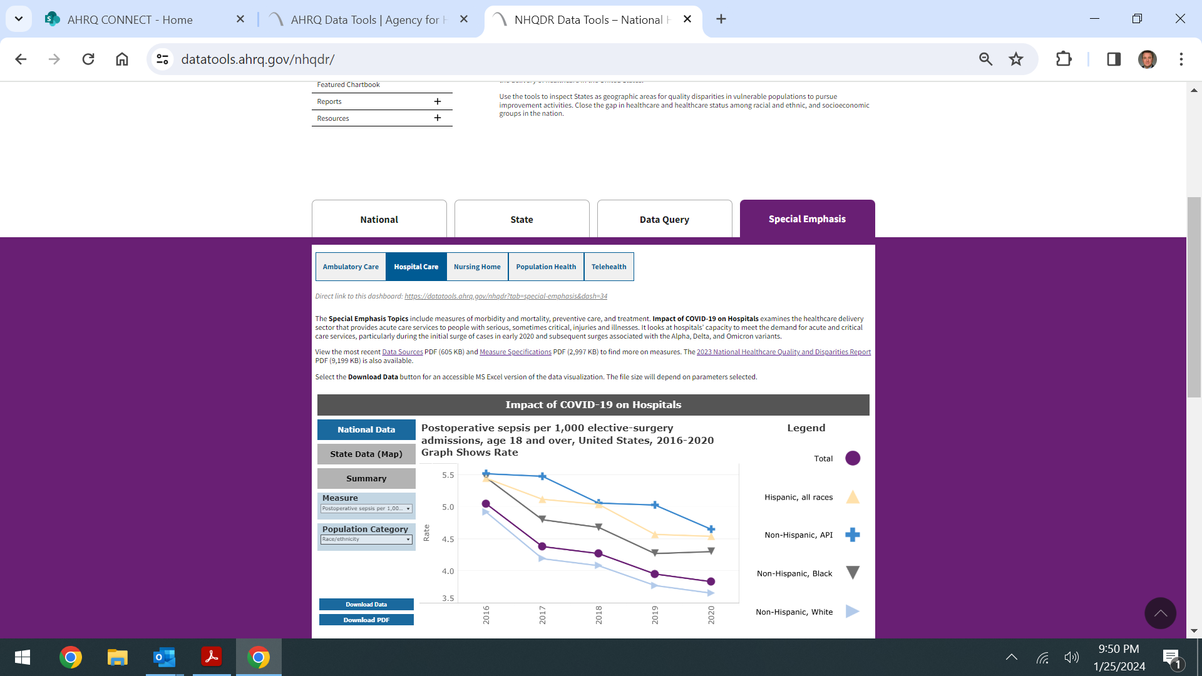
Proposed National Healthcare Safety Dashboard
ED
Ambulatory
Nursing Home
Hospital
HAIs
PSIs
Medicare
Experience
Culture
Stratified By
Adapted from current AHRQ NHQDR data tool:
https://www.ahrq.gov/data/data-tools/index.html
Notes:
Adapted from current NHQDR tool

Slide 15

The National Action Alliance Website Serves as a Hub to Engage
https://www.ahrq.gov/action-alliance/index.html

Slide 16

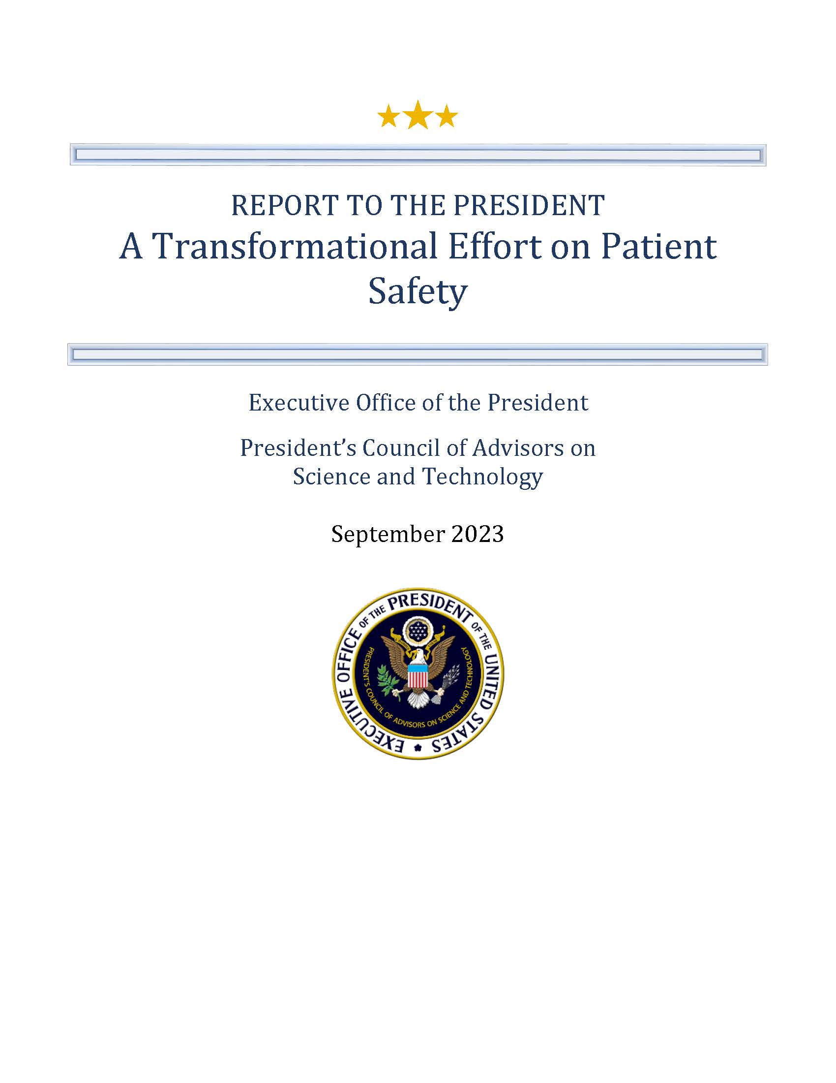
PCAST Recommendations
PCAST Recommendations
1. Establish and Maintain Federal Leadership for Patient Safety as a National Priority
  1.A Appoint Patient Safety Coordinator Reporting to the President
  1.B Establish Multidisciplinary National Patient Safety Team (NPST)
  Example AHRQ Strategies: OSTP Detail, Leading NAA, Co-Chairing NSC, PSOs
2. Ensure That Patients Receive Evidence-Based Practices for Preventing Harm
  2.A Identify High-Priority Harms and Incentivize Adoption of Evidence-Based Solutions
  2.B Create Learning Ecosystem to Ensure Evidence-Based Practices are Implemented and Reduced Harms are Realized
  Example AHRQ Strategies: NAA Website with Tools and Resources, National Safety Dashboard featuring QSRS, PSIs, CMS and SOPS measures
3. Partner with Patients and Reduce Disparities in Medical Errors
  3.A Implement a “Whole of Society Approach” in Patient Safety
  3.B Improve Data and Transparency to Reduce Disparities.
  Example AHRQ Strategies: Equity Lens on National Healthcare Safety Dashboard
4. Accelerate Research and Deployment of Safe Care
  4.A Develop a National Patient Safety Research Agenda
  4.C. Develop Federal Healthcare Delivery Systems’ Capacities and Showcase Results as Exemplars
  Example AHRQ Strategies: Support Development of Research Agenda, Engaging IHS, HRSA, DOD and VA, and NAA Best Practice Evaluations and Webinars to Identify and Spotlight Change Leaders
https://www.whitehouse.gov/pcast/briefing-room/2023/09/07/pcast-releases-report-on-transforming-patient-safety/
Notes:
PCAST_Patient-Safety-Report_Sept2023.pdf (whitehouse.gov)

