Slide 1
Towards A Real
Standard of Care
D.A. Wallach

Slide 2

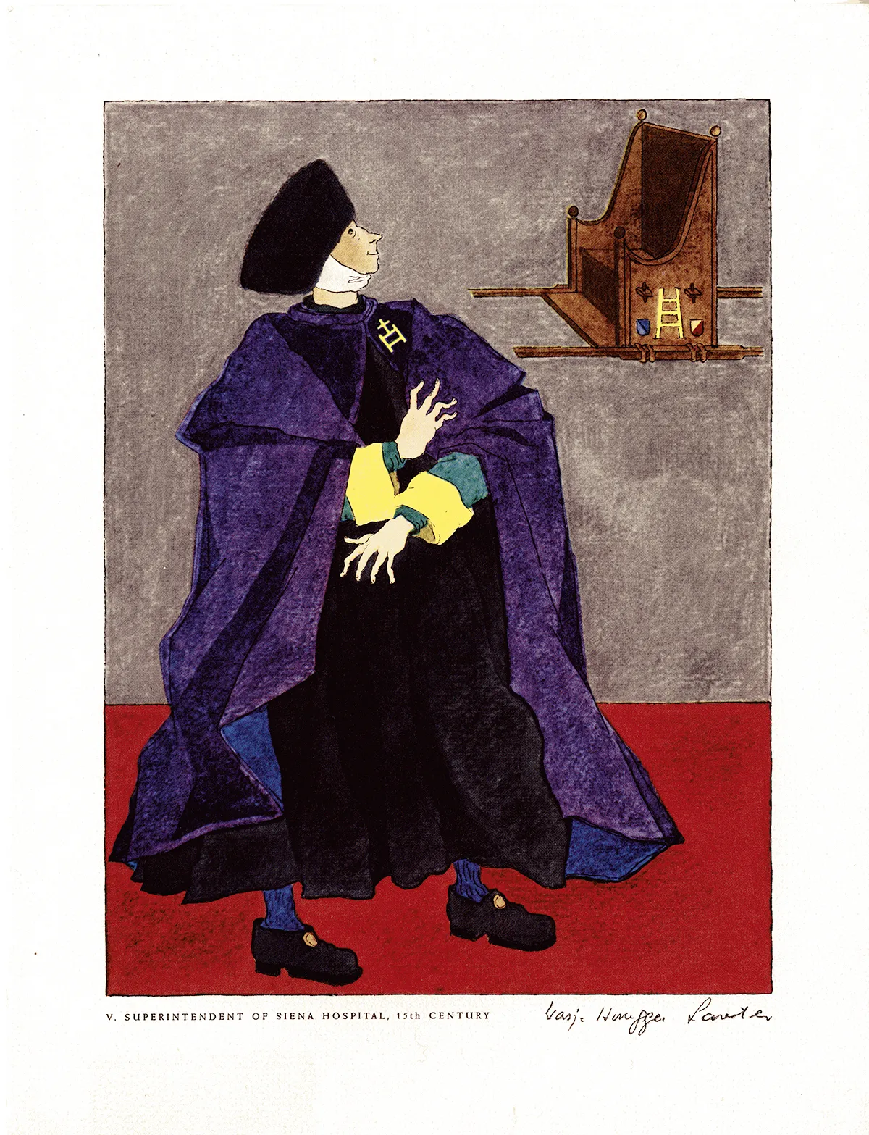

A long history of witchcraft and BS
Credit: Warja Honegger-Lavater

Slide 3
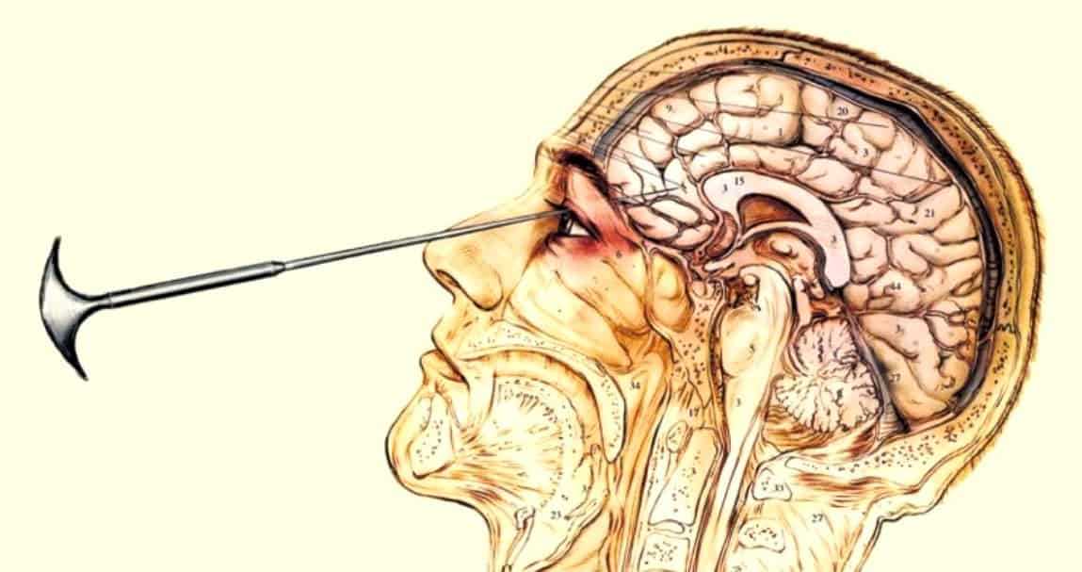
20th Century Witchcraft

Slide 4

And still going strong…

Slide 5


Medieval Moderating Forces
Henry VIII & Thomas Linacre (1518)

Slide 6

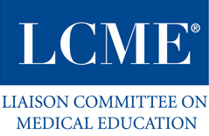

19th-20th Century Standardization
1847
1942
1981

Slide 7

Negligence & Liability

Slide 8
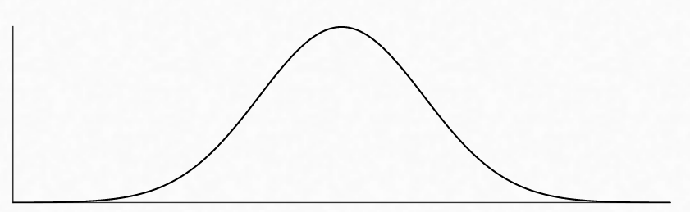
The question remains…where should we set the bar?
Quality of Evidence-Based Practice
Minimal
Community
World-Class

Slide 9


“Streaming Medicine” = world-class medicine for the whole world.

Slide 10
Built on a global, realtime standard of care.
Evidence-based
Personalized with validated algorithms
Always up-to-date
Geography and income invariant

Slide 11
Three major barriers:
Fragmentation
Medical Culture
Technology

Slide 12
Fragmentation: the many standards of care
Physician societies
Publications
Government
Provider guidelines / protocols / “care pathways”
Insurance company pre-authorization criteria / “rulebooks”
Medical curricula / continuing medical education
Clinical decision support software
Malpractice law statutes

Slide 13

2. Medical Culture
Art vs. Science
–
Paternalism vs Partnership

Slide 14
3. Technology
Instant real-time distribution
AI co-pilot assistance
Instant auditing
Access to information

Slide 15
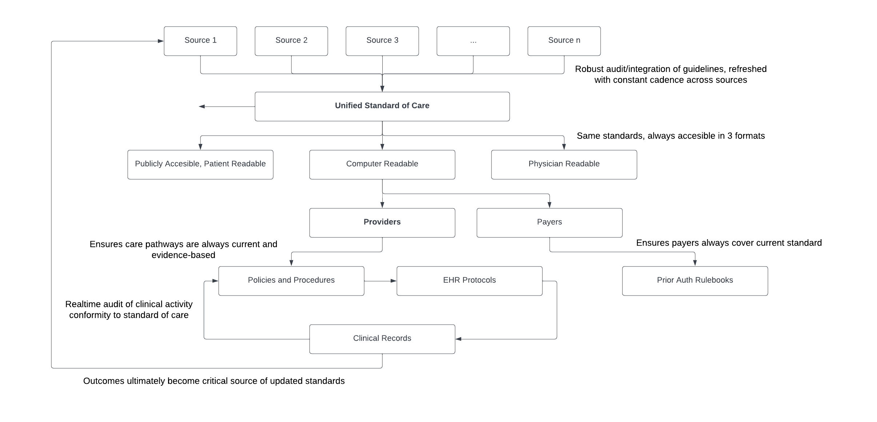
A Blueprint

Slide 16


Centralizing knowledge enables
decentralizing care and redefining labor roles.
+ >
?

Slide 17
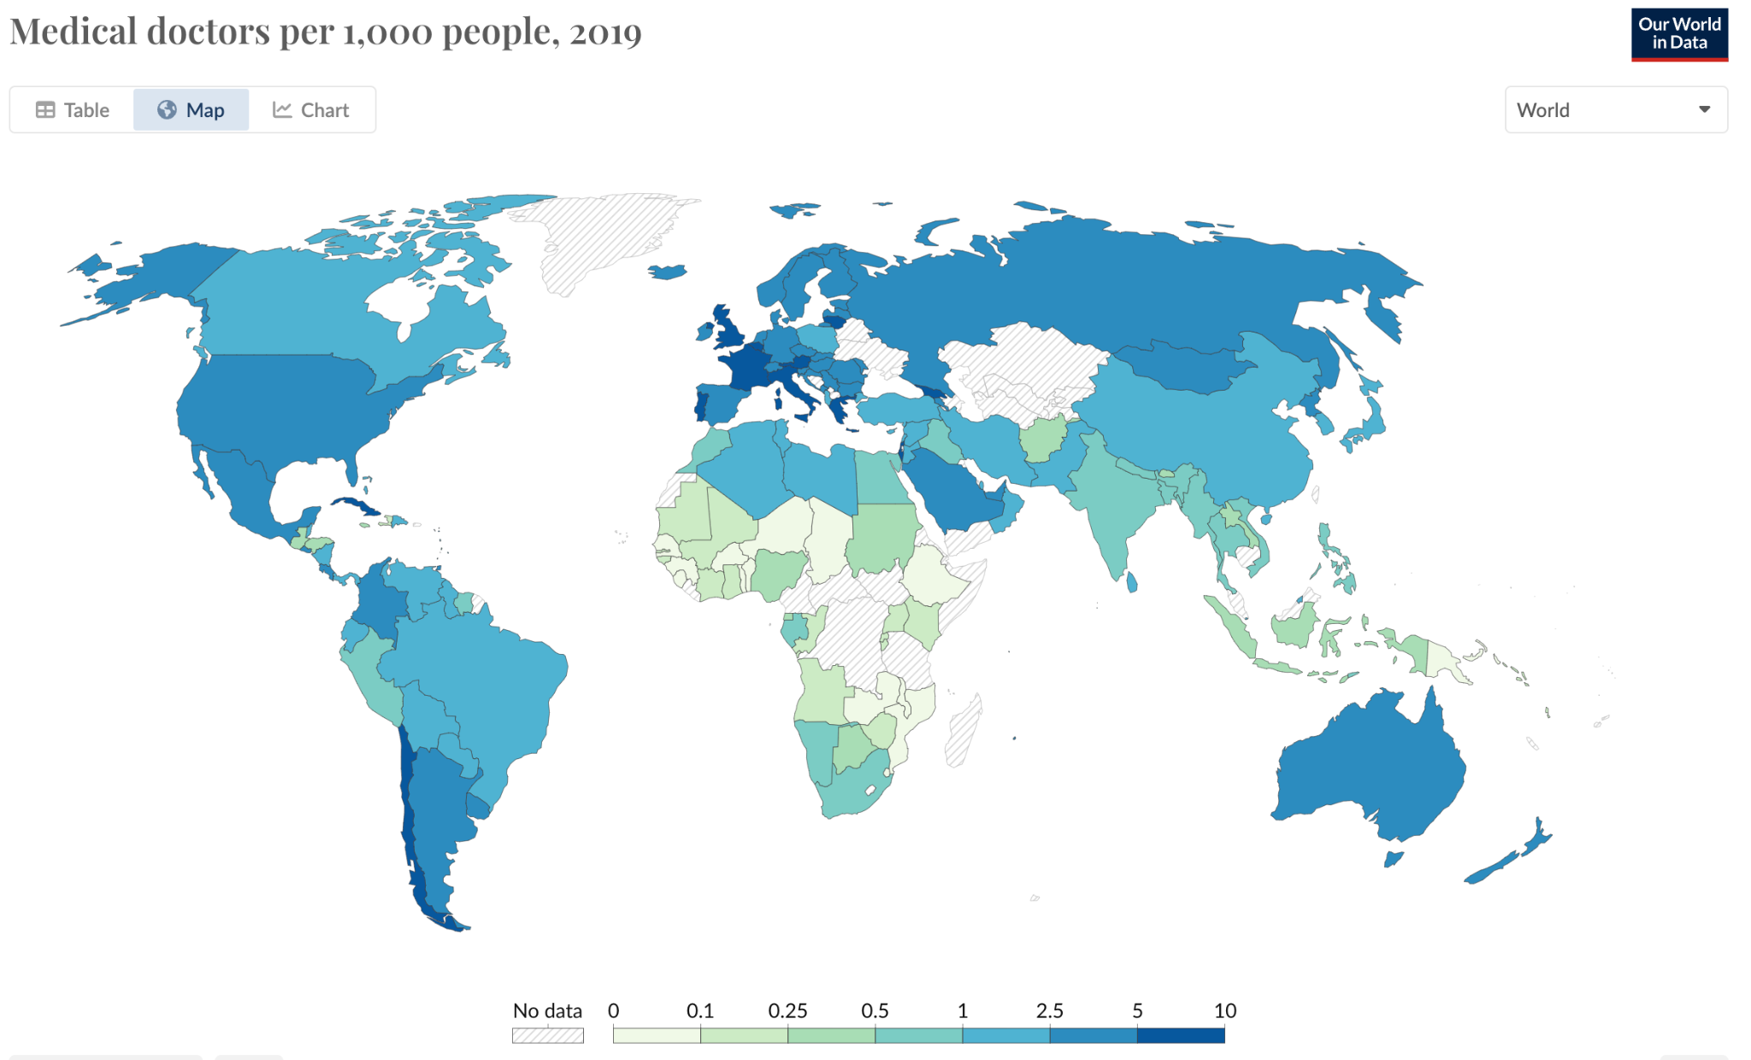
Lowering barriers to medical competence is the only way to equalize access to care worldwide.

Slide 18
Takeaways:
Medicine is on a long journey from witchcraft to science. Let’s finally vanquish the witchcraft and paternalism of the past. Evidence-based medicine should be synonymous with medicine.
The corpus of medical knowledge is among the treasures of human civilization. It is time to package it into a computable, global, and free “streaming medicine” system. Global governments & the private sector should collaborate to achieve this.
The internet, mobile computing, and AI can leverage this infrastructure to radically expand the labor pool for delivering medical care, creating jobs and extending access.
This new paradigm should be inherently safer and more amenable to continuous auditing and legal enforcement of the standard of care.

