Slide 1

Working at the Edge of Perioperative Safety: A Transformative Vision
Notes:
Ether was transformative. We are at an ether moment

Slide 2
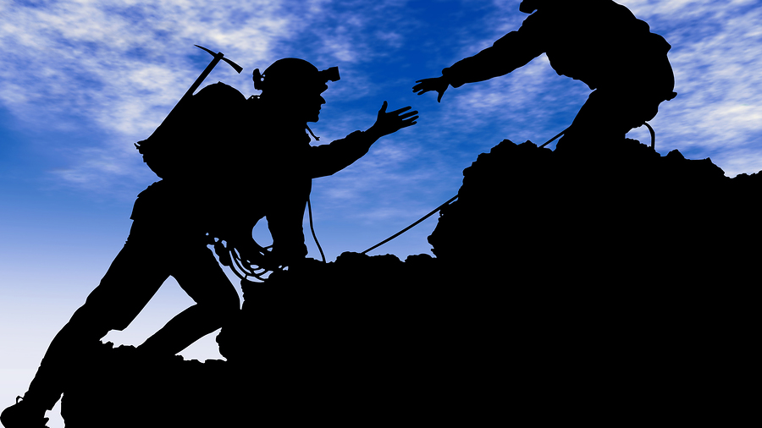

COLLABORATION

Slide 3
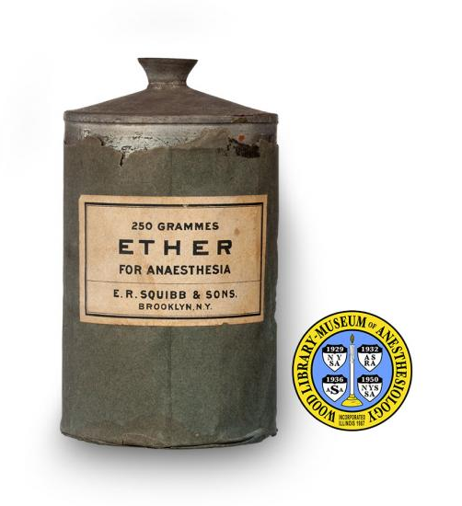
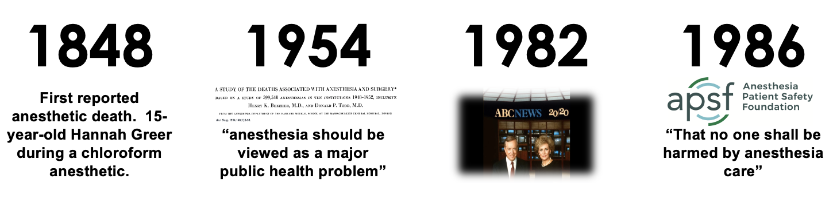

Notes:
The introduction of safety standards and improved training has resulted in a reduction in anesthesia-associated mortality from 64/100 000 in the 1940s to 0.4/100 000 in the present.

Slide 4

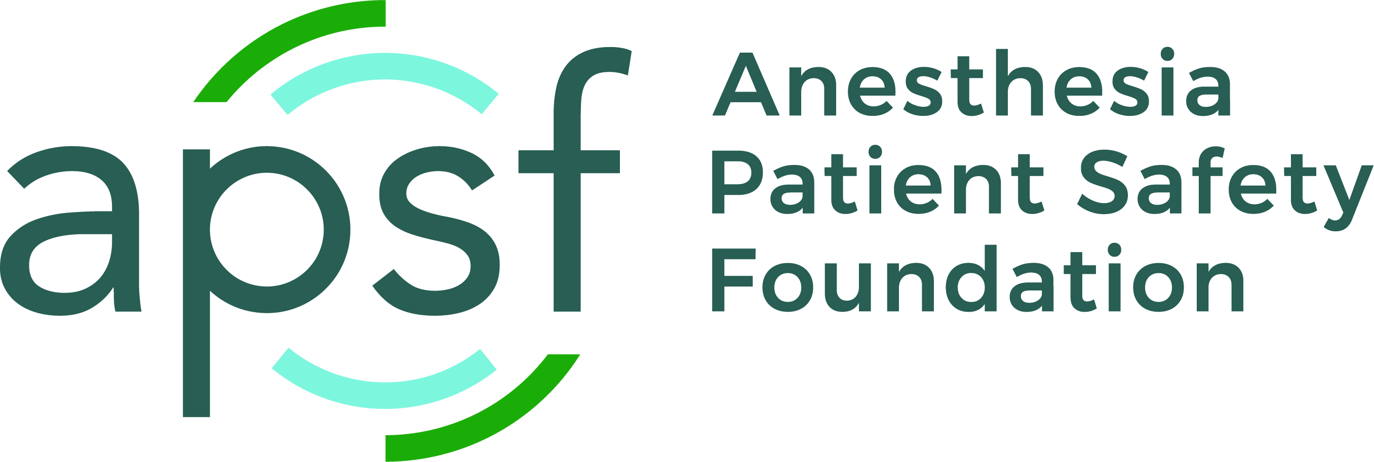
“A thousand candles can be lighted from the flame of one candle”
Research
Advocacy
Education
Communication
Newsletter
Collaboration
Notes:
Technology organization. Expect to be involved in advocacy
1,000,000 website visitors per year
Conservatively, Our newsletter reaches more than 650,000 of the world’s estimated 850,000 anesthesiologists and other anesthesia professionals.

Slide 5

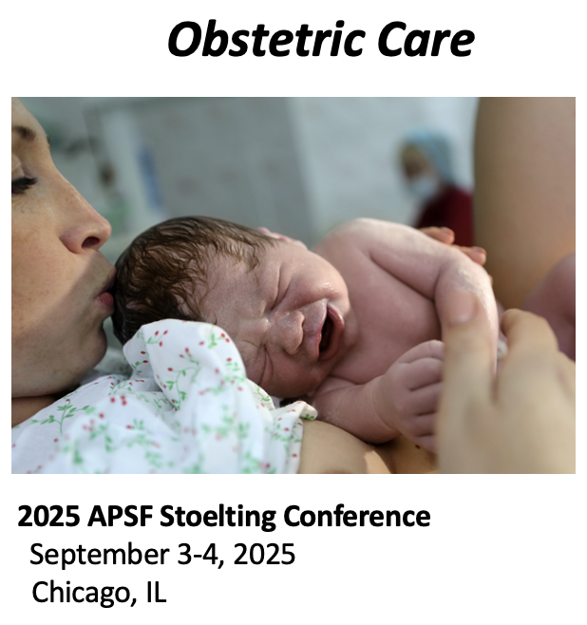
To change the Image…
Click on Picture
Go to Home> Shape Fill > Picture option
Browse and Select your Image
The entire slide will be filled with your image

Slide 6
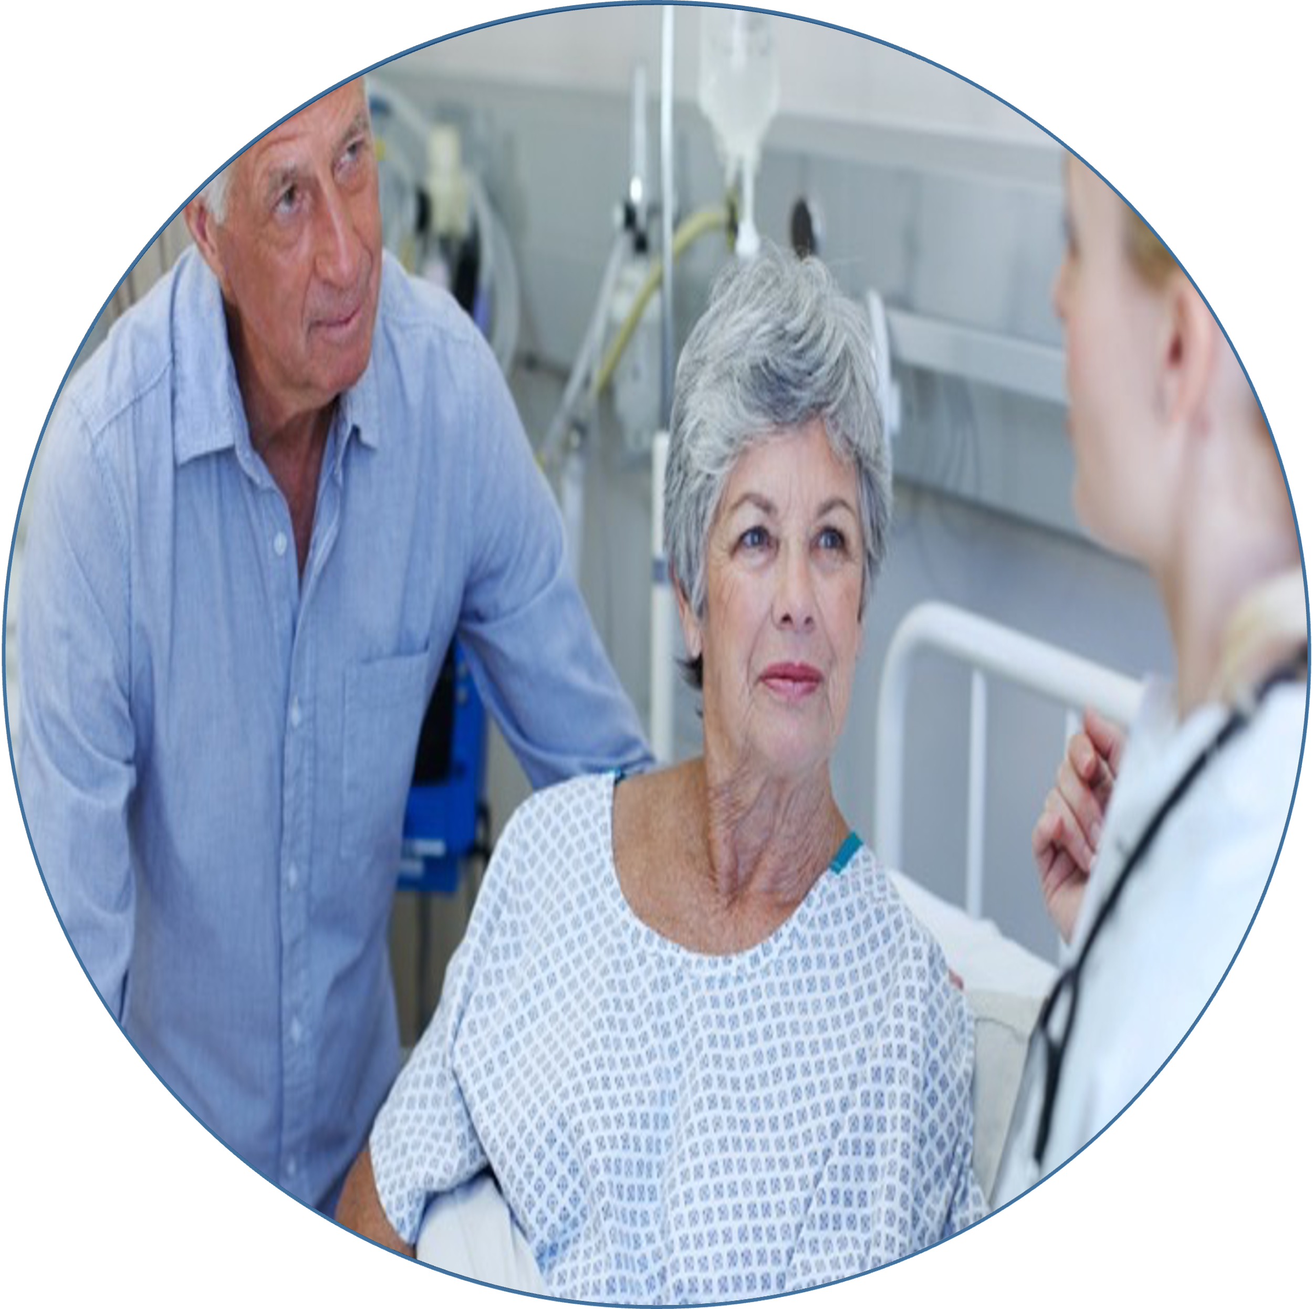
PRESENT
STATE
IDEAL
STATE
Culture
Systems
Patient
Engagement
Collaboration
Technology

Slide 7
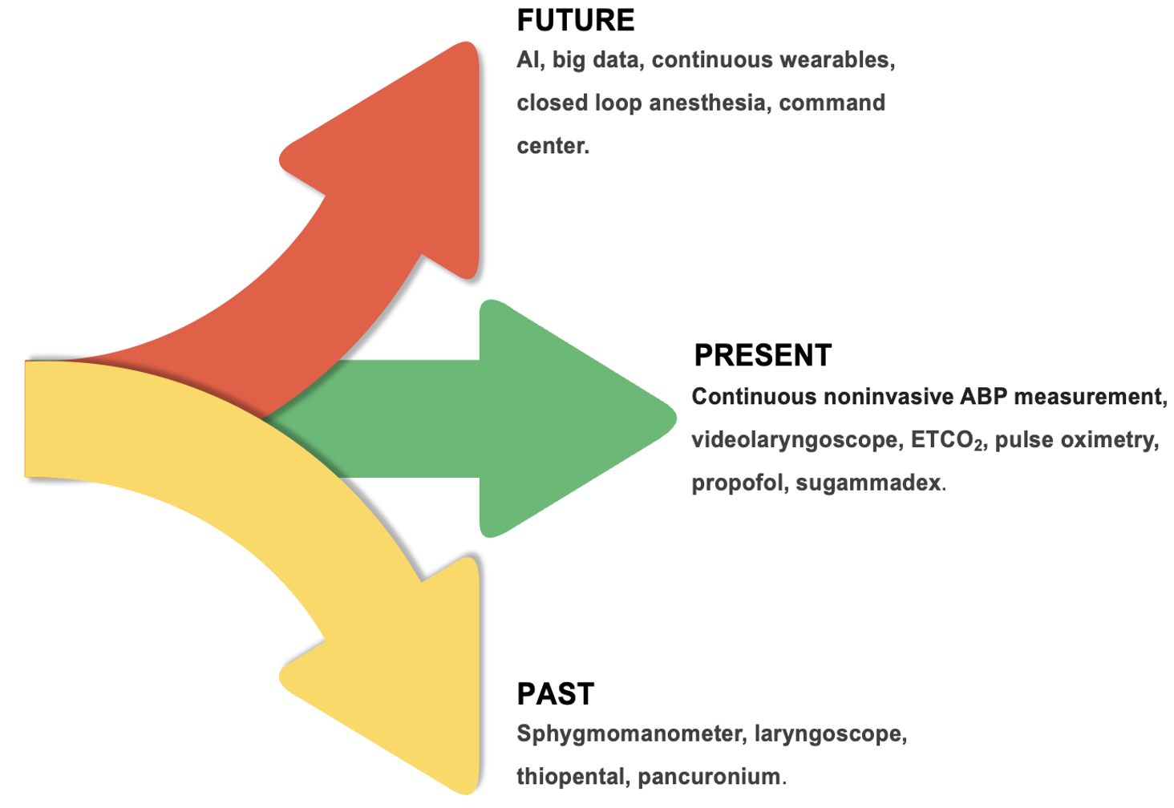
Emerging Medical Technologies ⎼ A Patient Safety Perspective on Wearables, Big Data and Remote Care
Notes:
I spend my time right next to the patient with an immense amount of data every moment which require smart decision. How can I make smarter decisions?
It’s an ether moment

Slide 8
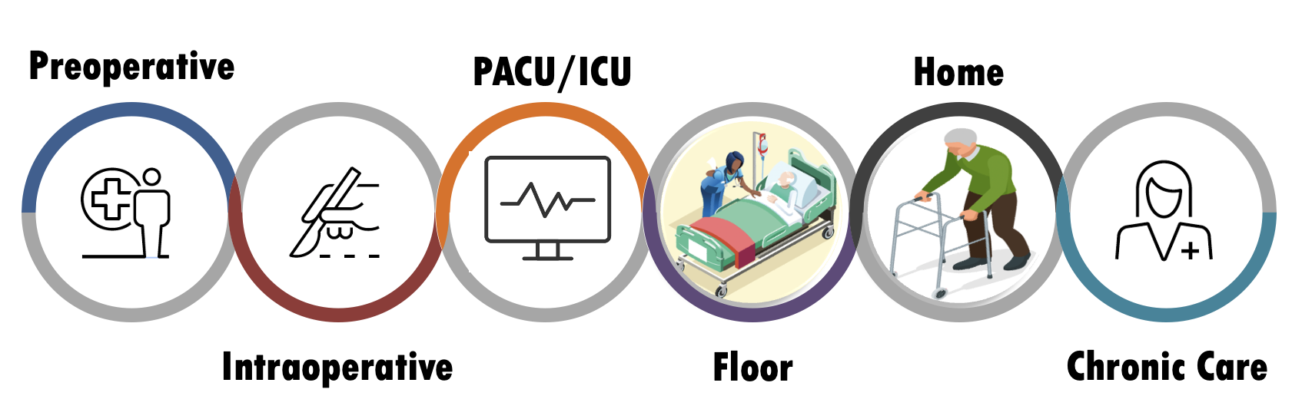
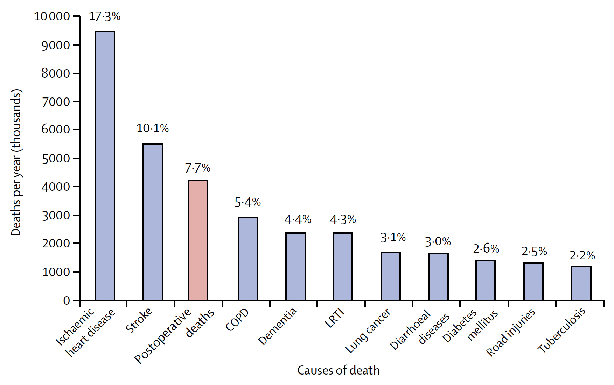
The Patient’s Journey

Slide 9
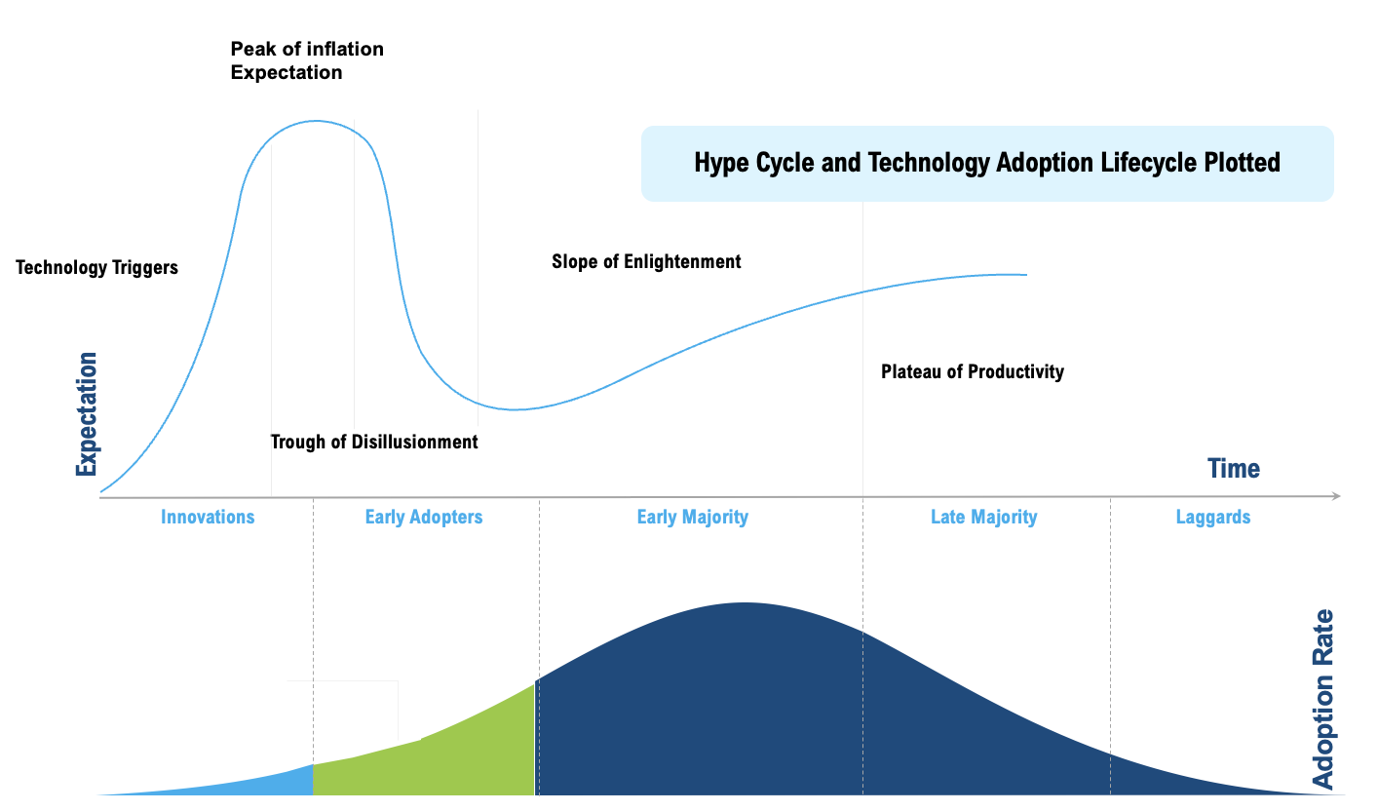
Emerging Medical Technologies ⎼ A Patient Safety Perspective on Wearables, Big Data and Remote Care

Slide 10
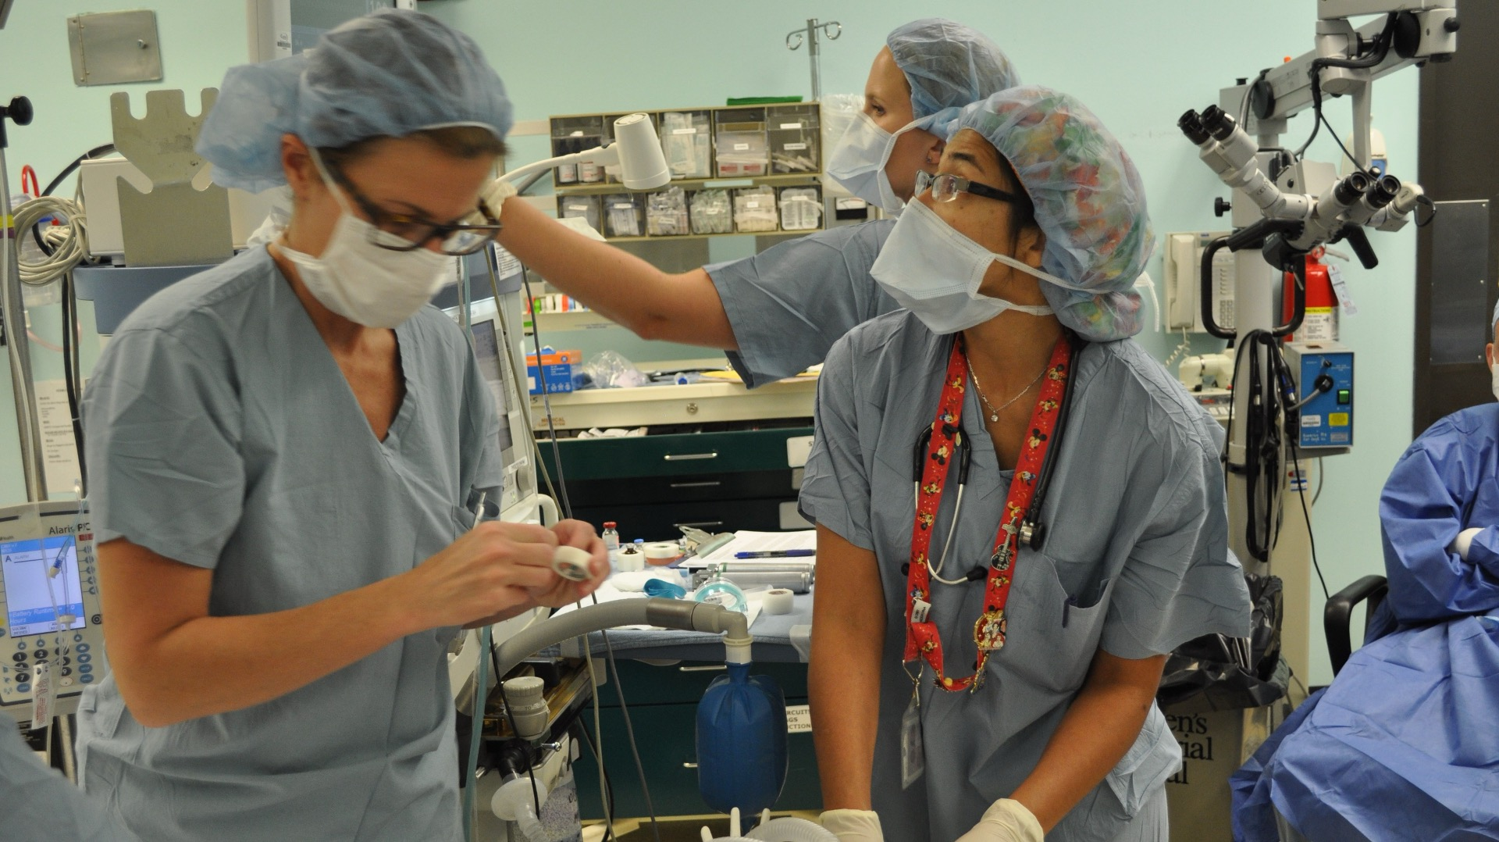
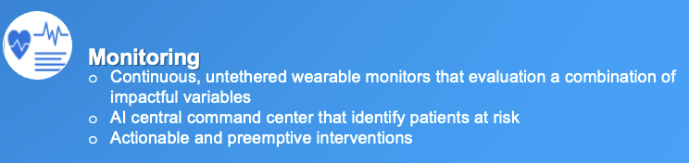
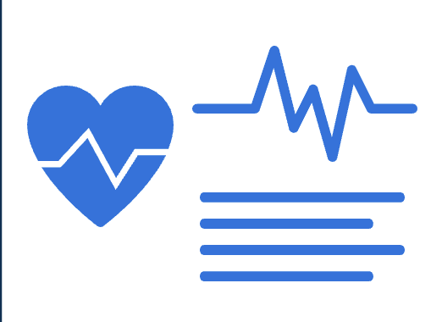
Emerging Technology in the Perioperative Period
Medical imaging
Helps detection of disease states
Identify abnormalities
Facilitates procedure success
Healthcare data analytics
Analyzes Electronic Health Records regarding risk
Provides useful information about care pathways
Predicts deterioration
Chatbots
Leverage deep learning models for realistic conversations with patients
Provide useful information for patients to achieve healthcare goals
Personalized medical treatments
Deliver personalized care
Provides insights from medical information to facilitate decisions
Monitoring
Continuous, untethered wearable monitors that evaluation a combination of impactful variables
AI central command center that identify patients at risk
Actionable and preemptive interventions
Notes:
Address points of failure.
Modern untethered wearable systems can now continuously evaluate a combination of physiologic variables such as BP, HR and rhythm, oxygen saturation, ventilatory frequency, temperature, activity, body position, and location in ward patients. This real-time patient information from ward monitoring along with other patient-specific clinical information (electronic record, laboratory results) goes to an artificial intelligence engine that will identify patients (perhaps 10%) who are currently at risk and project information about these selected patients to a command centre clinician for review. After review, the clinician alerts the ward team to patients who need attention. Our expectation is that timely identification of high-risk patients will allow clinicians to anticipate serious complications and intervene to prevent them, rather than trying to rescue patients thereafter. The overall goal is to go beyond rescuing patients who suffer major complications, and instead to anticipate and prevent such complications.

Slide 11


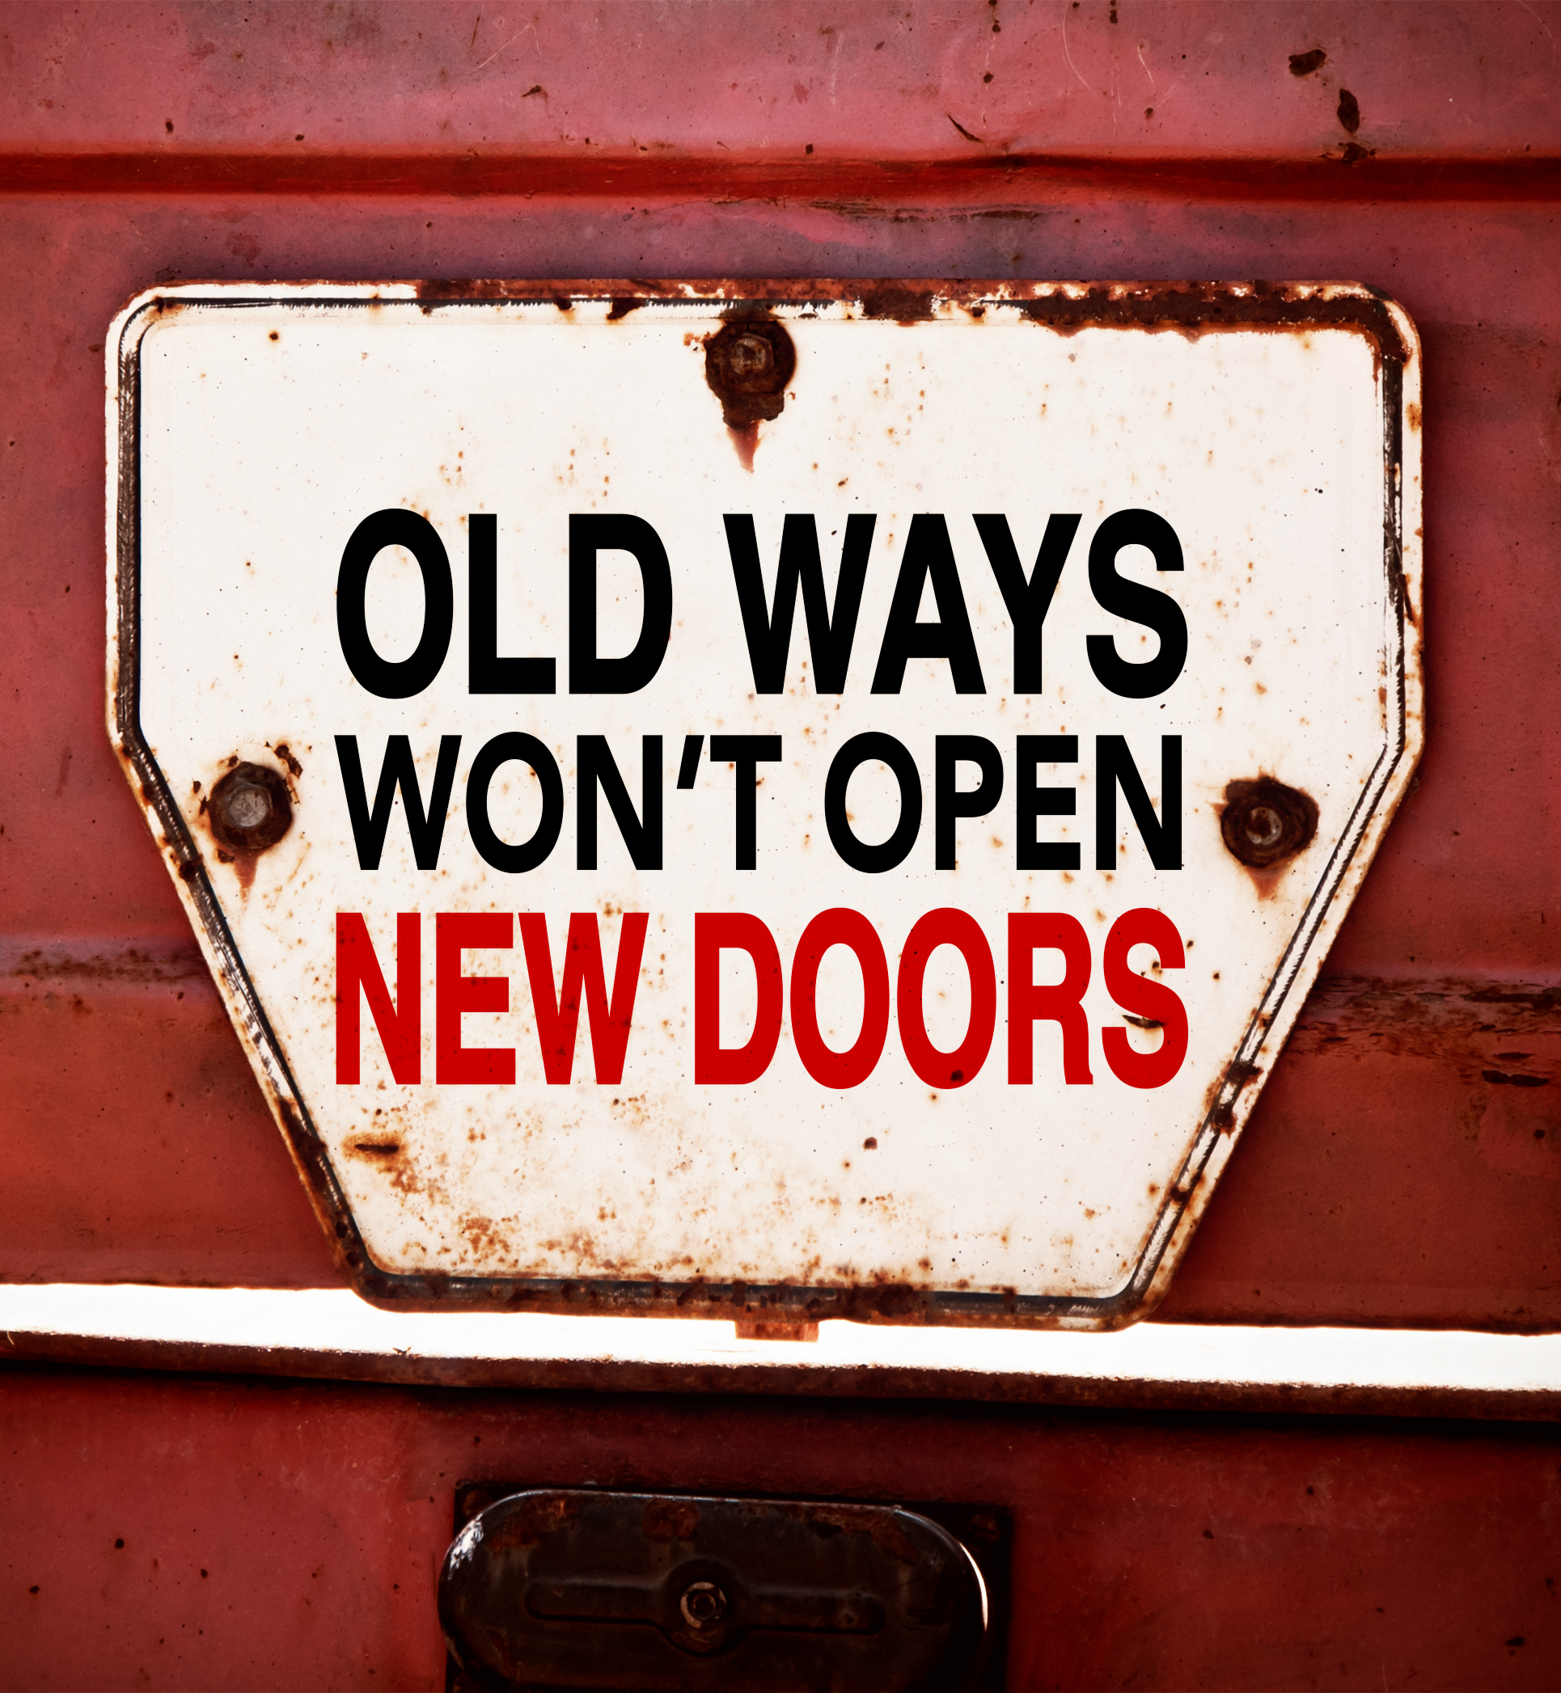
SUCCESS
will be determined not only by our existing strengths by how we leverage innovation and change for a better
FUTURE
Notes:
Key message

