Slide 1
Can Patient Safety Regain Attention?
The Essentials for Radical Transformation
Donald M. Berwick, MD, MPP
Senior Fellow, Institute for Healthcare Improvement
Patient Safety Movement Foundation
11th Annual World Patient Safety Science and Technology Summit
6 September 2024: Irvine, California

Slide 2
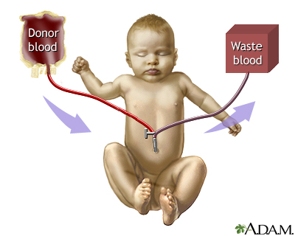
Exchange Transfusion

Slide 3
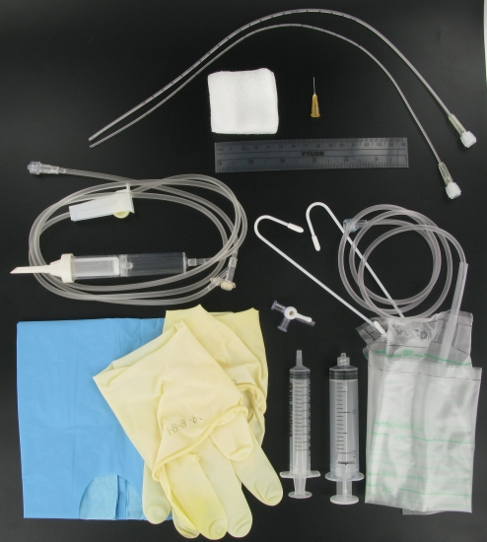
Exchange Transfusion

Slide 4

From Tom Nolan: Assets for Change
Will
Ideas
Execution

Slide 5
How We Are Doing on Will?
We still don’t believe patient safety is a problem.
And if we do, we don’t believe it applies to us.
We don’t think that it can be fixed. “Stuff happens.”
Evidence is not enough to induce change. (Bates study.)
We don’t know how to take advantage of intrinsic motivation. Reliance on control.

Slide 6
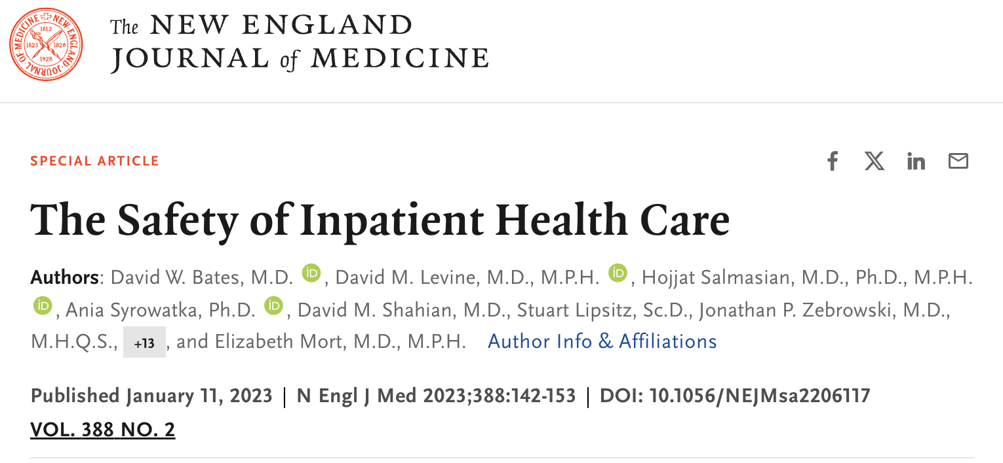
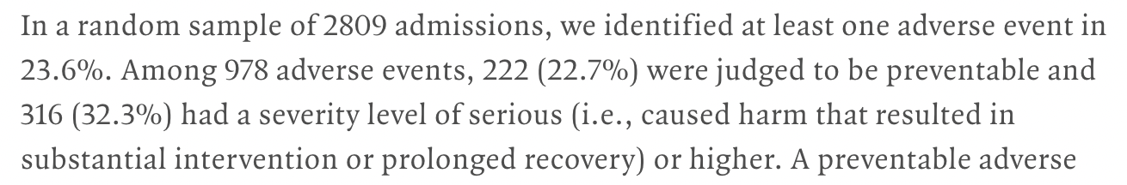

Slide 7
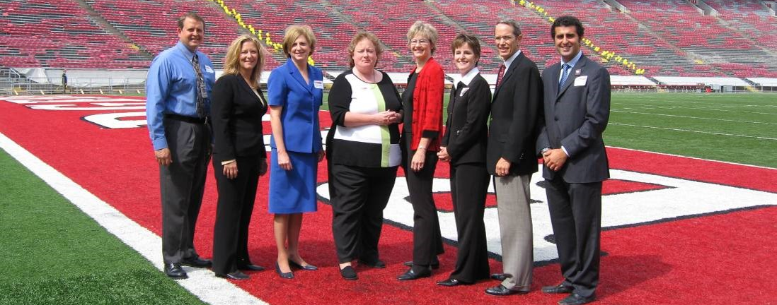
The 100,000 Lives Campaign

Slide 8
How We Are Doing on Will?
Distraction. “Just another thing.”
  Growing demands: equity, climate change, workforce burnout, changing payment systems, IT and cybersecurity.
Leadership and governance ignorant of the safety sciences and care processes.
Money eclipsing patient care. Under the pressure of the pandemic and the post-pandemic changes, whose budget gets cut first?

Slide 9
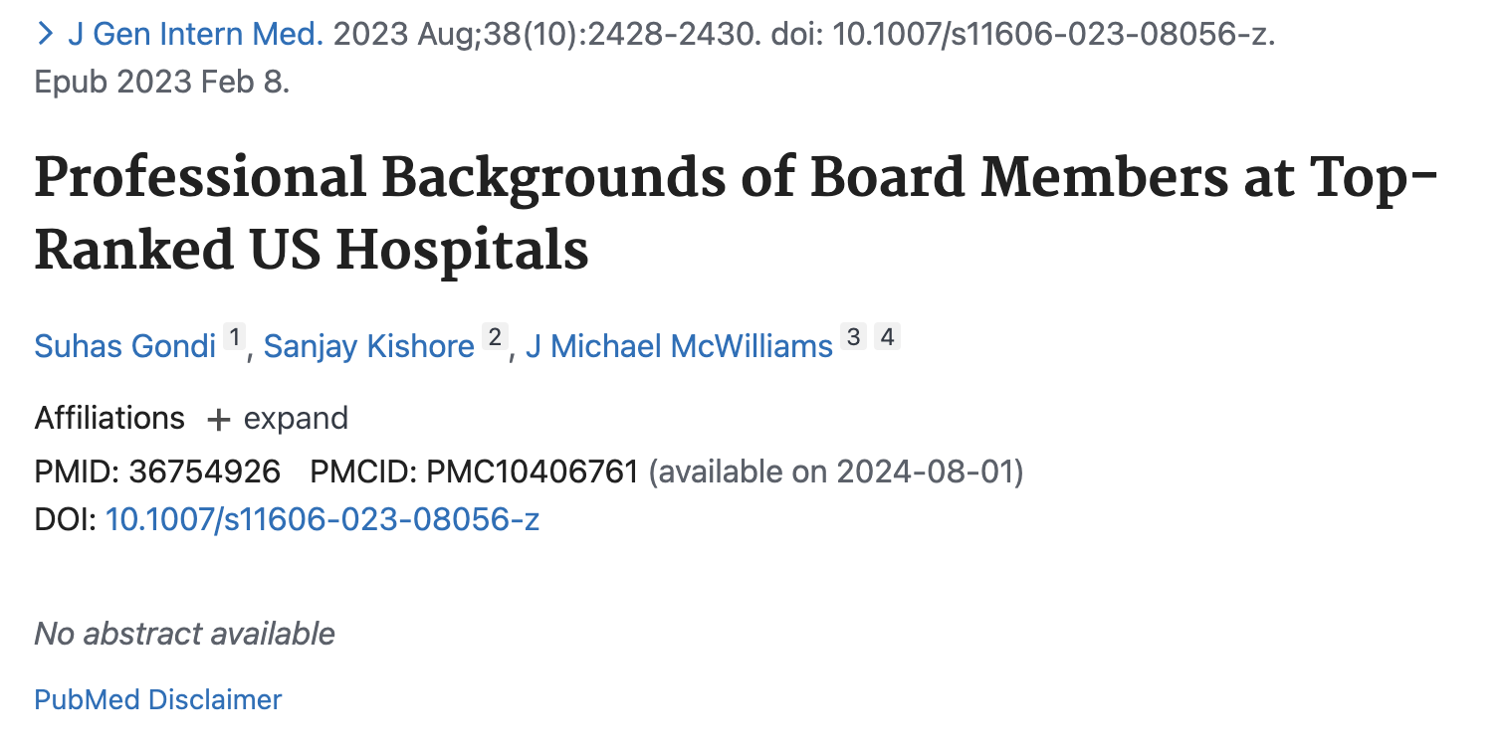
“Across all 15 hospitals, 14.6% of board members were health professionals.”

Slide 10
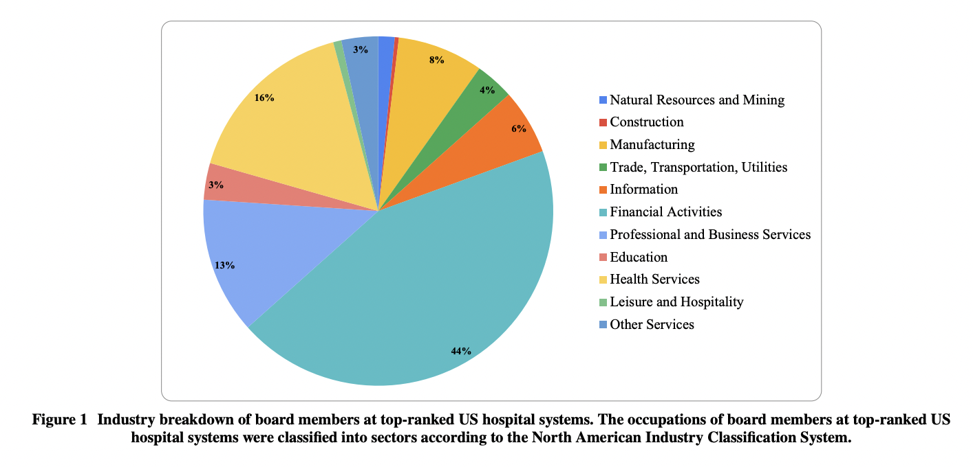
Professional Backgrounds of Board Members

Slide 11
How Are We Doing on Ideas?
Very rich science, but not studied or taught
Excellent analogues in other sectors, but not searched or used.
Basics not mastered.
  Hindsight bias
  RCAs
  Managing fear
Best anywhere as the standard everywhere.

Slide 12




A Reading List for Leaders, part 1
Jerry Langley,
Tom Nolan, &
Kevin Nolan:
The Improvement Guide
Peter Senge:
The Fifth Discipline
Chris Argyris:
Overcoming Organizational Defenses

Slide 13




A Reading List for Leaders, part 2
Don Norman:
The Design of
Everyday Things
Karl Weick and
Kathleen Sutcliffe:
Managing the
Unexpected
James Reason:
Human Error

Slide 14
How Are We Doing on Execution?
Improvement science – Much better known
Training experts
Lacking time and attention from Boards and executives
Malpractice litigation and confusing corporate risk with patient risk.
  Hospitals that merge safety improvement with enterprise risk reduction are making a big mistake.

Slide 15
How Are We Doing on Execution?
Transparency and sharing resisted
Glorification of measurement
Separation of quality and safety

Slide 16
A Question of Definition
  Does “patient safety” = “quality of care”?

Slide 17
A Question of Definition
2
1
For Example…
Reliability
Worry
Delay
Diagnostic Error
Safety
Quality
Safety
Quality
3
QUALITY
4
“TRIPLE AIM”
Timeliness
Better
Care
Effectiveness
Safety
Equity
Pt Centeredness
Efficiency
Better
Health
Lower
Cost

Slide 18





Blame Is Still Rampant… and Destructive
Dr. Hadiza Bawa-Garba….. RaDonda Vaught

Slide 19
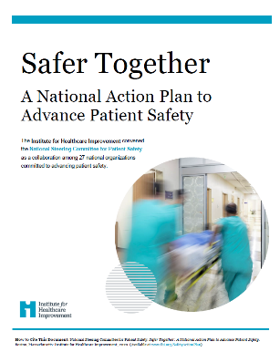
Safer Together National Action Plan
Culture, Leadership, Governance
Learning
System
Workforce Safety, Well-being
Patient & Family Engagement
1. Person-Centered Care
2. Care Across the Entire Continuum
3. The Relationship Between Patient Safety & Health Equity
www.ihi.org/SafetyActionPlan

Slide 20
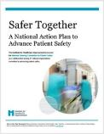

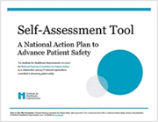
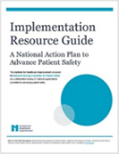
Safer Together in Action
1. REVIEW the 17 recommendations and tactics to advance patient safety in Safer Together: A National Action Plan for Patient Safety.
    2. IDENTIFY a senior sponsor and core team charged
    with deploying the Self-Assessment Tool to ASSESS
    your current state in each of the 4 foundational areas.
3. ESTABLISH and ENACT strategies, tactics, and measurement and improvement plans by leveraging the Implementation Resource Guide.
www.ihi.org/SafetyActionPlan

Slide 21

Safer Together National Action Plan (NAP)
NAP created by the National Steering Committee for Patient Safety included:
  27 national organizations
  5 federal agencies
  Several patient advocacy groups

Slide 22
Proposed CMS Patient Safety Structural Measure (Hospitals)
Systems-based approach to reducing patient harm
Assess how well hospitals have implemented strategies & practices to strengthen systems for safety
Five Measure Domains (attestation-based, multiple statements per domain):
  Leadership Commitment to Eliminating Preventable Harm
  Strategic Planning and Organizational Policy
  Culture of Safety and Learning Health System
  Accountability and Transparency
  Patient and Family Engagement

Slide 23
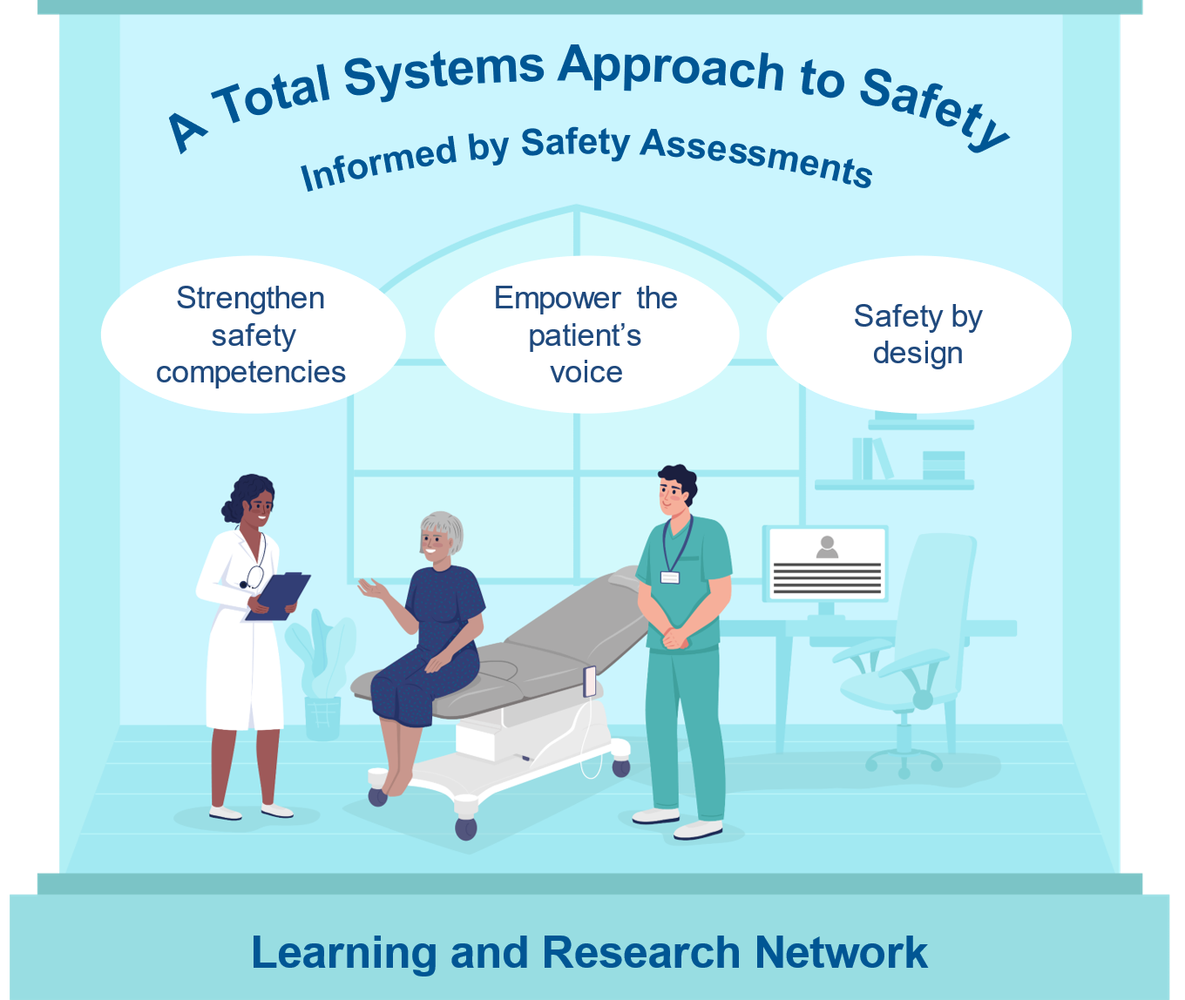
Five Aims of the National Action Alliance for Patient & Workforce Safety
Advance Organizational Safety Strategies Using Safety Self- Assessments​
    Make commitment
    Perform safety self-assessments​
    Enact safety strategy​ based on identified gaps
Empower the Patient’s Voice in Safety Strategy​
    Safety event submissions​
    Inclusion in event review​
    Input on safety initiatives​
    Communication and resolution programs​
Make Healthcare Safer by Design​
    Address five high-priority safety engineering needs​
Strengthen Safety Competencies​
    Develop, adopt, and report​ for all team members​
Launch Learning and Research Network​
    Encourage learning and sharing across network​
    Spotlight change leaders​
    Promote robust measurement​
    Research to address high-priority needs

Slide 24
Using the 2020 National Action Plan for Safety to Inform Safety Self-Assessments
Culture, Leadership, Governance
  Leader annual reviews incorporate safety
  Regular safety culture surveys
Patient and Family Engagement
  Actively engaged PFACs
  Analyzing data using “equity lens”
Workforce Safety
  Explicit worker safety strategy
  Occupational safety experts
Learning Healthcare Systems
  Defined safety competencies for all workers
  Regular participation in learning networks
https://www.ihi.org/initiatives/national-steering-committee-patient-safety/national-action-plan-advance-patient-safety
Notes:
Examples of assessment items in each of the foundational areas

Slide 25
National Action Alliance: Organizing to Achieve Safe Care Everywhere, Zero Preventable Harm for All
Healthcare Community Partners (including Patients &
Families)
Target
50% Reduction in Patient and Workforce Harm
by 2026
National
Steering Committee
Federal
Partners
Healthcare Provider Organizations Across All Settings

Slide 26
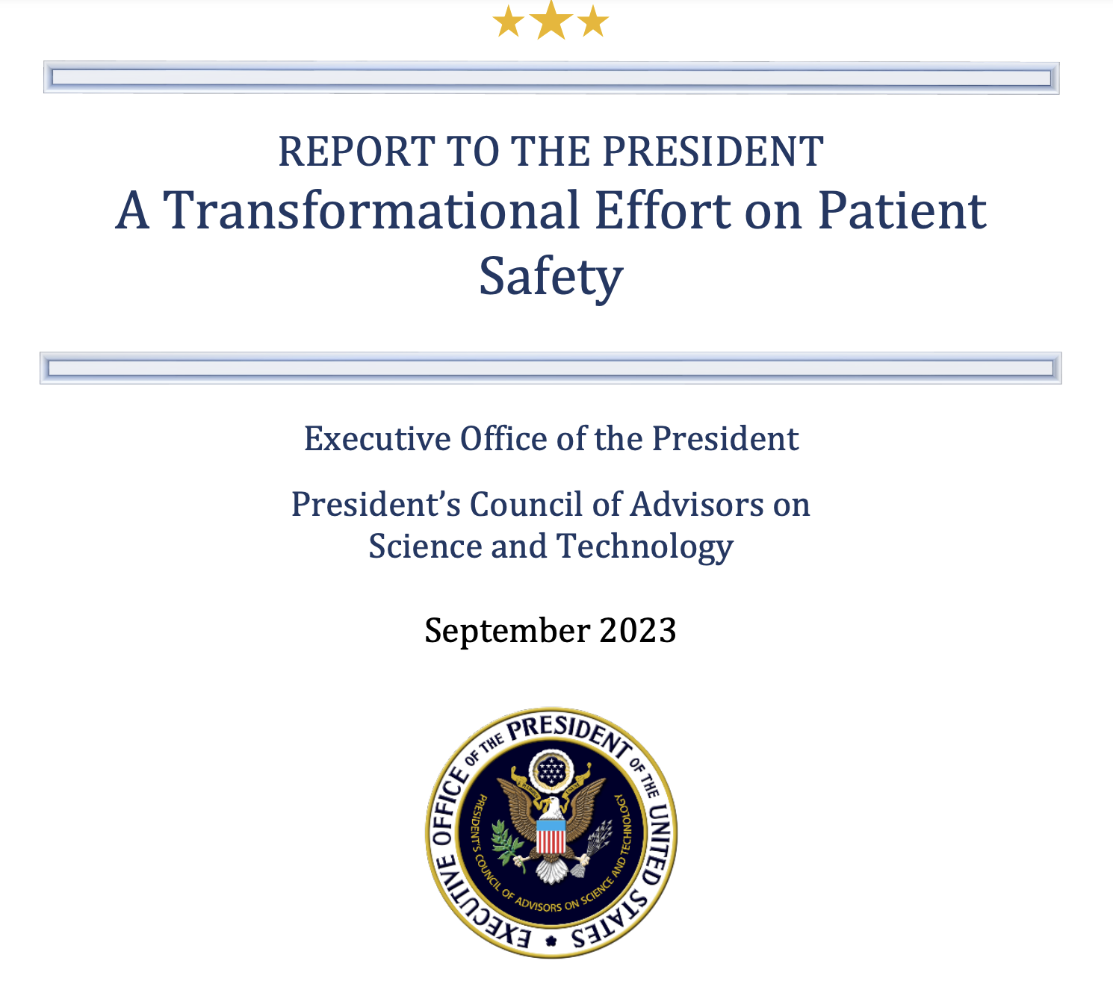
PCAST Report to the President

Slide 27
PCAST Recommendations
Establishing and maintaining federal leadership for the improvement of patient safety as a national priority.
Ensuring that patients across the country benefit from evidence-based practices for preventing harm and addressing risks.
Partnering with patients to reduce disparities in medical errors and adverse outcomes.
Accelerating research and deployment of practices, technologies, and exemplar systems of safe care.

Slide 28
Recommendation 1: Establish and Maintain Federal Leadership for the Improvement of Patient Safety as a National Priority.
The President should bring immediate attention to the urgent need to improve patient safety and healthcare workforce safety as a national priority, by establishing a White House-led Transformational Effort on Patient Safety.
1.A Appoint a Patient Safety Coordinator Reporting to the President on Efforts to Transform Patient Safety Among All Relevant Government Agencies.
1.B Establish a Multidisciplinary National Patient Safety Team (NPST) and Ensure Inclusion of Persons from Populations Most Affected.

Slide 29
Recommendation 2: Ensure That Patients Receive Evidence-Based Practices for Preventing Harm and Addressing Risks.
2.A Identify and Address High-Priority Harms and Promote Patient Safety Though Incentivizing the Adoption of Evidence-Based Solutions and Requiring Annual Public Reporting Immediately and Quarterly Public Reporting Within 5 Years.
2.B Create a Learning Ecosystem and Shared Accountability System to Ensure That Evidence-Based Practices are Implemented and Goals for Reduced Harms and Risks of Harm for Every American are Realized.
2.C Advance Interoperability of Healthcare Data and Assure Access to the Tracking of Harms and Use of Evidence-Based Solutions.
2.D Improve Safety for All Healthcare Workers and Their Patients Through Supporting a Just Culture of Patient and Clinician Safety in Healthcare Systems.

Slide 30
Recommendation 3: Partner with Patients and Reduce Disparities in Medical Errors and Adverse Outcomes.
3.A Implement a “Whole of Society Approach” in the Transformational Effort on Patient Safety.
3.B Improve Data and Transparency to Reduce Disparities.

Slide 31
Recommendation 4: Accelerate Research and Deployment of Practices, Technologies, and Exemplar Systems of Safe Care.
4.A Develop a National Patient Safety Research Agenda.
4.B Harness Revolutionary Advances in Information Technologies.
4.C. Develop Federal Healthcare Delivery Systems’ Capacities and Showcase Results as Exemplars for Safer Healthcare.

Slide 32
Would My NICU Story Be Different Today?
Would the NICU error become known?
Would the family be told?
Would a systems view be taken?
Would someone be responsible for improvement?
Would the next neonate be better protected?
Would my own scars be fewer?

Slide 33
Where Might “Value-Based Payment” Help?
Will?
Ideas?
Execution?

