Slide 1

RISING TO THE CHALLENGE:
Cross collaborative opportunities to improve the health of California
Diana E. Ramos, MD, MPH, MBA
California Surgeon General
11th Annual World Patient Safety, Science & Technology Summit
September 6, 2024

Slide 2
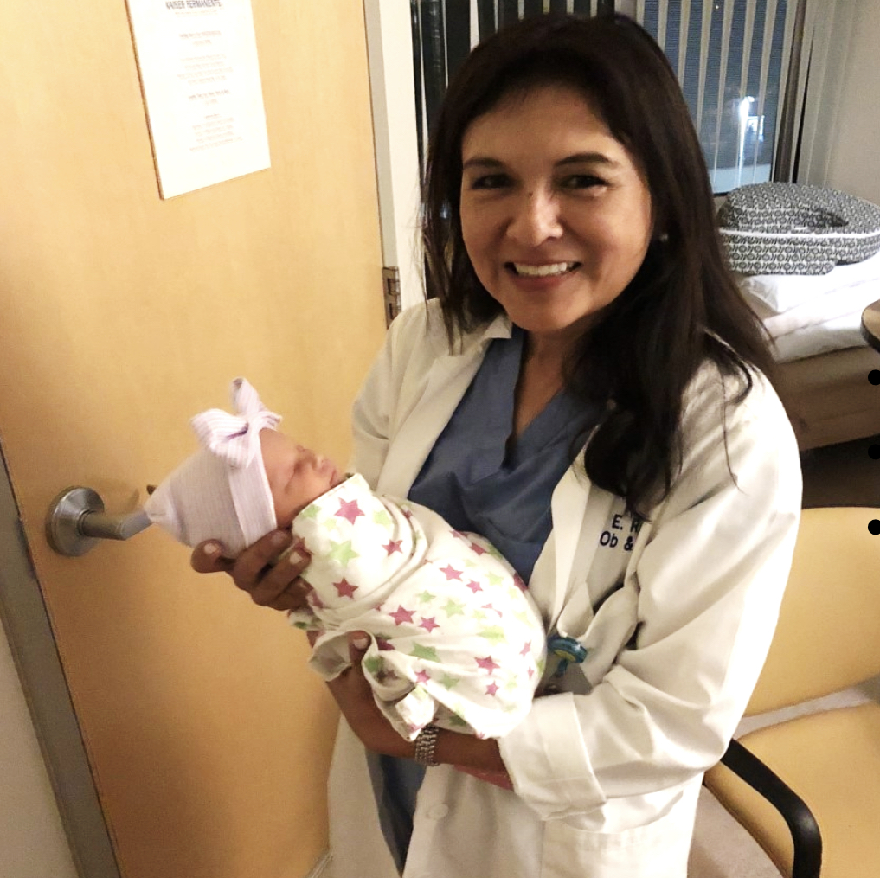


Slide 3
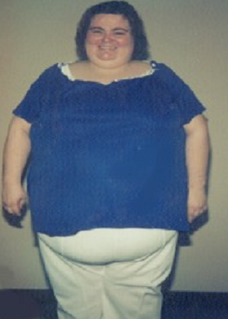
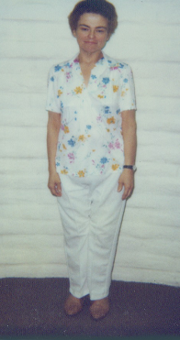

Notes:
Felitti Picture -

Slide 4



Slide 5



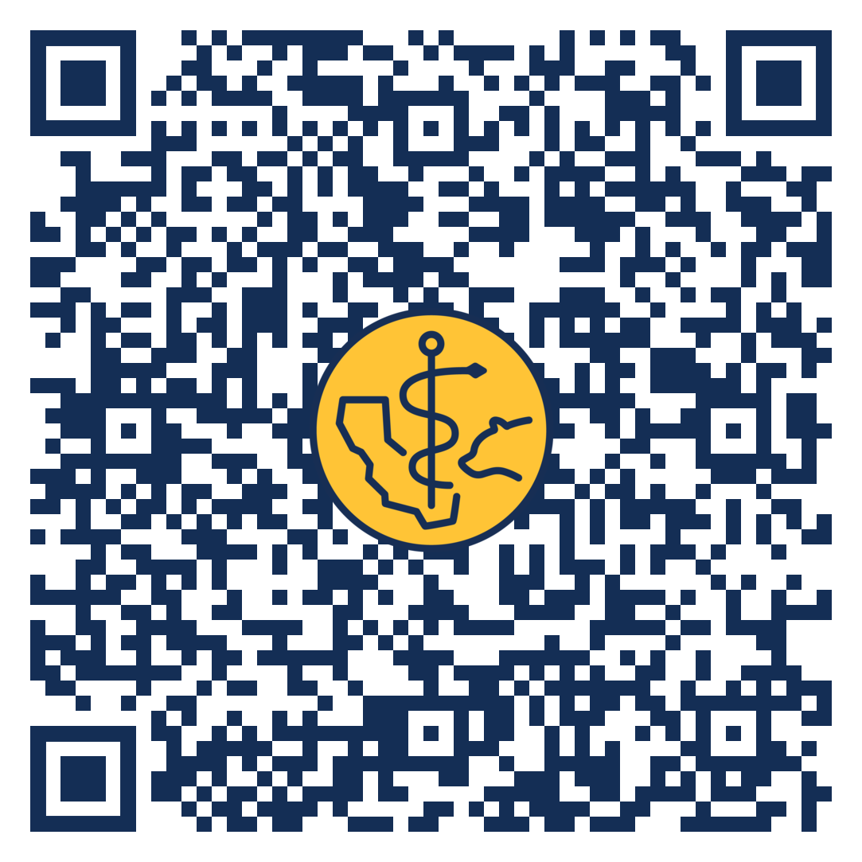
THANK YOU
Diana.Ramos@osg.ca.gov
@CASurgeonGeneral
@CA_OSG
Notes:
Breastfeeding
Comprehensive Perinatal Services Program (CPSP) Nurse-Family Partnership®
Perinatal Assessment And Coordination Team (PACT)
Pregnant and Parenting Teens Prenatal Care Guidance
Sudden Infant Death Syndrome (SIDS)
Thank you!

