Slide 1
The First Harm is Unintentional;
The Second is Intentional*
Changing the way Healthcare responds to Harm with
Communication and Reconciliation Programs
Evan Benjamin, MD, MS, FACP
Ariadne Labs
Associate Professor, Harvard Medical School and Harvard TH Chan School of Public Health
* Thanks to Carole Hemmelgarn

Slide 2


Slide 3


Slide 4


Slide 5
The Problem
Despite best efforts, harm happens during healthcare
"Deny and defend” approach:
  Compounds suffering of patients and family
  Heightens distress of clinicians
  Increases likelihood of litigation
  Lost opportunity for learning within and across institutions
  Degrades institutional culture/climate
  Reduces public trust in healthcare

Slide 6




Why Do We Struggle to Respond to Harm Events?
Human nature to want to keep problems to ourselves, to avoid difficult discussions
Fear of punitive consequences, shame/ embarrassment
Mixed messages from institutions/status quo
Lack of Tools/Skills; Different elements of response not implemented nor integrated and hard-wired

Slide 7
Additional Challenges in Responding to
Harm Events
Uncertainty among clinicians about what they should and should not say to patients about harm events
Complex case with grey areas and multiple stakeholders
Poor Implementation: Lack of tools, resources, standard work, and measures
  What exactly are we supposed to do?
  How well are we currently performing?
  What can we do to improve?

Slide 8
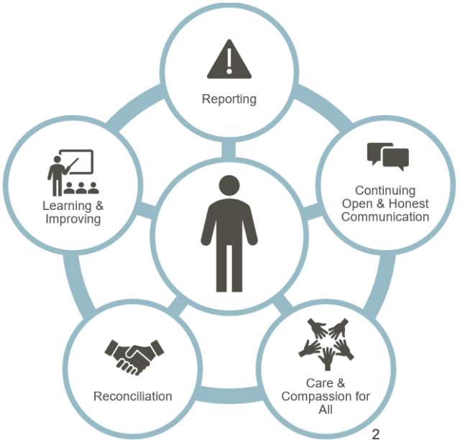
What is a CRP and Why Should You Care?
A Communication and Reconciliation
Program (CRP) is:
Principled
Comprehensive
Systematic
Compassionate

Slide 9
CRPs: Principled, Comprehensive, Systematic Programs for Preventing and Responding to Harm Events
 | Traditional Response | CRP Response
Incident reporting by clinicians | Delayed, often absent | Immediate
Communication with patient, family | Deny/defend | Transparent, ongoing
Event analysis | Physician, nurse are root cause | Focus on Just Culture, system, human factors
Quality improvement | Provider training | Drive value through system solutions, disseminated learning
Financial resolution | Only if family prevails on a malpractice claim | Proactively address patient/family needs
Care for the caregivers | None | Offered immediately
Patient, family involvement | Little to none | Extensive and ongoing
Notes:
CRPs are…..principled, comprehensive, systematic programs for responding and preventing to harm events.
They help move from the traditional “deny and defend” responses to a transparent response with immediate communication.
They help organizations learn from errors and they help move to earlier financial resolution for patients who have been harmed while creating a supportive environment taking the fear and worry out of the already stressful process.

Slide 10
Benefits of CRP: The evidence
01
Preserve trust and meet patient/ family expectations
02
Reduce distress of clinicians
04
Promote learning
within and across institutions
05
Strengthen institutional culture and climate
07
Reduce likelihood of litigation
Lower likelihood of disciplinary action by regulators
Increase public trust in healthcare
03
06

Slide 11
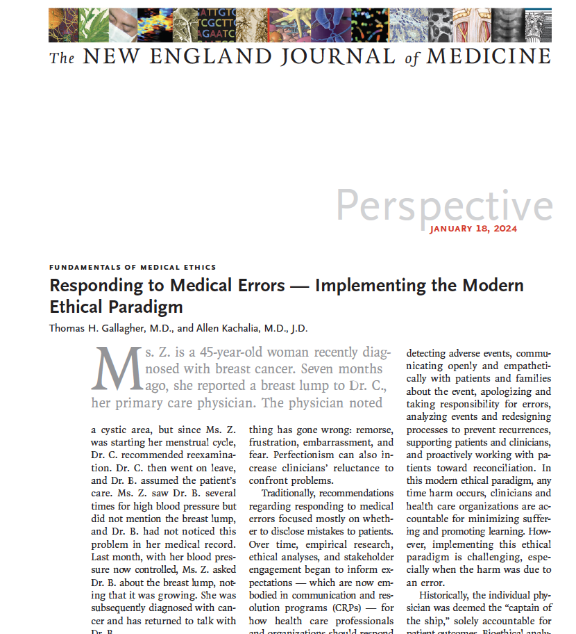
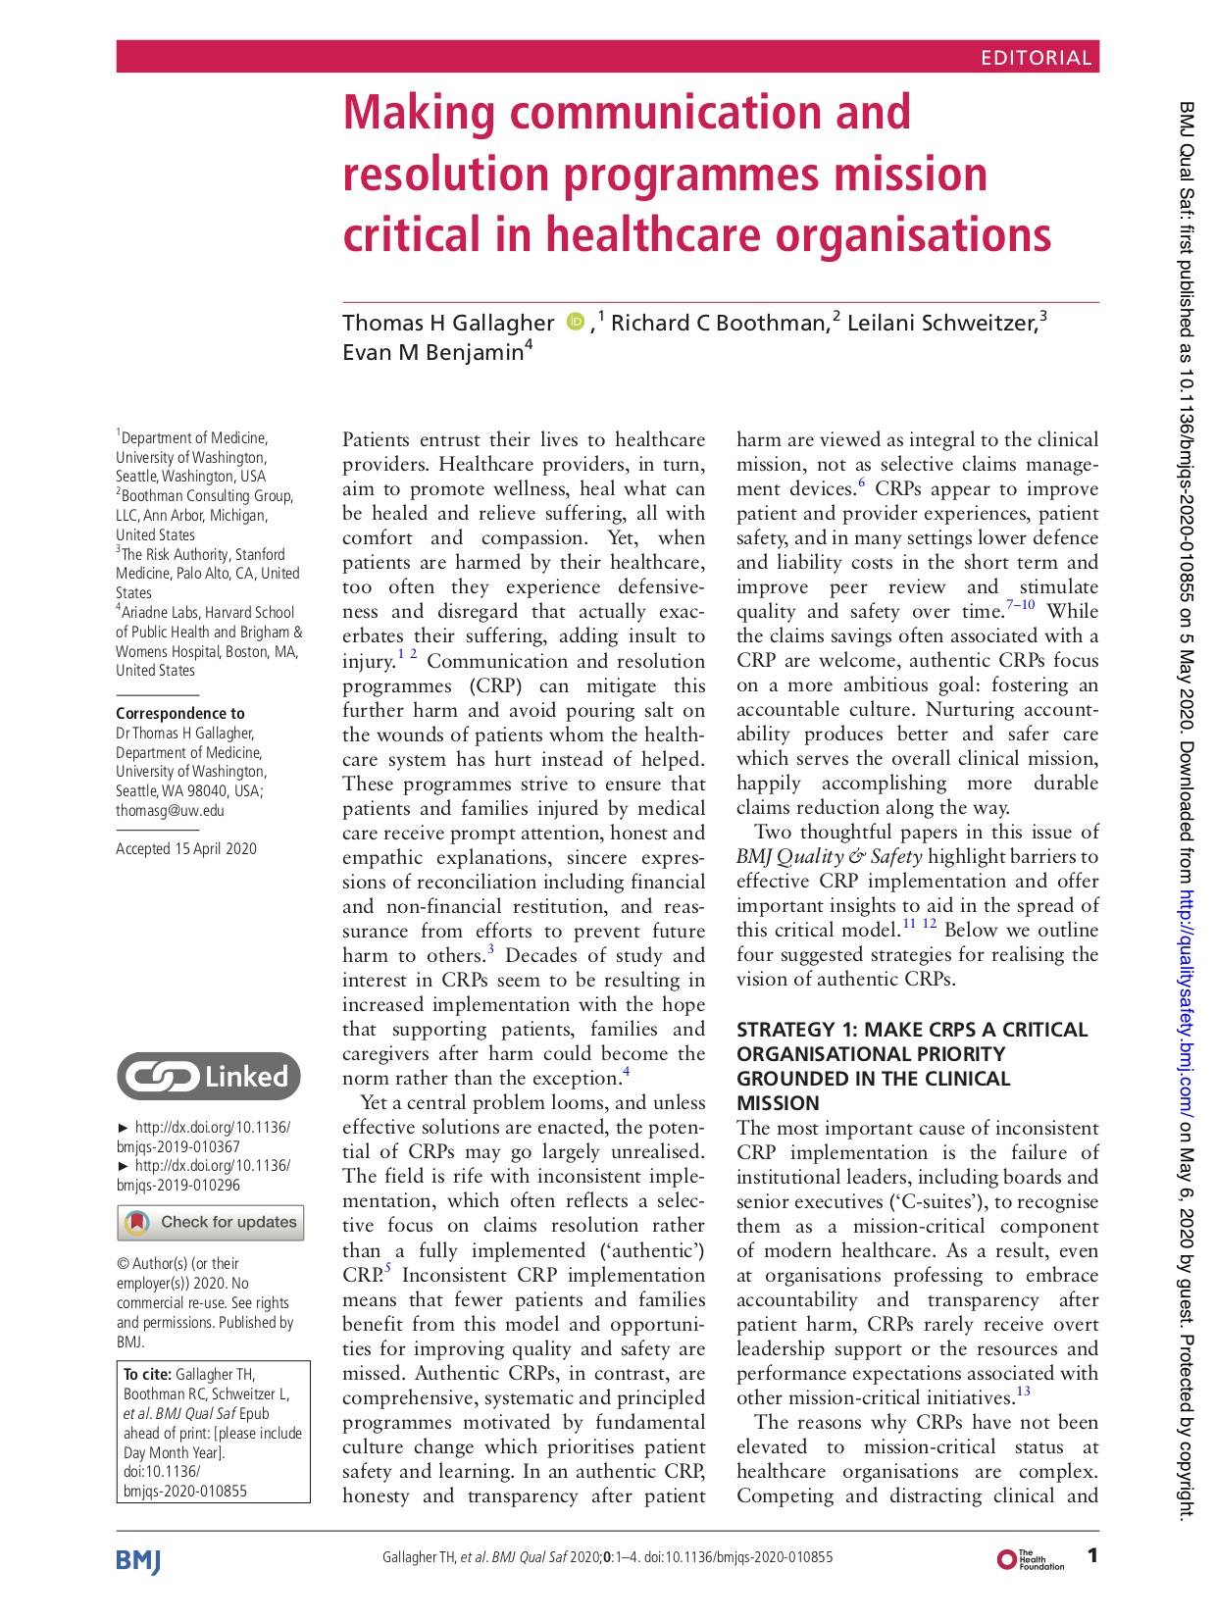
CRP is not a risk management tool–
Implementing the Modern Ethical Paradigm
11

Slide 12
The Challenge of Inconsistent Implementation
Use of CRP for some cases but not others
Use of some but not all CRP elements for individual case
Fuels skeptics’ concern that CRPs are actually a claims management strategy
  Raises doubt about commitment to transparency and safety culture
Ultimately, fewer patients, families, clinicians, and organizations
benefit from CRP process

Slide 13
CMS Patient Safety Structural Measure
Proposed measures passed and published August 28, 2024, take effect Oct 1, 2024
Attestation measure that “assesses whether hospitals demonstrate a structure and culture that prioritizes patient safety.”
5 domains
  Leadership Commitment to Eliminating Preventable Harm
  Strategic Planning & Organizational Policy
  Culture of Safety & Learning Health System
  Accountability & Transparency
  Patient & Family Engagement
Notes:
Our members span the country
We are all committed to a comprehensive, highly reliable response that is driven by accountability, compassion, and transparency
We have extensive experience and expertise
We have the passion to move our agenda forward

Slide 14
CMS Patient Safety Structural Measure
Domain 4: Accountability & Transparency
Statement 4. Our hospital has a defined, evidence-based communication and resolution program reliably implemented after harm events, such as AHRQ’s Communication and Optimal Resolution (CANDOR) toolkit, that contains the following elements:
  Harm event identification
  Open and ongoing communication with patients and families about the harm event
  Event investigation, prevention, and learning
  Care-for-the-caregiver
  Financial and non-financial reconciliation
  Patient-family engagement and on-going support
Statement 5. Our hospital uses standard measures to track the performance of our communication and resolution program and reports these measures to the governing board at least quarterly.
Notes:
Our members span the country
We are all committed to a comprehensive, highly reliable response that is driven by accountability, compassion, and transparency
We have extensive experience and expertise
We have the passion to move our agenda forward

Slide 15
PCAST Report
Identifies urgent need to “Transform Patient Safety”
Recognizes accountability and transparency as fundamental to improving patient safety
Recommends establishing a National Patient Safety Team
Communication and Resolution Programs one of few specific patient safety initiatives called out for implementation
Notes:
Chat in or raise your hand: How does this align with your intentions for our Network?

Slide 16
The PCAST Report
Recommendation 2.B
Create a Learning Ecosystem and Shared Accountability System to Ensure That Evidence-Based Practices are Implemented and Goals for Reduced Harms and Risks of Harm for Every American are Realized.
The pain of the families and communities of those who have experienced harm from unsafe care is magnified when personal and system-wide accountability and transparency are lacking, and when solutions to prevent harms are not implemented. To increase board and executive accountability for safety and quality oversight, CMS should add metrics and perform surveys that relate to healthcare organizations’ executive leadership and board accountability for patient safety, expanding similar tools like AHRQ’s Survey on Patient Safety Culture. To ensure standards for timely communication to patients and families of harm events and immediate root cause analysis of the harm - with dissemination of the findings internally and with appropriate medical bodies, CMS should require within five years that hospitals demonstrate their efforts to communicate with families and appropriate medical bodies after future adverse events as a Condition of Participation. Hospitals should consider, as a model, prior efforts aimed at communication and resolution, including the Communication and Optimal Resolution Program (CANDOR) and Communication Resolution Program (CRP).

Slide 17
Aligned with pt/fam preferences
Want disclosure, to know what happened & why, what will be done re: harm, and how recurrence will be prevented
Impacts of harm on pts/families are physical & non-physical, can be long-term
Support professionals
Retains “Meaning” in work and can promote positive learning & adaptation after errors
CRPs associated with decr. post-event pt/fam suffering and rebuilding trust
Aligned w/prof. perspectives
Generally, agree with at least some post-event communication, but benefit from training & support
Professional, moral, ethical, regulatory responsibility/duty
CRPs evidence-based patient safety practice
Promote culture of safety
Via better event reporting, rigorous event analysis, just culture, support for all, learning systems, patient/family engagement, ethics, accountability, and transparency
Implementation can be sustained
Support of senior leaders, collaborative group implementation & support, use of standardized protocols, and investing in physicians, program management, and organization/insurer relationships
Positive medicolegal experience
Patient/family experiences of “closed” post-event communication are known drivers of litigation
CRPs → sig. decr. in claims & costs in 4 studies (MI, IL, TN, DE), and slight decr./neutral in 3 studies (KY, MA, NY)

Slide 18



The PACT Collaborative
Pathway to Accountability, Compassion, and Transparency
Created through a partnership between the Collaborative for Accountability and Improvement, Ariadne Labs, and the IHI (all non-profits)
Mission: To inspire and guide healthcare organizations in the implementation of highly reliable processes for responding to patient harm through collaborative learning, robust tools and resources, innovation, and the spread of best practices.
PACT tools/resources publicly available
Creating Highly Reliable Communication & Resolution Programs
This program presented by:

Slide 19



PACT helps Healthcare Providers respond to harm
12-month Breakthrough Series Collaborative with 33 healthcare organizations thus far
Six learning sessions, cohort check-ins, meetings with faculty coach, and access to additional support as needed while implementing all aspects of the PACT Change Package
Twelve founding member organizations
Ongoing participation
Community and accountability to ensure the sustainability of a highly reliable program, opportunity to step into leadership roles to move the field forward
PSO based case discussions
Launching soon for those who are new in their journey and want to learn more about a comprehensive, highly reliable response to harm
Join at any time and participate at their own pace
Access to the PACT Change Package, a community forum, monthly webinars, and quarterly office hours with faculty

Slide 20
Selected PACT Tools
PACT Process Map and Driver Diagram
Communication Tip Sheet
PACT Case Compendium
PACT Resolution/Reconciliation Toolbox
Supporting Patients and Families After Harm
The CRP Pathway for Patients and Families
PACT Measurement Guide
20

Slide 21

Pathway to Accountability, Compassion, and Transparency (PACT):
Process Map with Tools
A step-by-step map of the activities involved in responding to a harm event
and tools to support the process
Clinician uses Communication and Resolution Program (CRP) principles to respond with support as needed
IDEAL PROCESS
SUPPORT TOOLS
Low Harm
RESPONSES AFTER HARM EVENT
POTENTIAL HARM EVENT
Early
0-3 days
Middle
1-6 weeks
Later
6 weeks-5+ months
PACT Communication Coaching Guide;
PACT Communication Tip Sheet;
Peer Support Toolkit;
Psychological Safety Tip Sheet
CRP Eligible
Guide: Crafting Policy to support your CRP
Event
Management
Enter event
in management software
Stabilize patient and identify CRP Lead and Patient Liaison
Coordinate event review and ongoing communication (with Patient Liaison) and comply with local, state, and federal reporting requirements
Plan (with Patient Liaison) for implementation of action items, communication
Event
Review
Gather initial information about event
Review event and identify action items/ improvements
Initiate implementation of action items/ improvement
PACT Measurement Guide;
PACT Data Tracker Tool
RCA2
Clinician
Engagement
PACT Communication Coaching Guide;
PACT Communication Tip Sheet;
Peer Support Toolkit
Offer peer support and initial communication coaching to clinician(s)
Interview
clinician(s)
Follow up with peer support and feedback re: improvement opportunities using Just Culture
Close loop with clinician(s) and solicit feedback on CRP experience
ACTIVITIES
Provider Experience Measures
Patient / Family
Engagement
Communicate with patient/ family and offer patient support
Interview
patient/family
Provide ongoing support for patient/family and communicate re: review and action items
Close loop with patient/family and solicit feedback on CRP experience
PACT Patient/Family Pathway;
PACT Patient/Family Brochure;
PACT Patient Support Program Guide
PACT Patient Engagement in Event Analysis Tool
Patient/Family Experience Measures
Resolution/
Reconciliation
Ensure bills are held
Initiate claim
event review for standard of care/preventability assessment
Ensure account adjustment is processed and communicated
Proactively offer compensation and/or non-financial resolution if appropriate
Sharing Event Review Findings with Patients and Families: Non-preventable Events
Sharing Event Review Findings with Patients and Families: Preventable Events
PACT Resolution/ Reconciliation Toolbox
Notes:
Access support tools by clicking the links

Slide 22
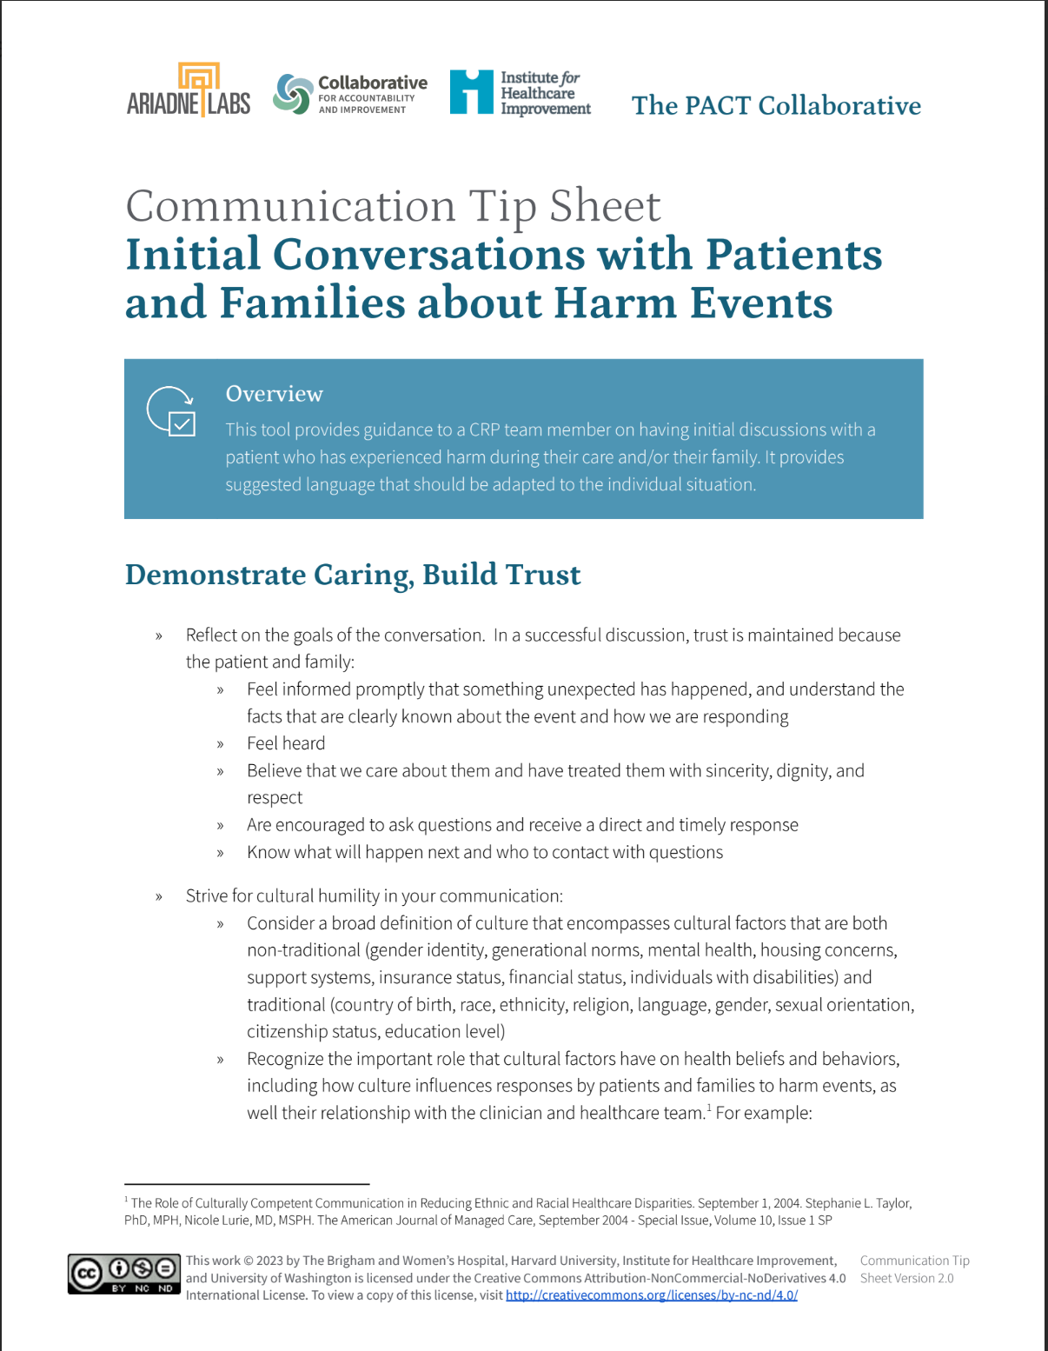
Communication Tip Sheet
22

Slide 23
The First Harm is Unintentional;
The Second is Intentional*
Changing the way Healthcare responds to Harm with
Communication and Reconciliation Programs
Join us!
Evan Benjamin, MD, MS, FACP
Ariadne Labs, Harvard University
Ebenjamin@AriadneLabs.org
* Thanks to Carole Hemmelgarn

