Slide 1

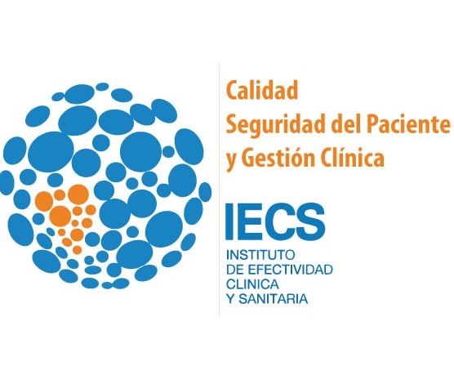
Patient Safety in Less Resourced Settings: Why care?
Ezequiel Garcia-Elorrio
September 7th 2024

Slide 2

Who am I
      Based in Buenos Aires. At the institute of Clinical Effectiveness and Health Policy (IECS)
      Clinician and researcher.
      Director of the Quality and Patient Safety Department at IECS
      Interested in Health Systems improvement with focus of evidence implementation, patient Safety, equity for all, waste reduction and value in health.
      Co-Pi in regional networks to improve population health –QuEST- and knowledge on methods to transform the delivery of health care –The Global Health Network-
      Currently part of the board and President of the International Society for Quality in Health Care – ISQua-
2

Slide 3
Why I am here?
To make the case about patient safety in less resourced settings
(what may also include areas of HIC and regions of the world in conflict)
Patient Safety in Less Resourced Settings: Why Care?

Slide 4
The problem

Slide 5
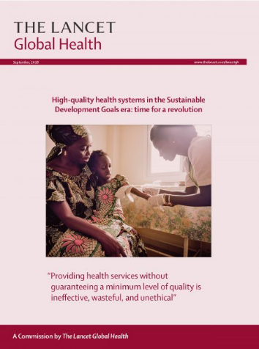

Global Health Commission of the Lancet on High Quality Health Systems (2018)
Of the 8.6 million deaths from diseases treated in low and medium income countries, 5 million (60%) are produced through low quality care and health services.
Patient Safety in Less Resourced Settings: Why Care?

Slide 6
5.7 to 8.4 million deaths
15% of deaths in LMIC
US$ 1.4 to 1.6 trillion lost
OECD indicators are valid for improvement
No more indicators are needed
Patient Safety in Less Resourced Settings: Why Care?
The Global State of Patient Safety
6

Slide 7
  More information from WHO on patient safety in Less Resourced Settings
Around 1 in every 10 patients is harmed in health care and more than 3 million deaths occur annually due to unsafe care. In low-to-middle income countries, as many as 4 in 100 people die from unsafe care.
Above 50% of harm (1 in every 20 patients) is preventable; half of this harm is attributed to medications.
Some estimates suggest that as many as 4 in 10 patients are harmed in primary and ambulatory settings, while up to 80% (23.6–85%) of this harm can be avoided (4).
Common adverse events that may result in avoidable patient harm are medication errors, unsafe surgical procedures, health care-associated infections, diagnostic errors, patient falls, pressure ulcers, patient misidentification, unsafe blood transfusion and venous thromboembolism.
Patient harm potentially reduces global economic growth by 0.7% a year. On a global scale, the indirect cost of harm amounts to trillions of US dollars each year.
Investment in reducing patient harm can lead to significant financial savings, and more importantly better patient outcomes.
An example of a good return on investment is patient engagement, which, if done well, can reduce the burden of harm by up to 15%
Patient Safety in Less Resourced Settings: Why Care?

Slide 8
The reasons

Slide 9

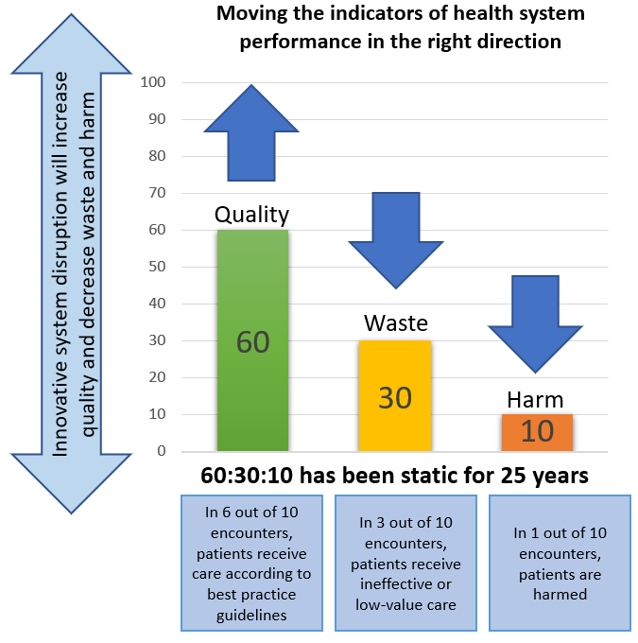
  Just three numbers – 60:30:10
[Braithwaite, J., Glasziou, P. & Westbrook, J. The three numbers you need to know about healthcare: the 60-30-10 Challenge. BMC Med 18, 102 (2020). https://doi.org/10.1186/s12916-020-01563-4]
Patient Safety in Less Resourced Settings: Why Care?

Slide 10
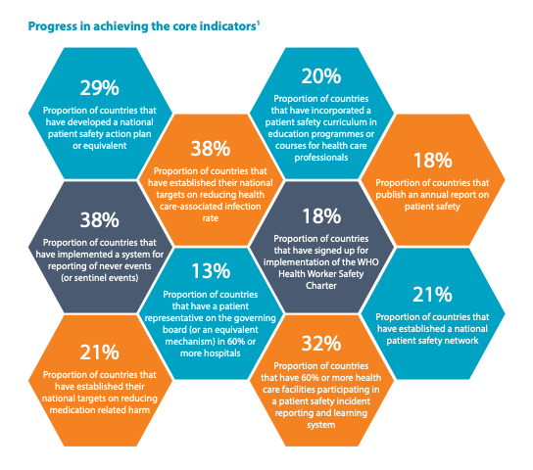
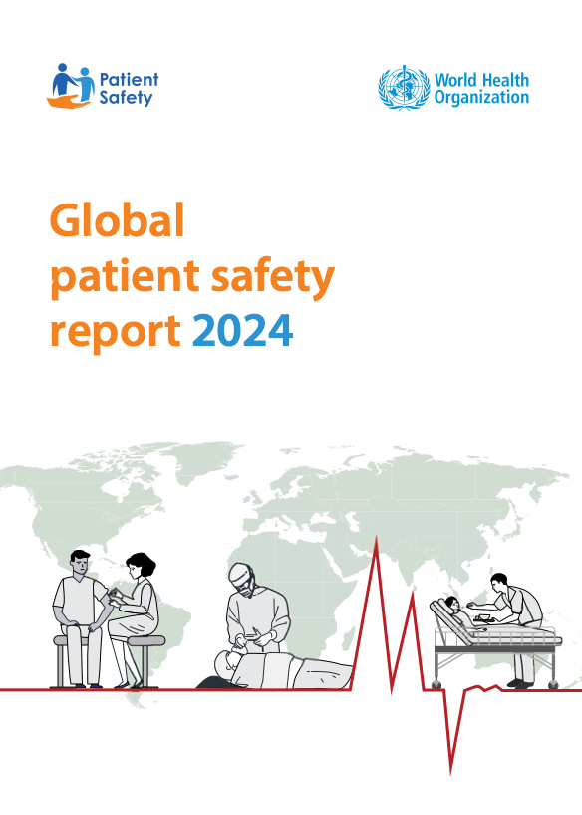
Patient Safety in Less Resourced Settings: Why Care?

Slide 11
The solutions (some of them)

Slide 12
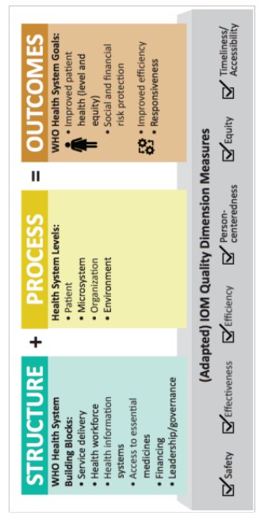
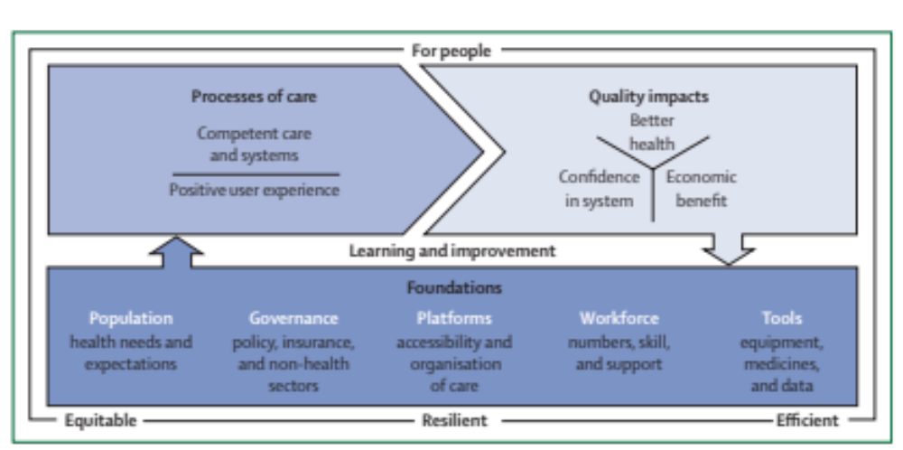
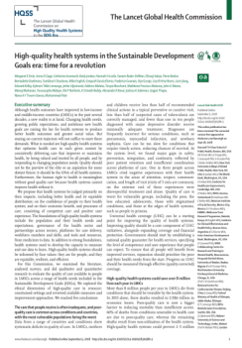
A new paradigm
Patient Safety in Less Resourced Settings: Why Care?

Slide 13
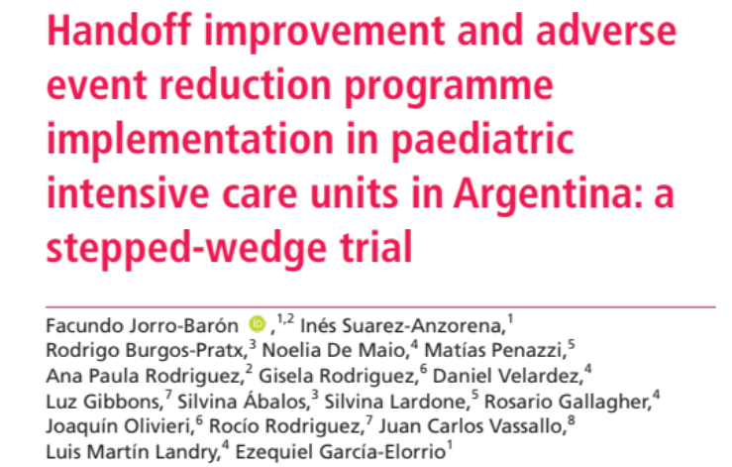
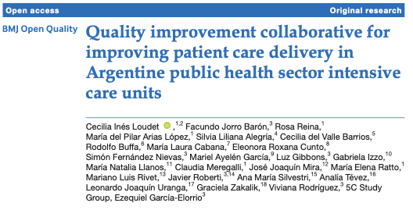
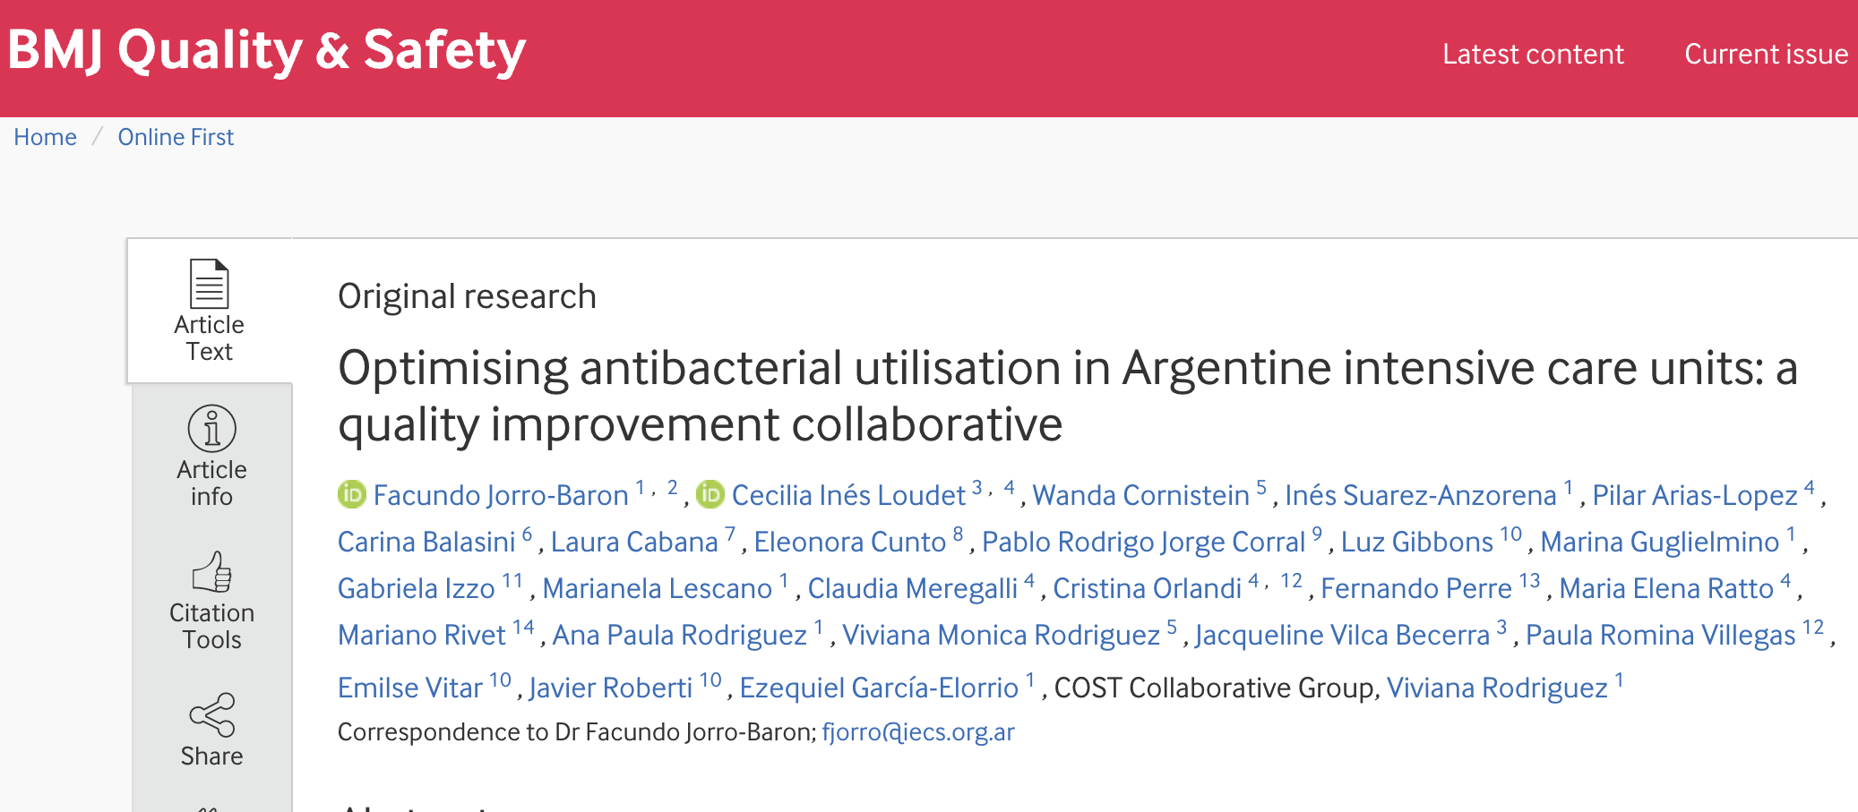
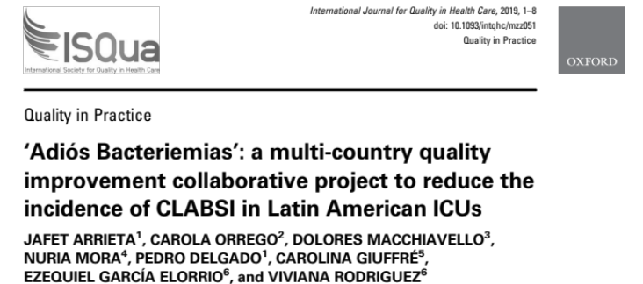
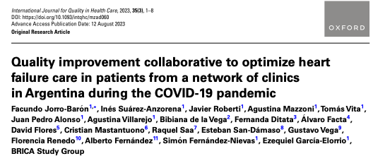
Examples from our setting: Implementation Science

Slide 14
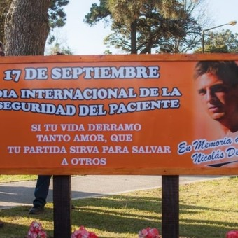


From advocacy to legislation

Slide 15
ISQua Patient Safety Task Force
Since March 2023 ISQua has established a Patient Safety Task force to ”boost” its efforts in patient safety.
During the first phase of collaboration, we have partnered with the Patient Safety Flagship from WHO as well with academics like Jeffrey Braithwaite, Charles Vincent and Wendy Nicklin, joined by ISQua board members and representatives.
It’s main goal is to support members in scaling up the implementation of the WHO Global Patient Safety Action Plan 2021-2030 (GPSAP) in their respective countries.
After approval of the TOR by ISQua´s board are already deploying activities related to advocacy, members participation in shaping a workplan and have a stronger voice in health systems.
This group is also open to joint efforts with other stakeholders to increase the interest and willingness to accelerate the provision of safe care (i.e United for Safety)
Patient Safety in Less Resourced Settings: Why Care?

Slide 16

The way forward
Measurement
Governance
Implementation Science
Advocacy
  Ignite demand
Persistence

Slide 17
egarciaelorrio@iecs.org.ar
Together, we can create a safer healthcare system with zero preventable harm.
Thank You

