Slide 2
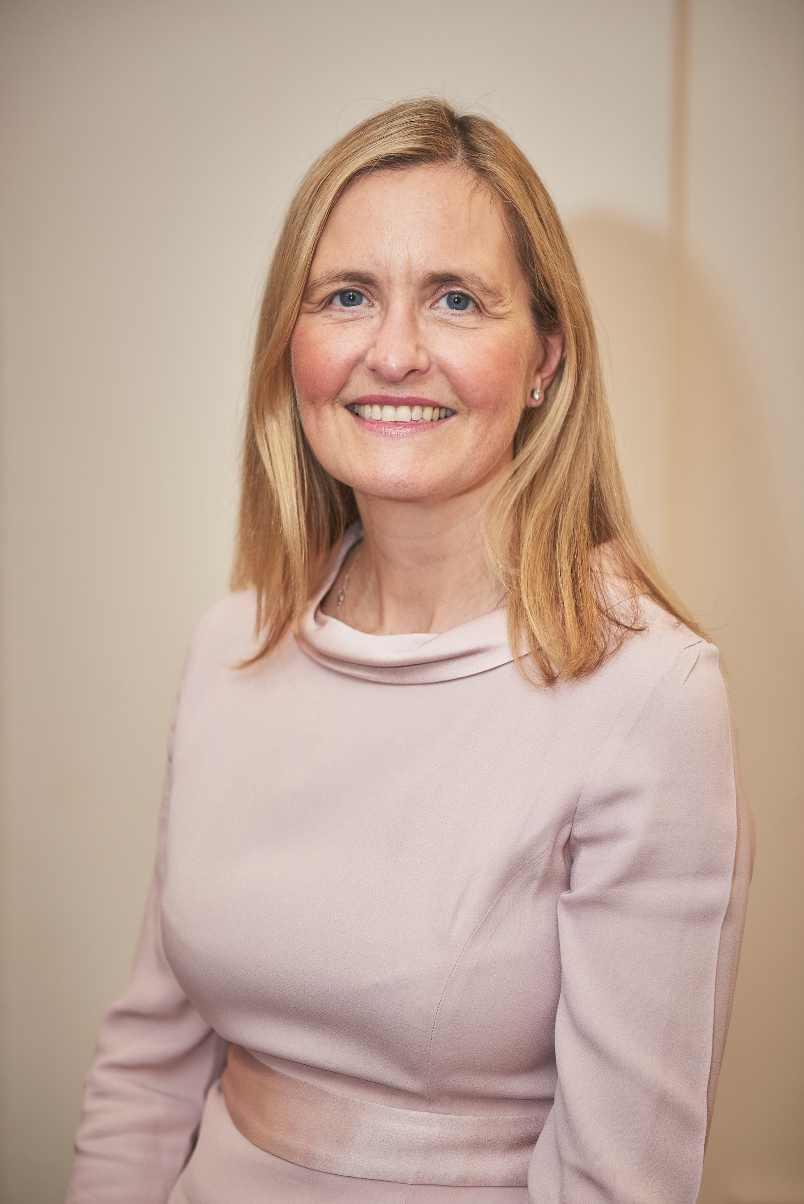
Dr Henrietta Hughes
Patient Safety Commissioner for England
Listening to Patients

Slide 3
Patient Safety Commissioner
Promote patient safety
Promote the value of listening to patients
In relation to Medicines and Medical Devices

Slide 4
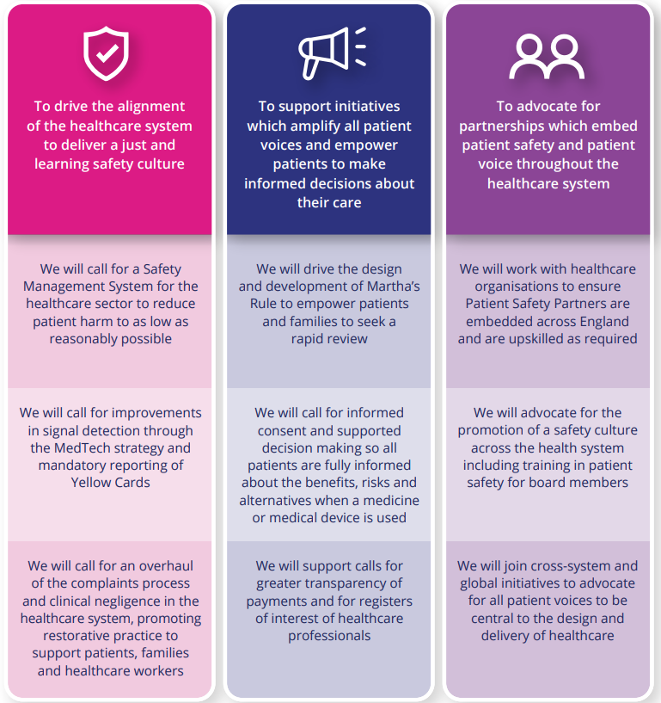
PSC Strategy
Alignment of healthcare culture
Patient voice in their own care
Patient voice in the design and delivery of healthcare
Principles of Better Patient Safety

Slide 5
PSC Strategy

Slide 6

Martha's Rule

Slide 7










A whole system approach

Slide 8
Martha’s Rule – the plan
  Structured approach to listening
  24/7 escalation route to CCOT* for staff
  Patients have access to same escalation route
*Critical care outreach teams

Slide 9



Martha’s Rule
  Safer for patients
  Safer for staff
  Safer for all

Slide 10

Principles of Better Patient Safety
  A guide to design and deliver safer care for patients
  Applicable to all involved in healthcare
  A framework for working with patients as partners

Slide 11



What’s needed
  Leadership
  Listening
  Partnership

Slide 12

Thank you
​
Website: www.patientsafetycommissioner.org.uk
Twitter / X: @PSCommissioner
Email: Commissioner@PatientSafetyCommissioner.org.uk

Slide 13
Together, we can create a safer healthcare system with zero preventable harm.
Thank You

