Slide 1
Misinformation and the Impact on Patient Safety
John Whyte, MD, MPH
Chief Medical Officer, WebMD
September 7, 2024

Slide 2
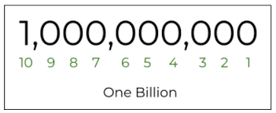
A billion health-related queries a day!

Slide 3



SEARCH HAS CHANGED

Slide 4
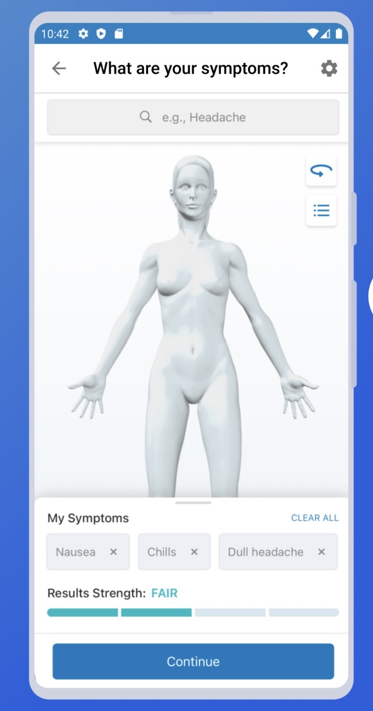

Slide 5



New Ways of “Search”

Slide 6
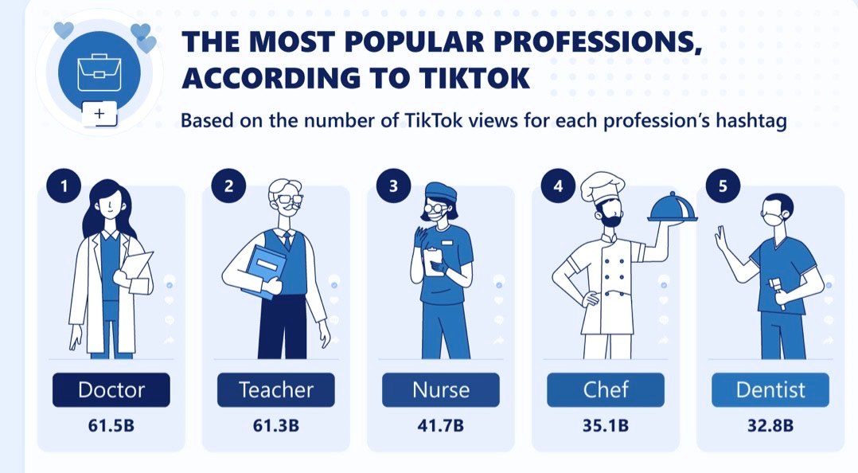

Slide 7



Slide 8
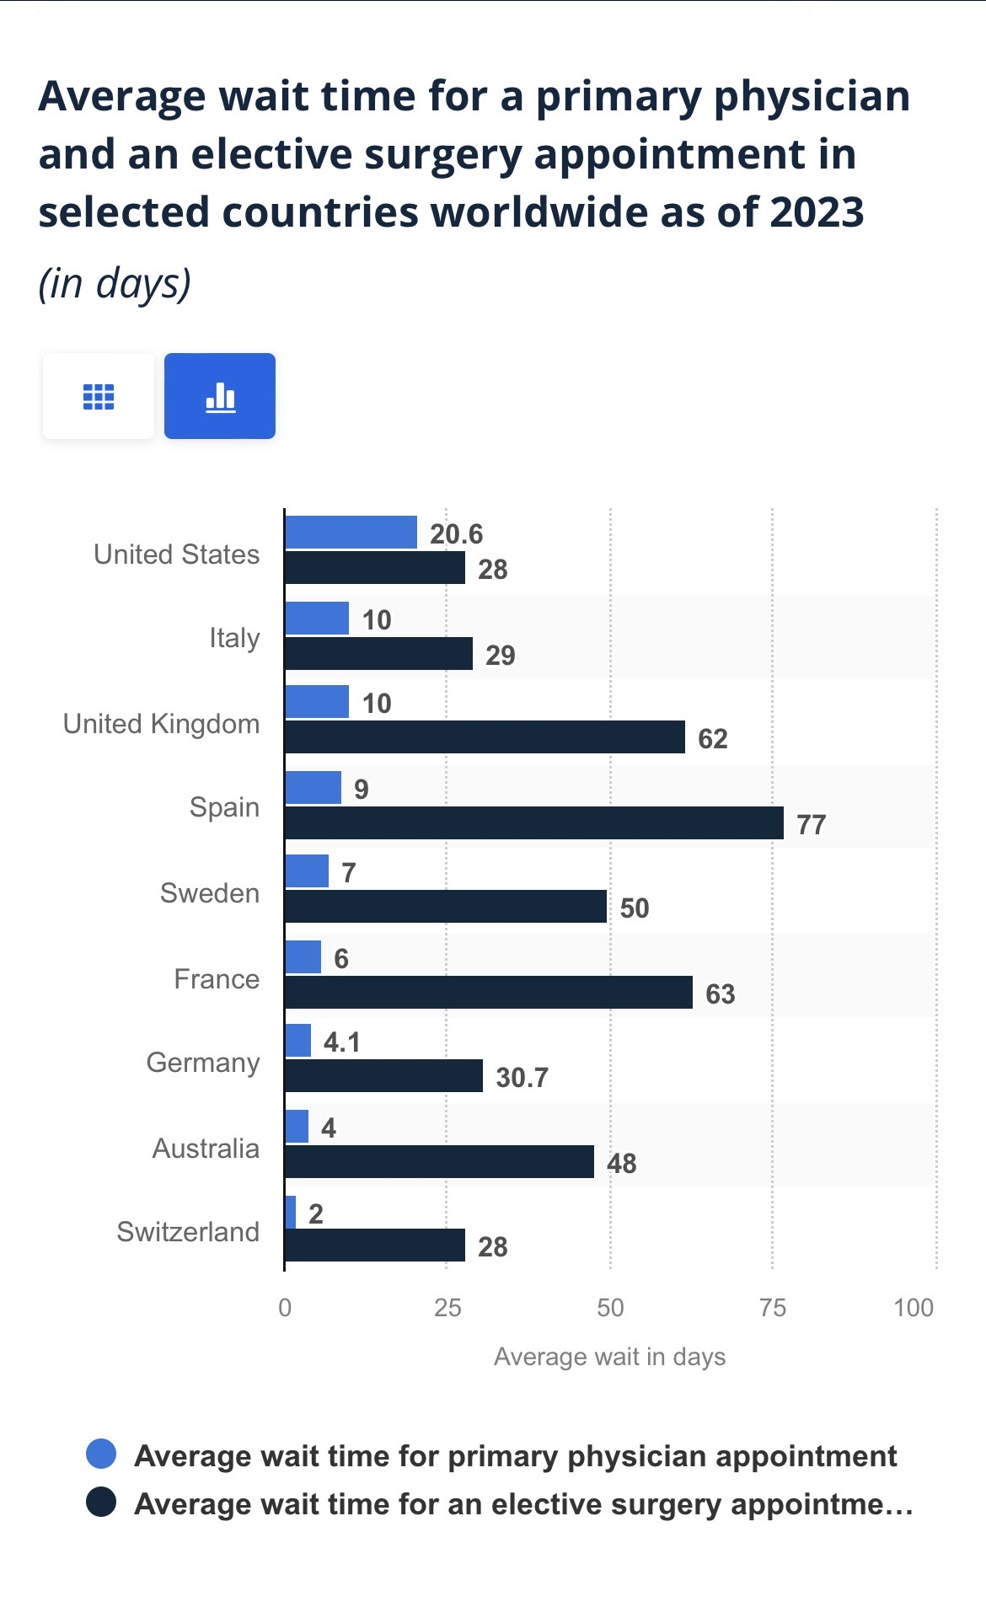
50 !

Slide 9


Slide 10



The CHANGING HEALTH Consumer Experience
Connectivity
Convenience
Control
Cost

Slide 11


Bringing care to the patient

Slide 12
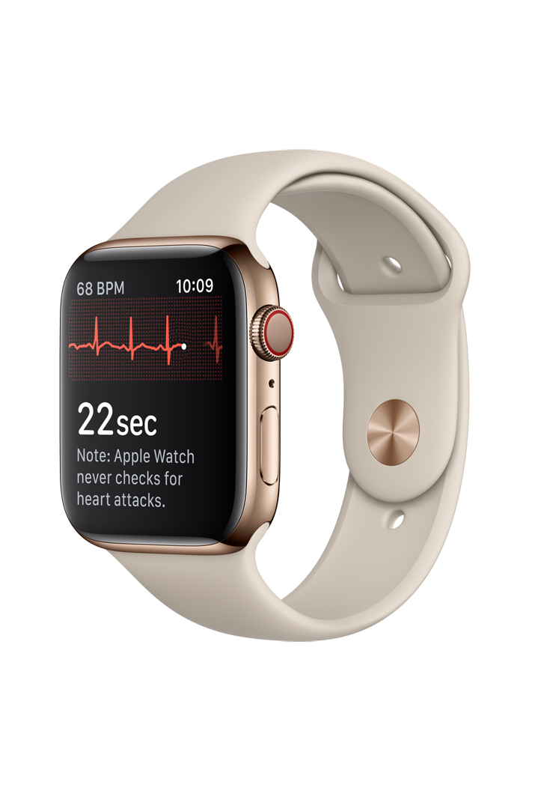
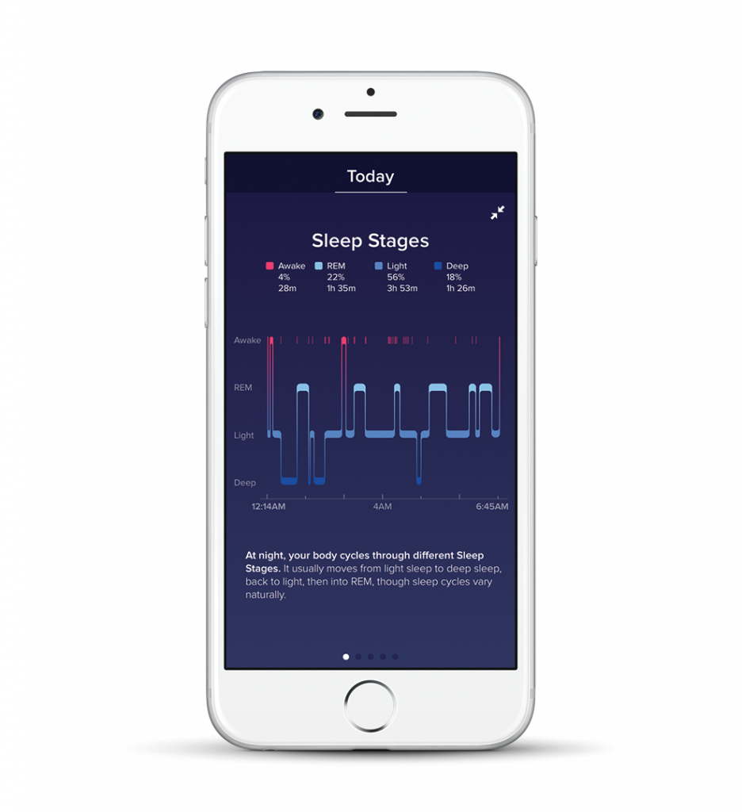
THE WEARABLE TECH MARKET IS PROJECTED TO GROW TO $64 BILLION BY 2024 – THAT’S UP 137% FROM 2019

Slide 13
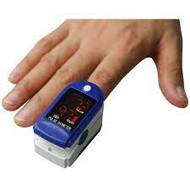
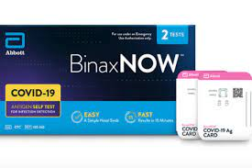
Self-Care

Slide 14




$11B
The global self testing market is forecasted to reach a valuation of $11B by 2030
Source: PRNewswire 2020
Notes:
The DIY Healthcare experience is estimated to grow to $11B by 2030.

Slide 15


Slide 16
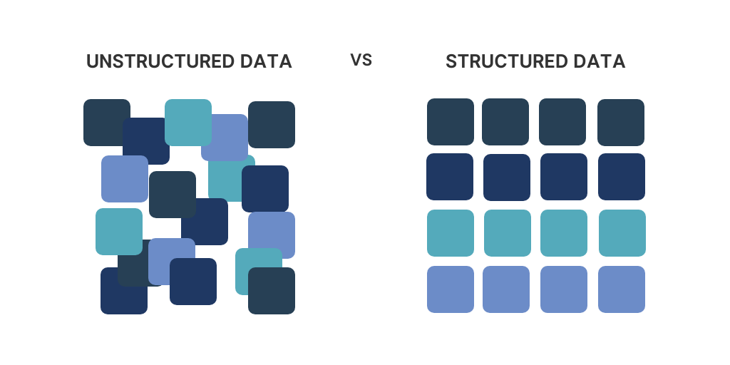
Data – Quality and Quantity

Slide 17
Consider this!
Supercomputers can do as many calculations in a single second as an individual can in 32 BILLION years.

Slide 18


Slide 19

40% diagnostic errors
Stroke
Sepsis
Pneumonia
Venous thromboembolism
Lung cancer

Slide 20
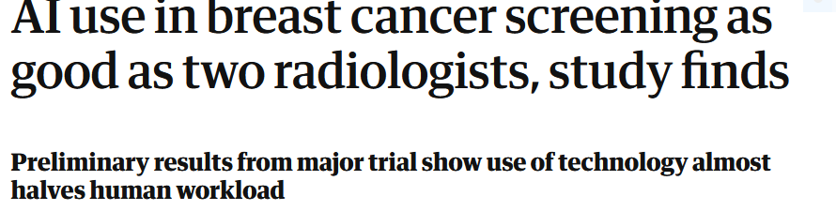
Headline

Slide 21
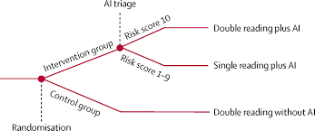
Lancet Oncology
80,000 women
Randomly assigned AI-supported radiologist vs 2 radiologist
244 cancers detected AI-supported vs 203 solely radiologists
Reduced personnel costs 50%

Slide 22
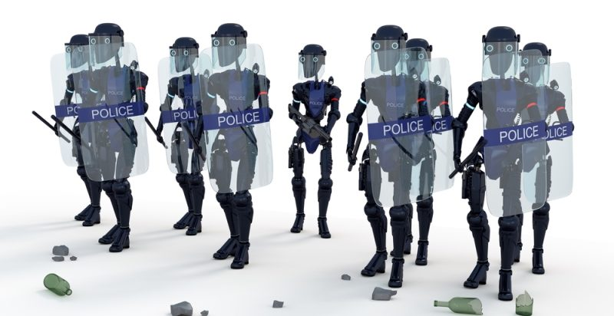

Slide 23


Slide 24



For more information…
jwhyte@webmd.net
@DrJohnWhyte

