Slide 1

Michael J. Stamos, MD | Dean
11th Annual World Patient Safety, Science & Technology Summit
How Culture Drives Safety
September 7, 2024

Slide 2
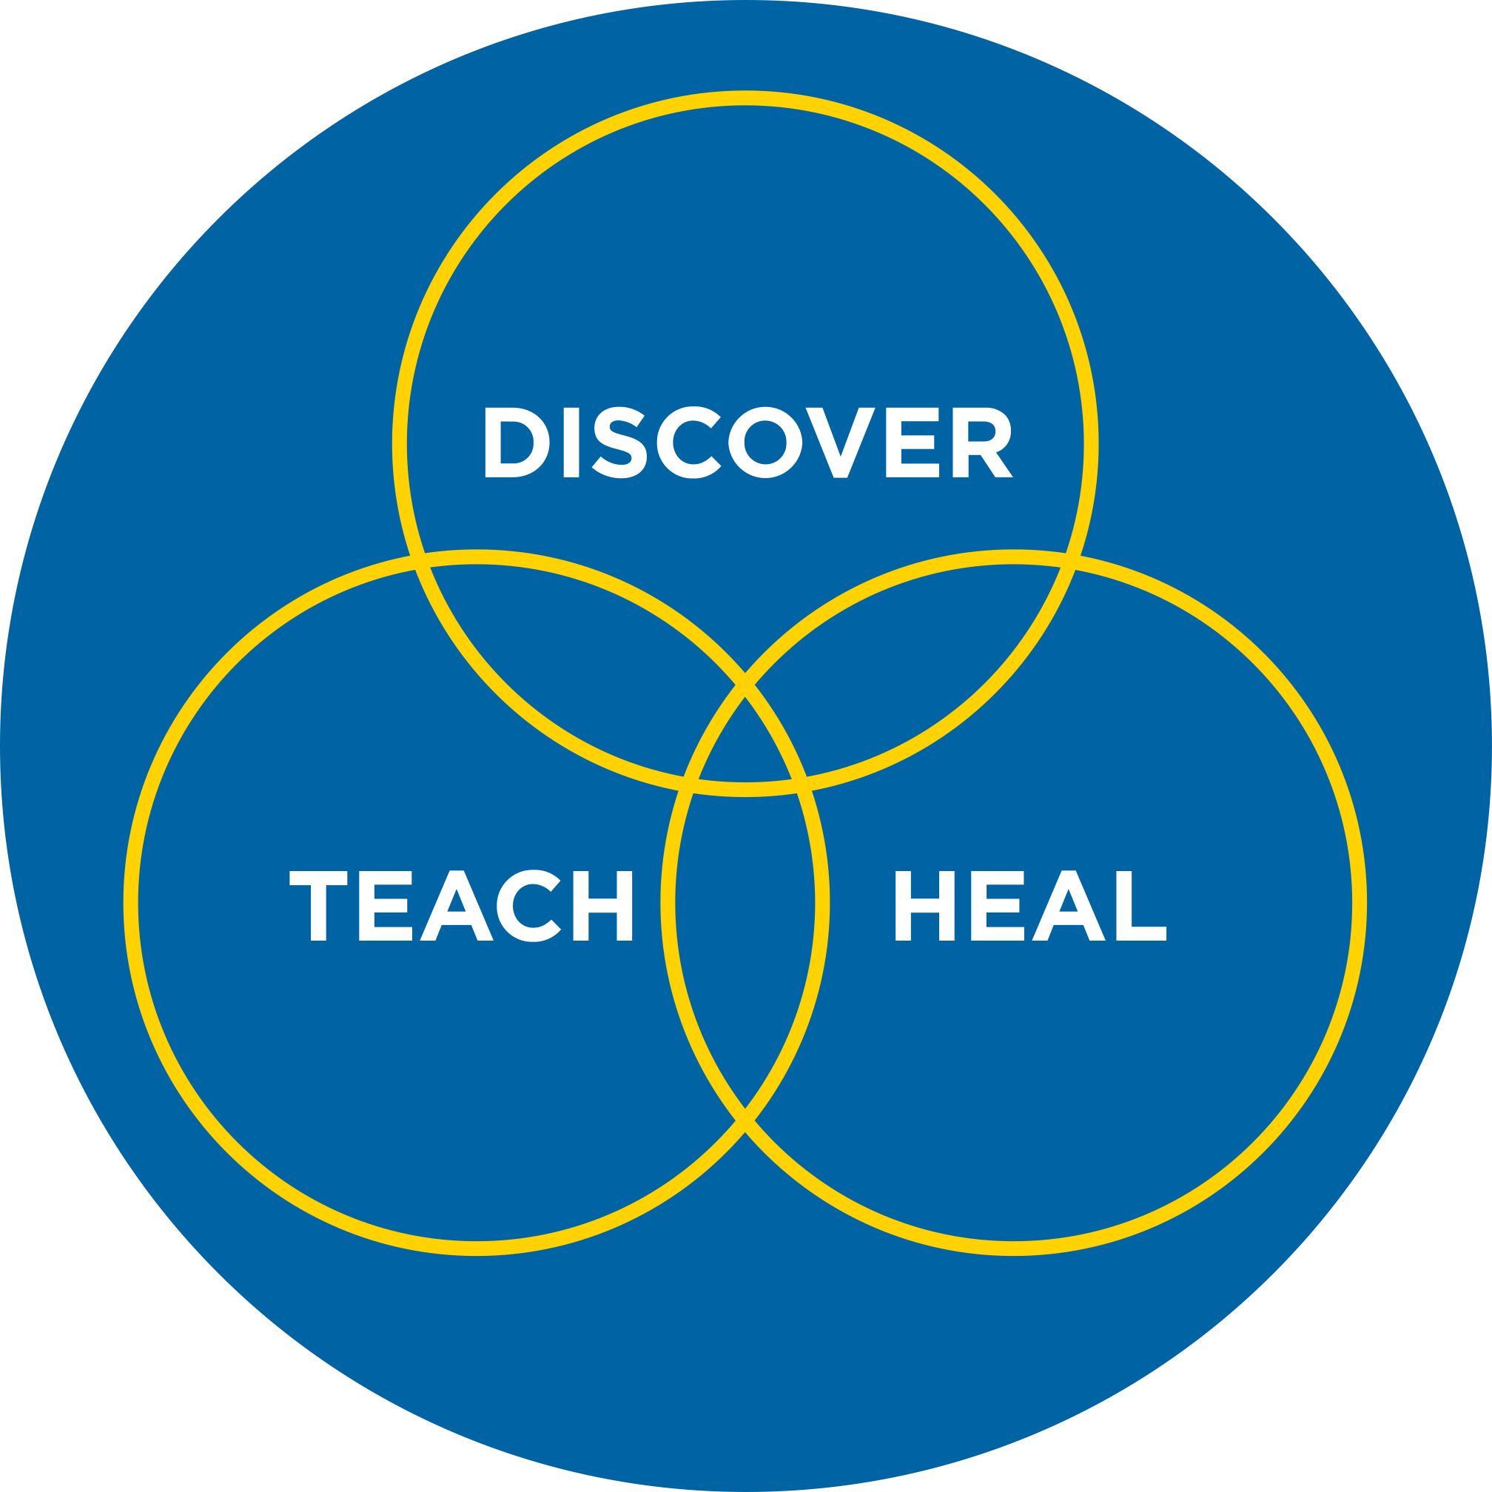

Clinical Integration
Clinical Integration brings UCI School of Medicine faculty and Health System together under one structure (The Enterprise)
Dyad Leadership Model with a board-like structure with equal representation from faculty leadership and our health system reporting up to the dean and UCI Health CEO
Outcomes: Alignment and improved culture among physicians and staff, organizational support, and overall success both financially and with better patient care
Notes:
More than $340 million of all UCI research funding in fiscal 2020-21 was for biomedical and health sciences clinical work across campus.
One thriving site of this is UCI’s Chao Family Comprehensive Cancer Center – Orange County’s only National Cancer Institute-designated comprehensive cancer center. Its researchers brought in $55 million for basic, translational and clinical studies in fiscal 2020-21, 24 percent more than last year.
Also continuing to increase was total financial backing for clinical trials in all health science areas to advance new treatments for life-altering diseases. In 2020-21, UCI received $94 million in grant and corporate funding from all sources for clinical trials, a 34 percent jump over the previous year. Within this amount, industry support topped $81 million for the first time.

Slide 3
Enterprise Structure
CELC Subcommittees
Workforce Planning
QSEC
Ambulatory Operations
Medical Center Operations
Strategic Opportunities
SOM
Dean
UCI Health
CEO
Clinical
Enterprise Leadership Committee
(CELC)
Notes:
More than $340 million of all UCI research funding in fiscal 2020-21 was for biomedical and health sciences clinical work across campus.
One thriving site of this is UCI’s Chao Family Comprehensive Cancer Center – Orange County’s only National Cancer Institute-designated comprehensive cancer center. Its researchers brought in $55 million for basic, translational and clinical studies in fiscal 2020-21, 24 percent more than last year.
Also continuing to increase was total financial backing for clinical trials in all health science areas to advance new treatments for life-altering diseases. In 2020-21, UCI received $94 million in grant and corporate funding from all sources for clinical trials, a 34 percent jump over the previous year. Within this amount, industry support topped $81 million for the first time.

Slide 4
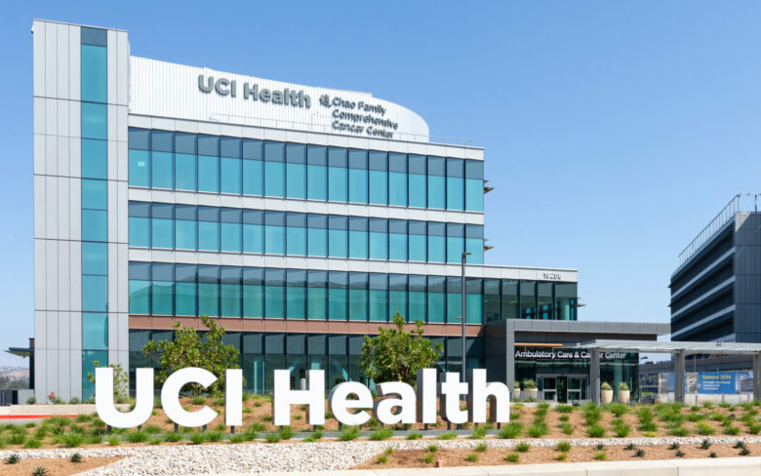
Impetus for Structure
Alignment: Set a goal years ago to build a cancer center on our campus that just opened (and much more!)
Outcomes: Improved quality and safety of care; financial success
Notes:
More than $340 million of all UCI research funding in fiscal 2020-21 was for biomedical and health sciences clinical work across campus.
One thriving site of this is UCI’s Chao Family Comprehensive Cancer Center – Orange County’s only National Cancer Institute-designated comprehensive cancer center. Its researchers brought in $55 million for basic, translational and clinical studies in fiscal 2020-21, 24 percent more than last year.
Also continuing to increase was total financial backing for clinical trials in all health science areas to advance new treatments for life-altering diseases. In 2020-21, UCI received $94 million in grant and corporate funding from all sources for clinical trials, a 34 percent jump over the previous year. Within this amount, industry support topped $81 million for the first time.

Slide 5


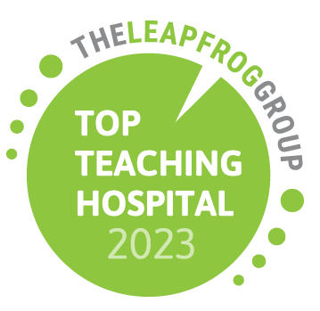


Recognitions
Notes:
More than $340 million of all UCI research funding in fiscal 2020-21 was for biomedical and health sciences clinical work across campus.
One thriving site of this is UCI’s Chao Family Comprehensive Cancer Center – Orange County’s only National Cancer Institute-designated comprehensive cancer center. Its researchers brought in $55 million for basic, translational and clinical studies in fiscal 2020-21, 24 percent more than last year.
Also continuing to increase was total financial backing for clinical trials in all health science areas to advance new treatments for life-altering diseases. In 2020-21, UCI received $94 million in grant and corporate funding from all sources for clinical trials, a 34 percent jump over the previous year. Within this amount, industry support topped $81 million for the first time.

Slide 6
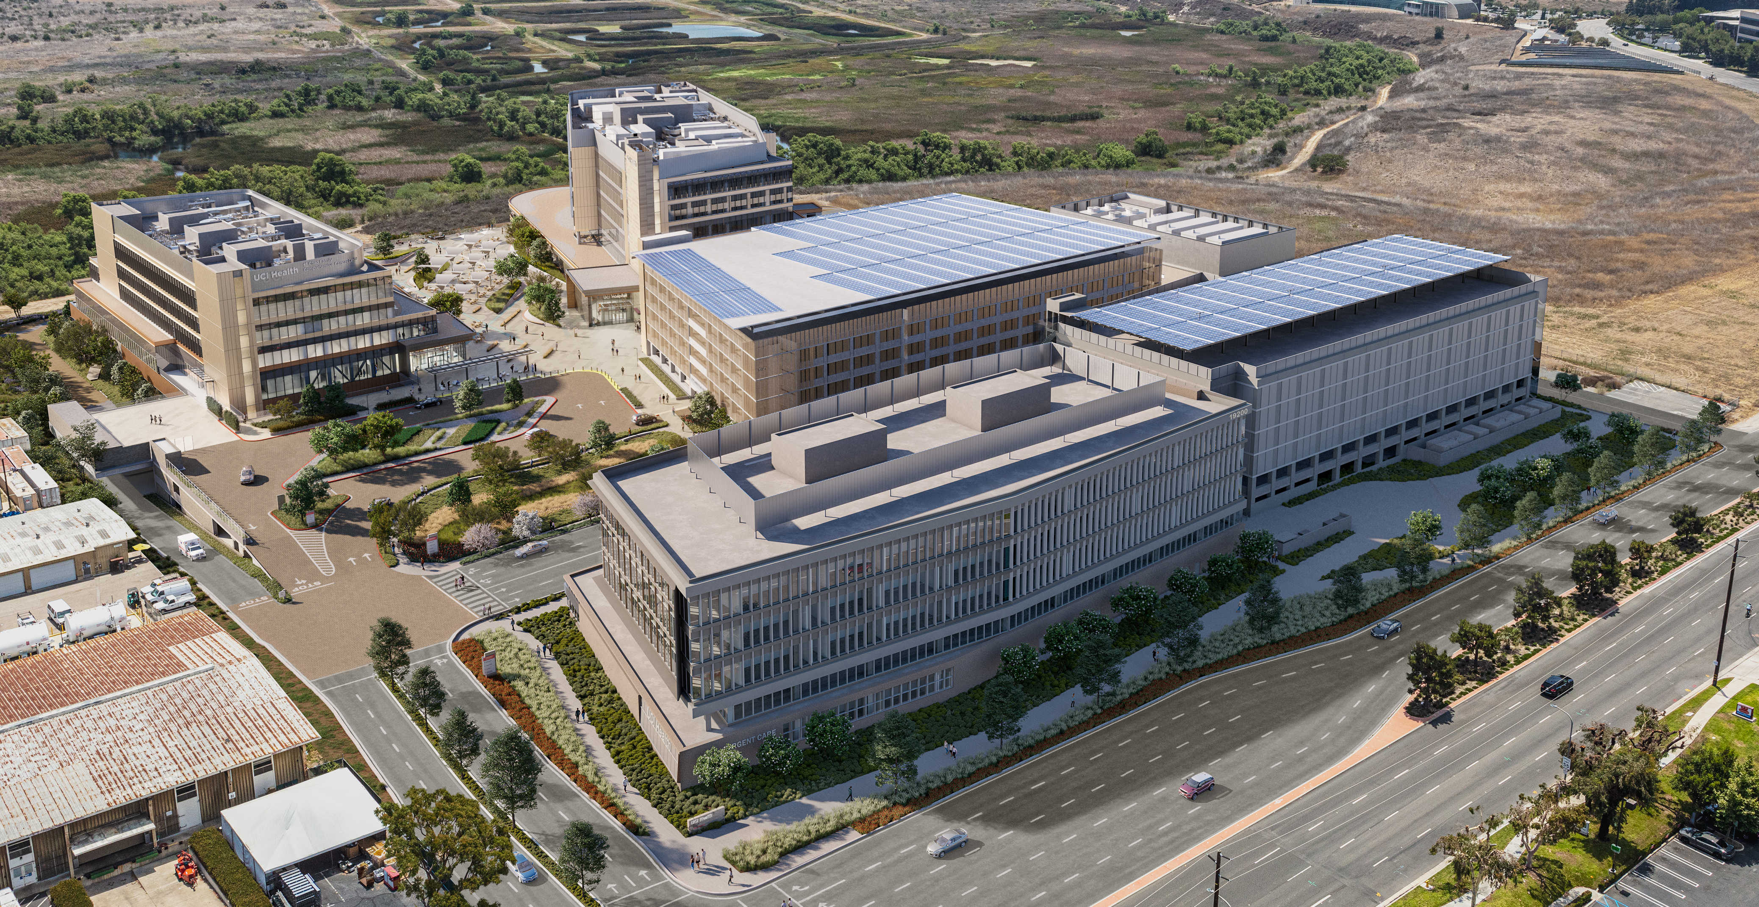
Notes:
More than $340 million of all UCI research funding in fiscal 2020-21 was for biomedical and health sciences clinical work across campus.
One thriving site of this is UCI’s Chao Family Comprehensive Cancer Center – Orange County’s only National Cancer Institute-designated comprehensive cancer center. Its researchers brought in $55 million for basic, translational and clinical studies in fiscal 2020-21, 24 percent more than last year.
Also continuing to increase was total financial backing for clinical trials in all health science areas to advance new treatments for life-altering diseases. In 2020-21, UCI received $94 million in grant and corporate funding from all sources for clinical trials, a 34 percent jump over the previous year. Within this amount, industry support topped $81 million for the first time.

