Slide 1
Bridging Safety Cultures:
Integrating Best Practices Across Industries for Safer Healthcare
Personal Observation…
Najm Meshkati
Professor of Engineering and International Relations
University of Southern California (USC)
11th Annual World Patient Safety, Science & Technology Summit
Patient Safety Movement Foundation
Irvine, California
September 6, 2024

Slide 2
My story…
Defining characteristics of my last 39-years of academic work - conducting research, teaching and consulting:
Safety-critical systems and industries
Interdisciplinary orientation
Cross-cutting nature of Safety Culture, Human Factors, and HSI (Human-Systems Integration)

Slide 3
My story…
Last 39 years of working directly with and experience with:
Nuclear power
Petrochemical
Refining
Oil & Gas Pipeline
Offshore Drilling
Aviation
Railroad
Maritime
Coal Mining
(last 25+ years) Healthcare industry

Slide 4
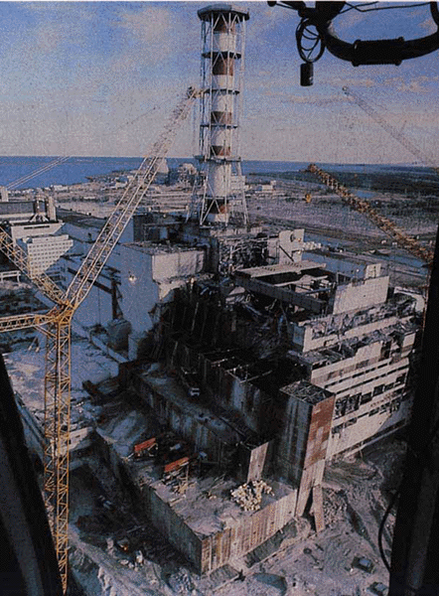
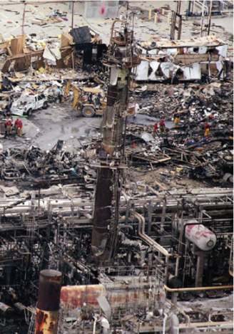
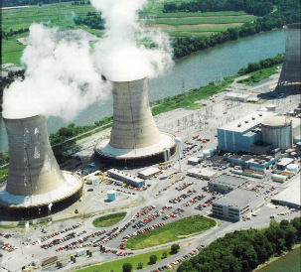
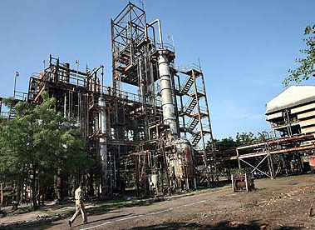
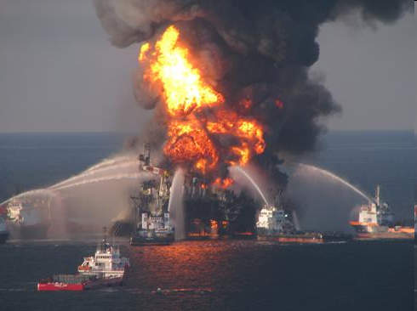
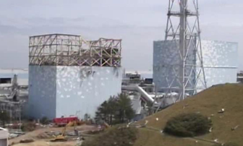
My life story…..
BP Refinery
Chernobyl
BP Deepwater Horizon
Three Mile Island
Bhopal
Fukushima
March 28, 1979
December 3, 1984
April 26, 1986
March 23, 2005
April 20, 2010
March 11, 2011

Slide 5
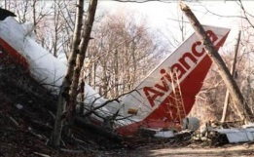
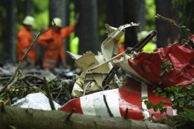
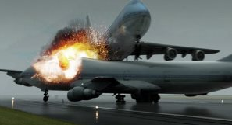
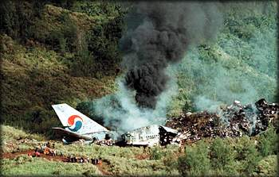
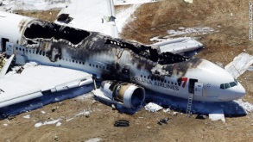
My life story + Aviation accidents
BP Refinery
Boeing 737 Two Crashes 2018 & 2019
Chernobyl
BP Deepwater Horizon
Three Mile Island
Bhopal
Fukushima
March 28, 1979
December 3, 1984
April 26, 1986
March 23, 2005
April 20, 2010
March 11, 2011
Avianca, 1990
Überlingen, 2002
Tenerife,
1977
Korean Air 801, 1997
Asiana 214, 2013

Slide 6
Visited and Conducted Research on
Nuclear Power Plants
San Onofre (USA)
TMI (USA)
EBR II (USA)
Darlington (Canada)
Chernobyl (Ukraine)
Fukushima Daiichi & Daini (Japan)
Mihama (Japan)
Laguna Verdi (Mexico)
Bushehr (Iran)
Metsamor (Armenia)
(Studied: Wolf Creek, Davis-Besse, Indian Point, Yankee Rowe, Rancho Seco, Diablo Canyon, etc.)

Slide 7
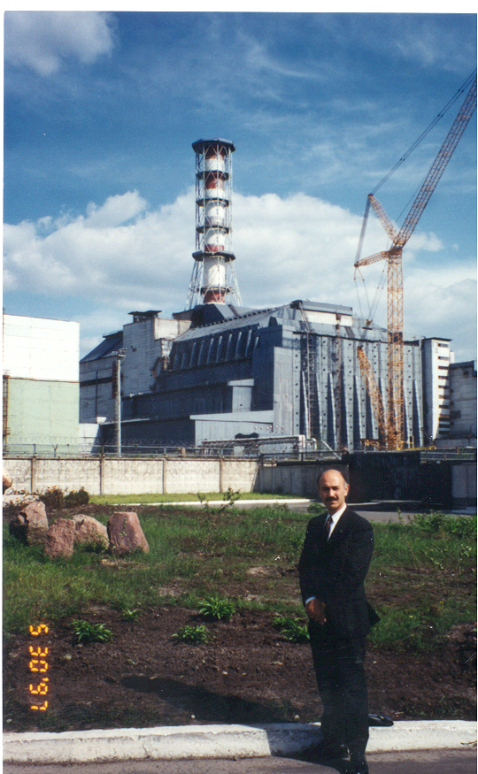
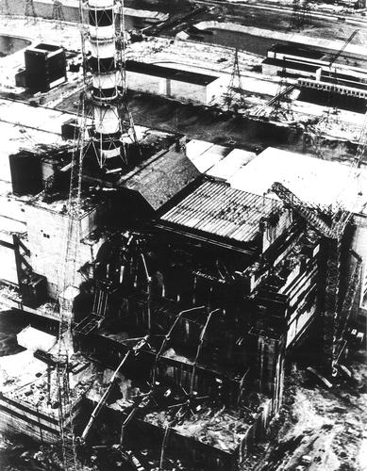
Chernobyl, 1997

Slide 8
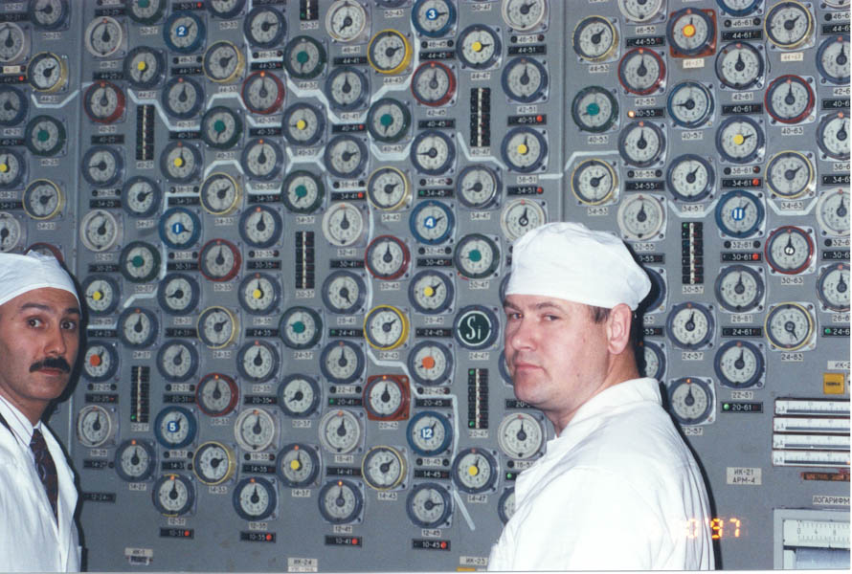

Slide 9
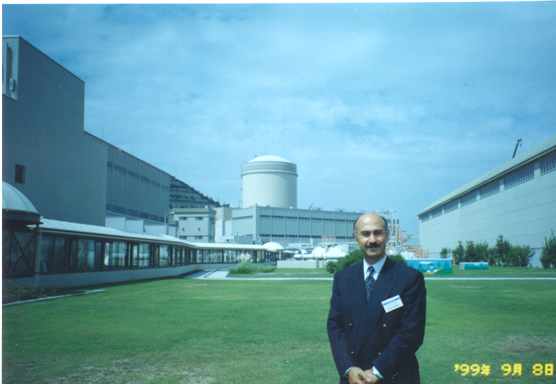
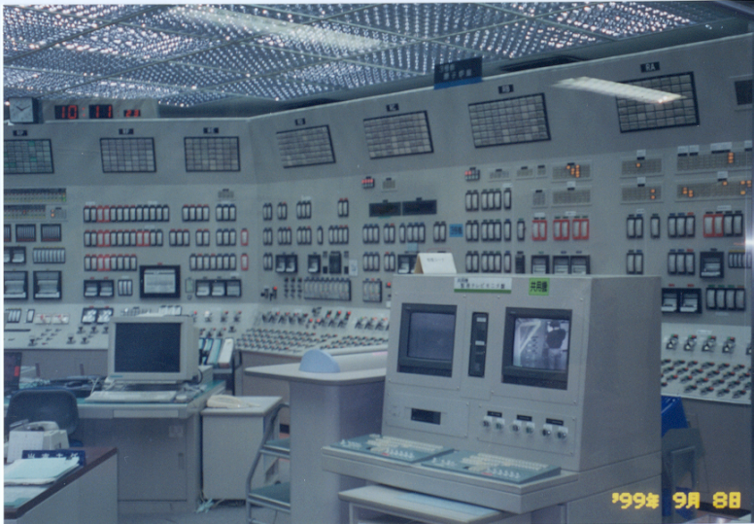
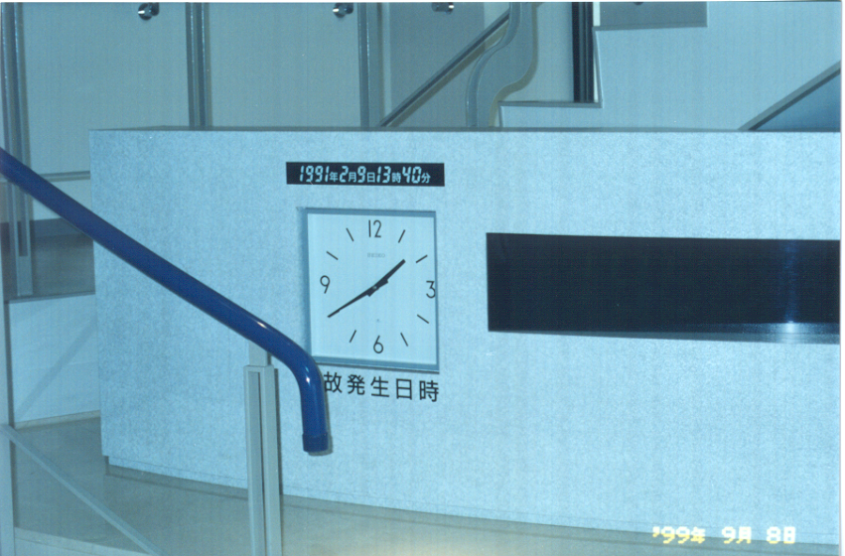
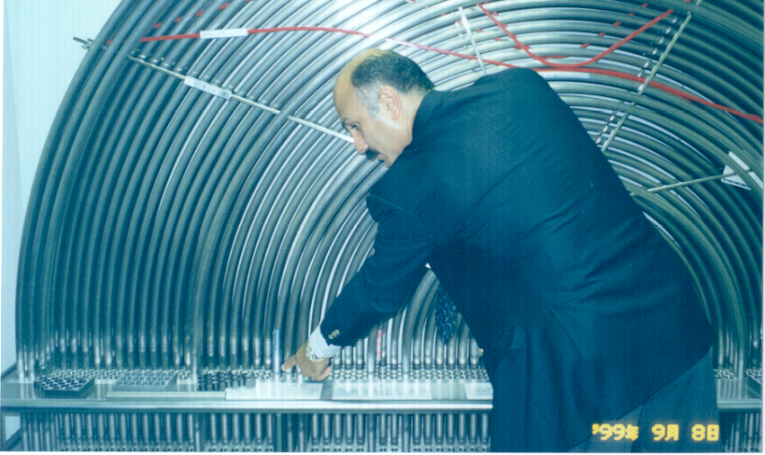
Mihama, 1999

Slide 10
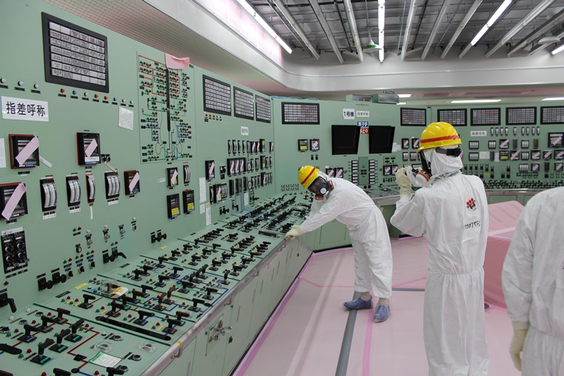
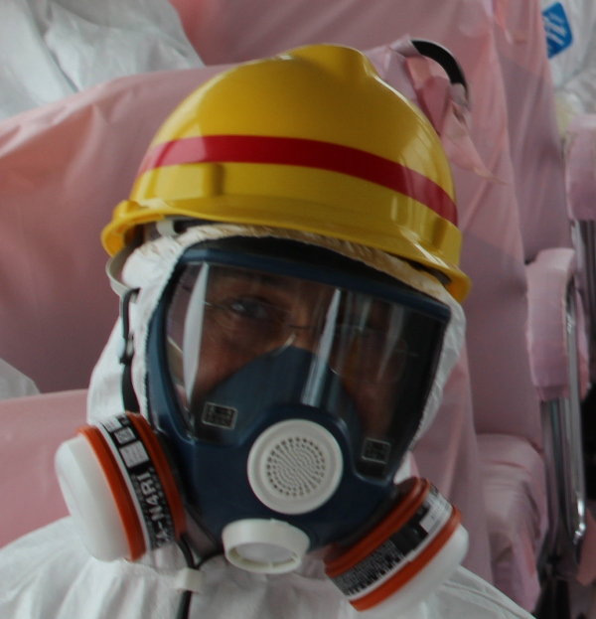
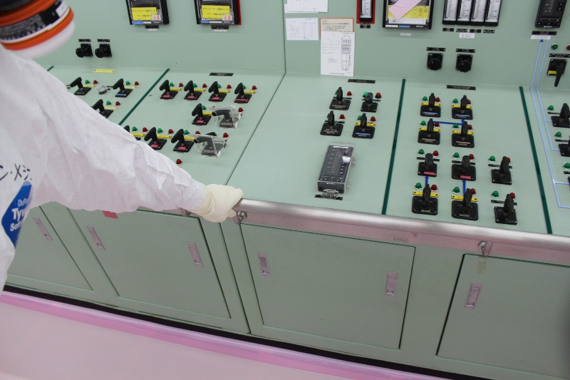
Fukushima Daiichi, 2012

Slide 11
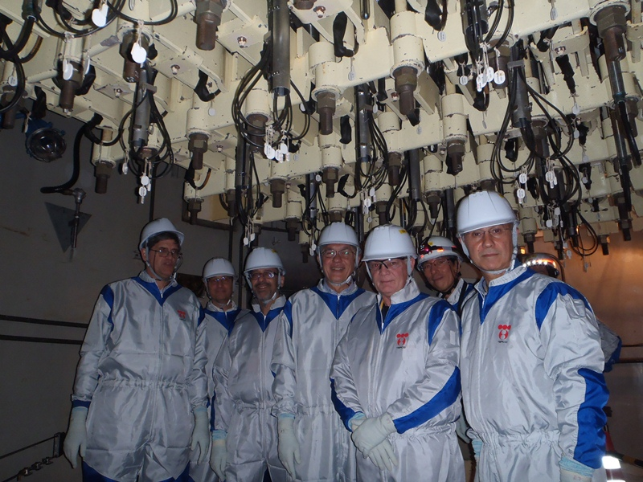

Slide 12
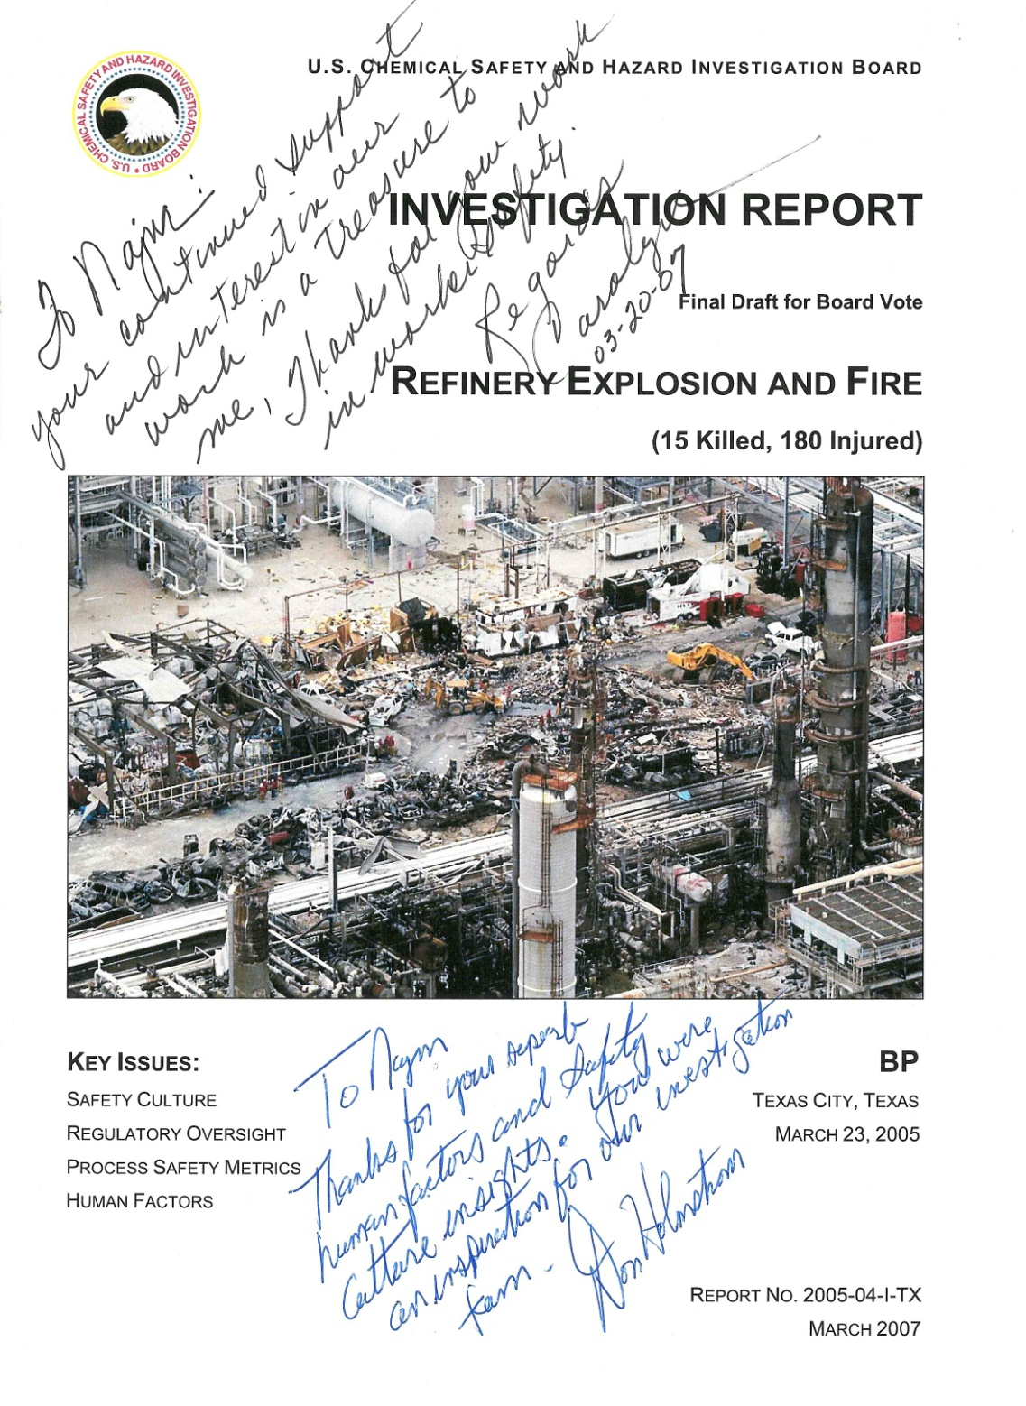

Slide 13
BP Deepwater Horizon

Slide 14
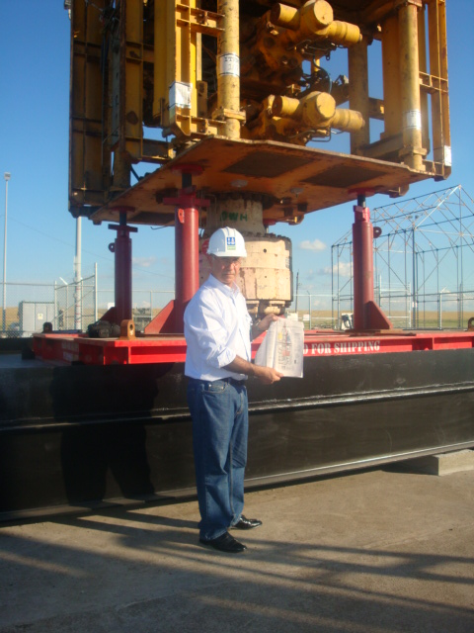

Slide 15
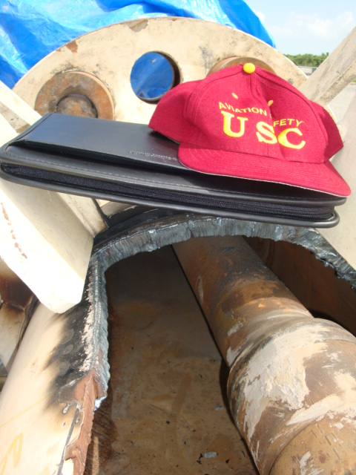
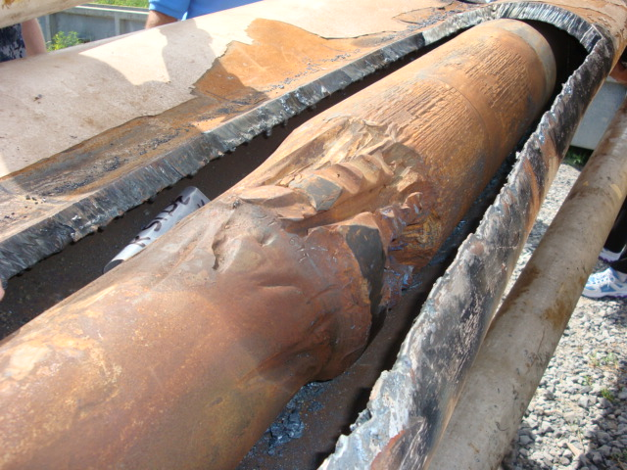

Slide 16
Healthcare

Slide 17
Medical Equipment Design and Evaluation
Perfusion Pump

Slide 18
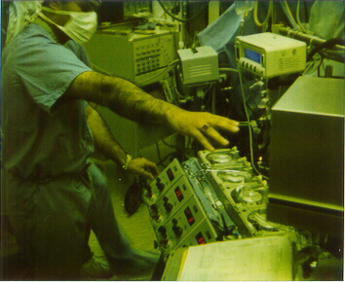

Slide 19
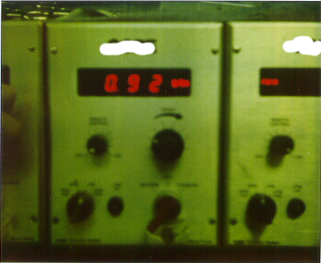

Slide 20
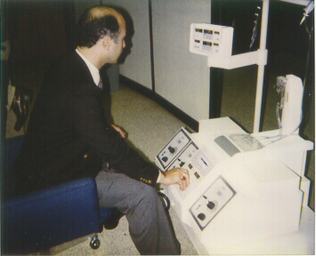

Slide 21
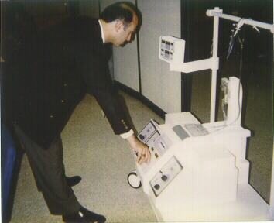

Slide 22
Healthcare System Example:
USC Keck Hospital

Slide 23
Operating Room
Perioperative Project

Slide 24
Healthcare
From Left to Right:
Dr. John Franklin
Dr. Sanaz Massoumi
Najm Meshkati
Dr. Greg Placencia
Dr. Yalda Khashe
Dr. Maryam Tabibzadeh
Dr. Joshua Gray
USC Keck Hospital, Perioperative Project, 2014

Slide 25
Some recent works…

Slide 26
FAA Expert Panel on Boeing…

Slide 27
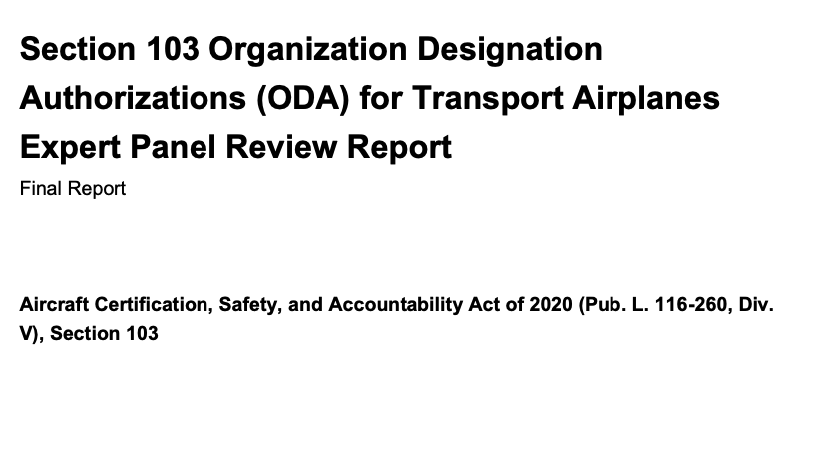
Released on February 26, 2024

Slide 28
Excerpts from Findings about
Safety Culture
The Expert Panel observed a disconnect between senior management and other members of the organization on safety culture.
The Expert Panel also observed inadequate and confusing implementation of the five components of a positive safety culture (Reporting Culture, Just Culture, Flexible Culture, Learning Culture, and Informed Culture).

Slide 29
The ‘HOT’ Model
Major Subsystems of a Complex Safety-Critical Technological System

Slide 30
Interactive Effect
Human
Organization
Technology
Volume of Output

Slide 31
Interactive Effect
Human
Organization
Technology
Volume of Output

Slide 32
What is Safety Culture and why it is so important/critical/vital

Slide 33
My “Understanding” of Safety Culture
I believe that safety culture is analogous to the human body’s immune system that protects against pathogens and diseases.
Due the pervasive nature of safety culture and its widespread impact, according to Prof James Reason, “it can affect all elements in a system for good or ill”.
As such, it is incumbent upon the leadership to strive for immunizing, protecting, maintaining, and nurturing (boosting!) the healthy safety culture of any company.

Slide 34
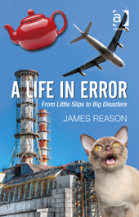
Safety Culture as a Root-Cause of a System’s Common Mode Failure
Because of their diversity and redundancies, the defense-in-depth will be widely distributed throughout the system.
As such, they are only collectively vulnerable to something that is equally widespread. The most likely candidate is safety culture.
It can affect all elements in a system for good or ill.
Professor James Reason, A Life in Error, 2013, Page 81

Slide 35
Safety Culture at NASA

Slide 36
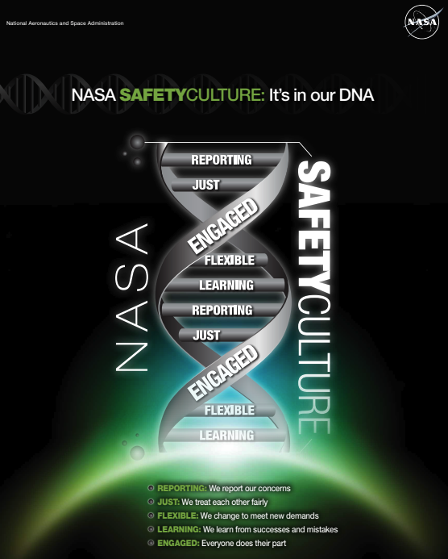

Slide 37
Safety Culture, SMS and HRO at American Airlines

Slide 38
Our Safety Management System is foundational for HRO practices to thrive
OPERATING AS A HIGH RELIABILITY ORGANIZATION
Reluctance to Simplify
Deference to Expertise
Future: Anticipate and detect
Sensitivity to Operations
Preoccupation with Failure
Commitment to Resilience
SMS
Present: Proactive
processes and procedures
Safety
Policies and
Objectives
Safety Risk
Management
Safety
Assurance
Safety
Promotion
Safety Culture
Top Level Commitment
HRO Characteristics
Notes:
Here is where we are good and where we need to grow
American is already high reliability organization.
Need the capability to identify and manage problems when small
Require furthering and enhancing our high reliability systems
Continue to introduce new programs to influence culture and maintain systems

