Slide 1
Building for the future of patient safety
Peter Lachman

Slide 2
Learning objectives
Attendees will be able to:
Define the key knowledge components required for a safer system
Develop a learning programme for clinical leaders and teams to deliver safer care
Evaluate the impact of learning programmes on people receiving and delivering care

Slide 3

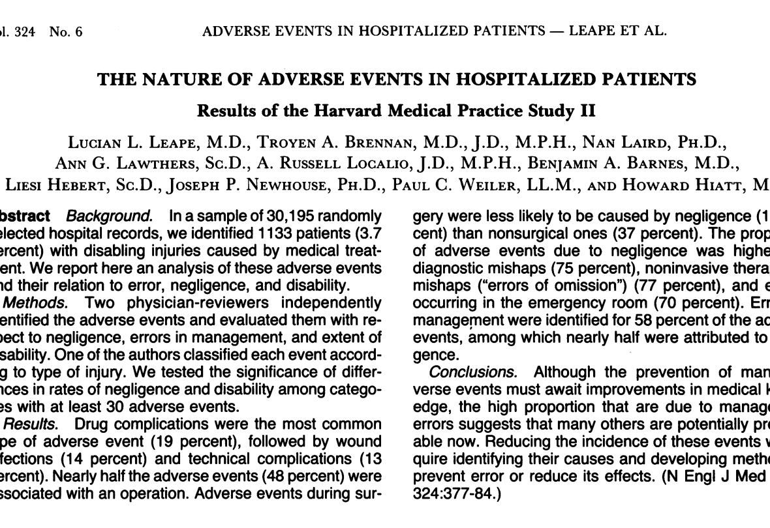
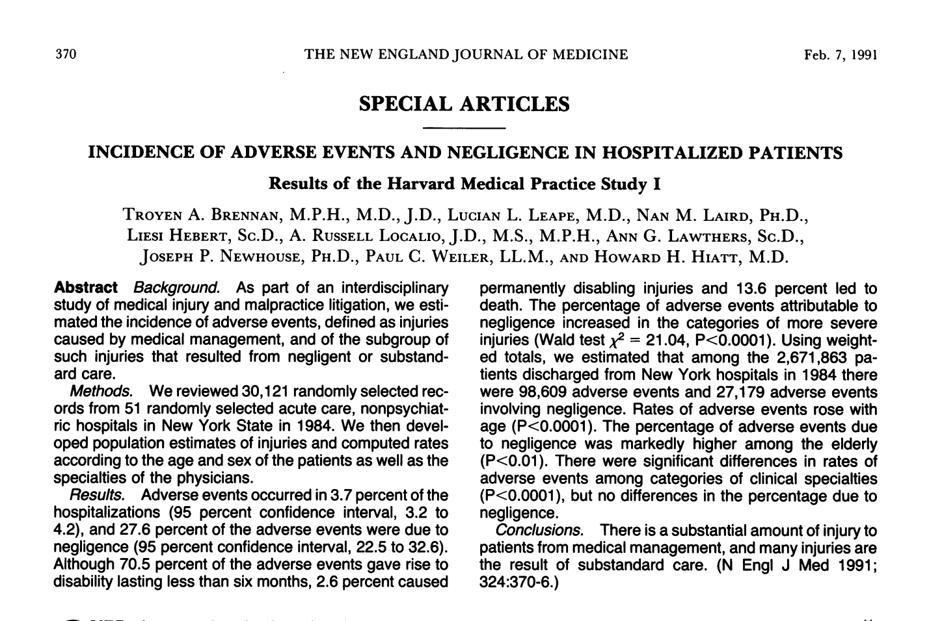
Remember the starting point

Slide 4

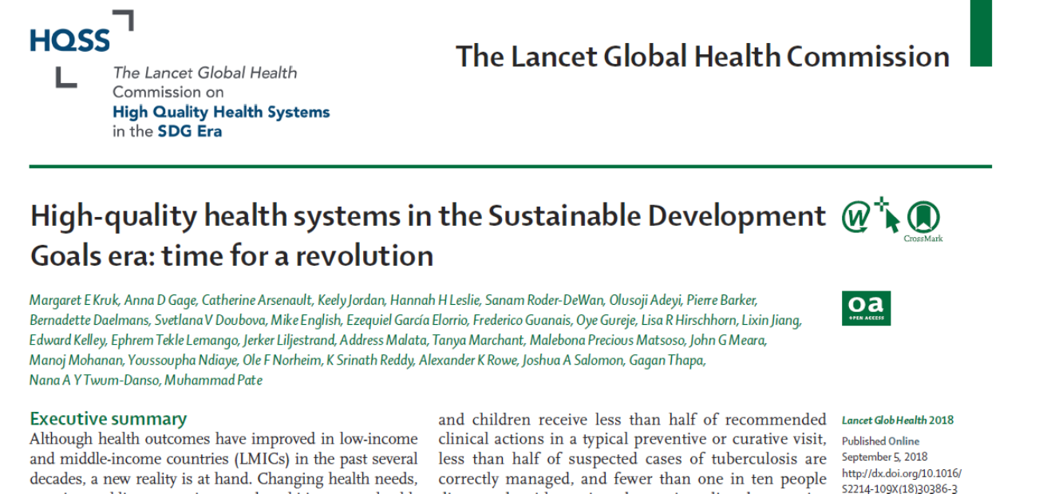
The worldwide situation 2018

Slide 5


Celebrate! We have come a long way

Slide 6
But we have a long way to go

Slide 7
The problem
We know what to do
But
We seem not to know
how to implement
what we know to do at scale

Slide 8
Structural issues
Culture
Context
Tradition Hierarchies
Complexity Design
Resources
Knowledge
Finance Human Physical
Theory Method

Slide 9
  Leadership for Patient Safety

Slide 10
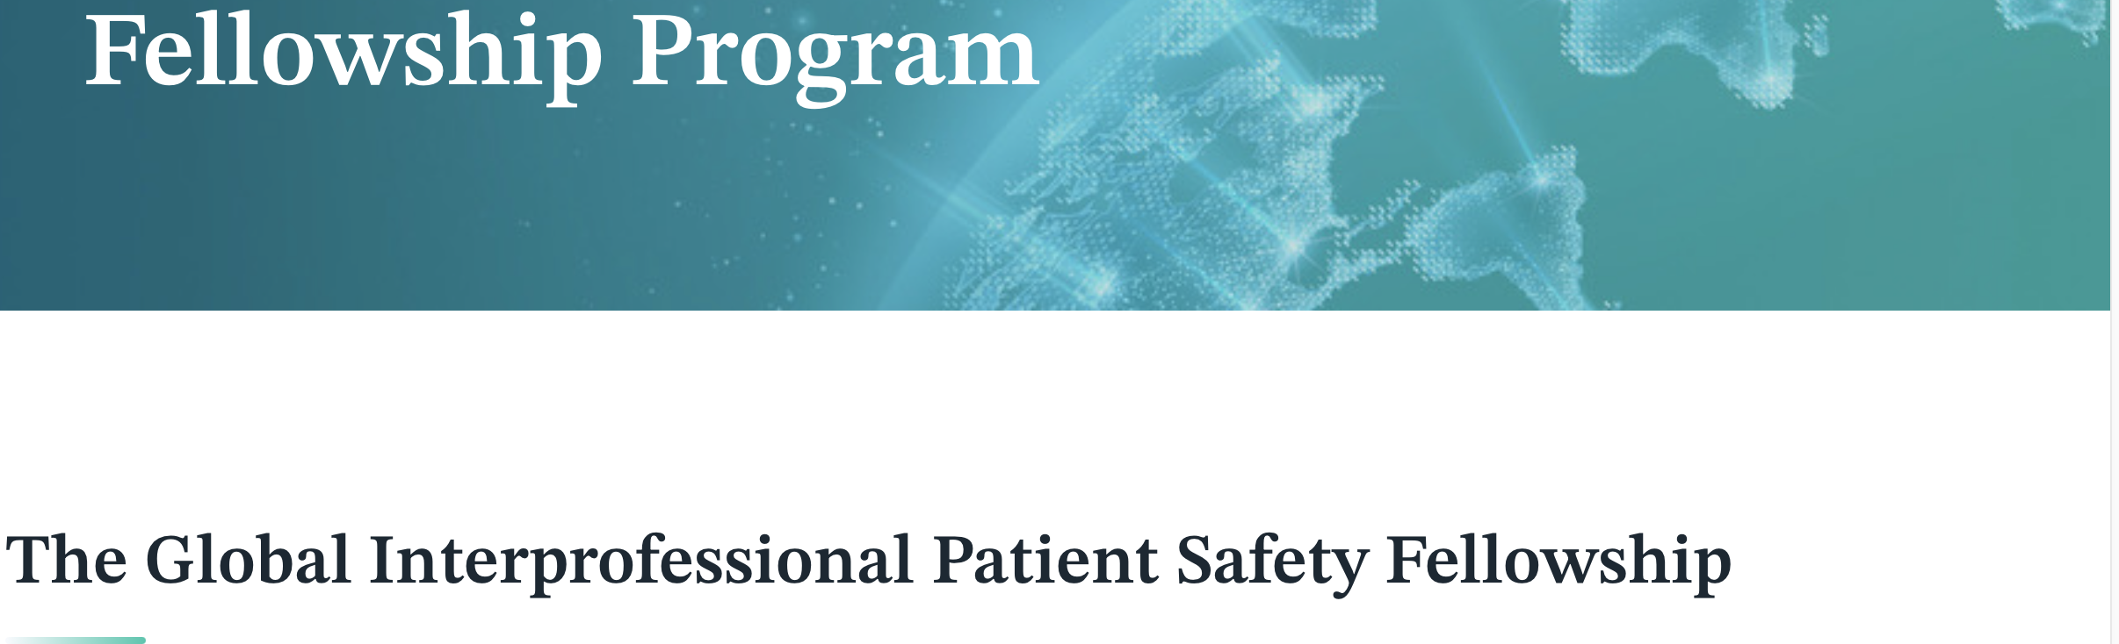
The global action

Slide 11
The knowledge components
  Theory and method
  Reflective Practice
  Action

Slide 12
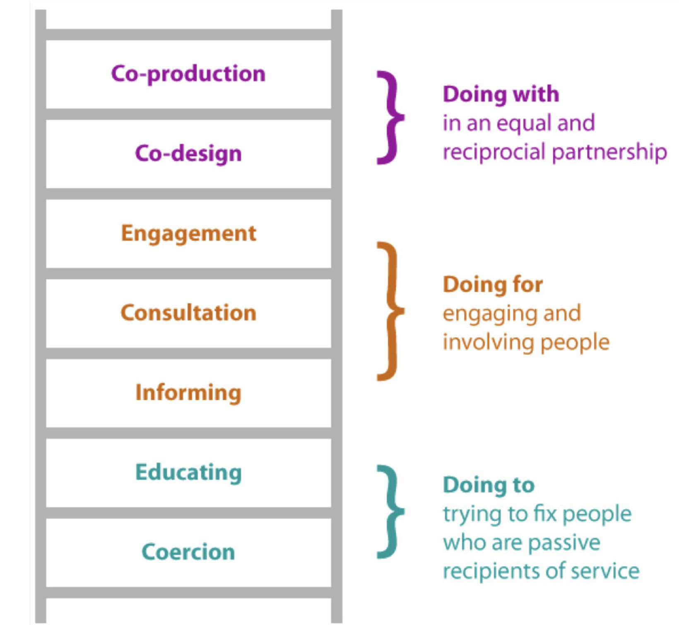
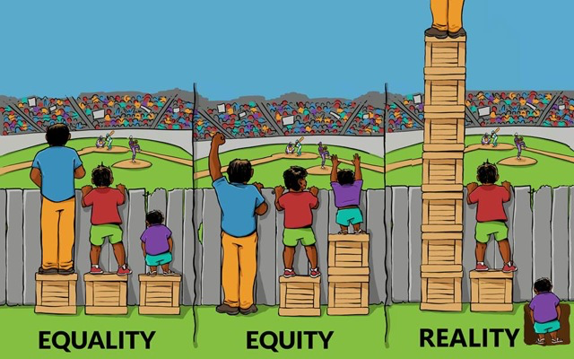
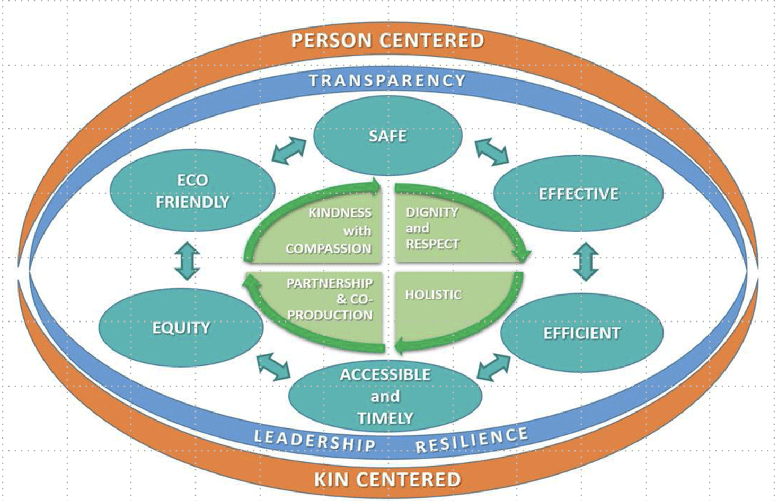
Learning 1
Multi-dimensional model of quality
Coproduction
Equity

Slide 13
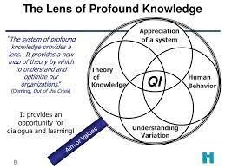
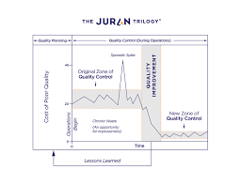
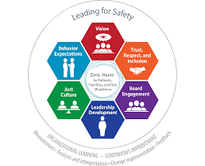


Learning 2
Leadership safety and quality
Profound knowledge and quality
Caring for the well being of healthcare professionals
Being a leader for patient safety

Slide 14
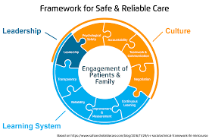
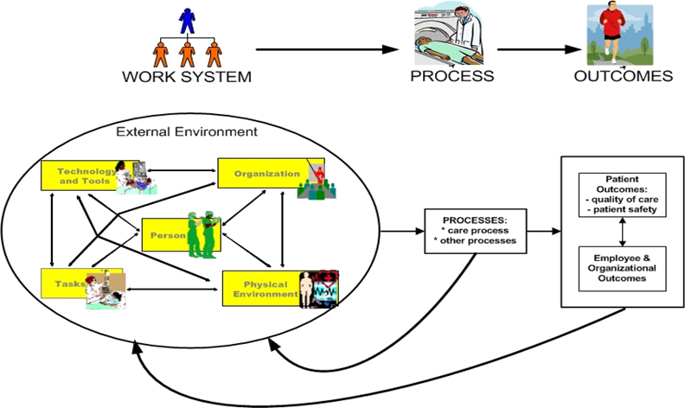
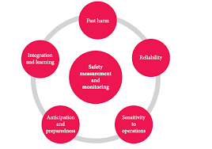
Learning 3
Patient Safety theory and methods
Reliability
Human factors
Proactive Risk management

Slide 15
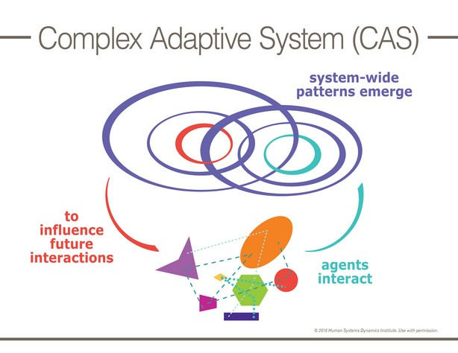
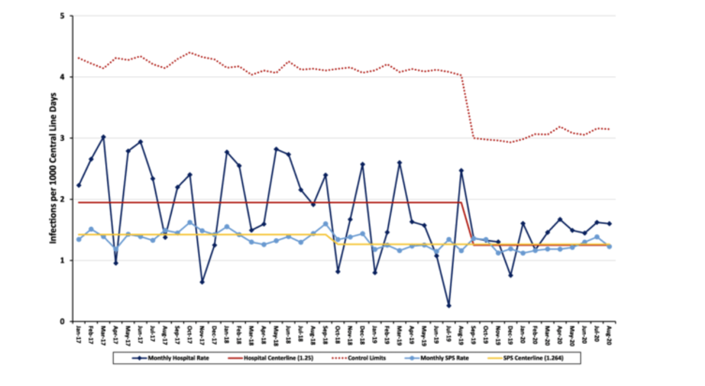
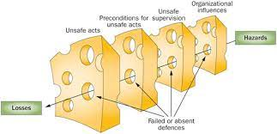
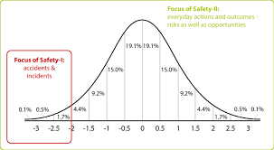
Learning 3
Incident management
Resilience and Safety 2
Measurement
Complexity

Slide 16
Learning 4
Feelings
Evaluation
Analysis
Description
Conclusion
Action
What
So, what
Now what
Rolfe
Gibbs

Slide 17
In their own words

Slide 18
"The fellowship was a turning point in my career, as it opens new doors to a different kind of thinking when it comes to patient safety."
Manal Younis Iraq

Slide 19
How has the fellowship made a difference to me as a patient safety leader?
I oversee program and perioperative safety at a global non-profit organization that spans across 4 different regions of the world.
During the fellowship, I realized that in patient safety matters, there is no one size fits all solution and therefore patient safety solutions must be culturally appropriate and contextualized.
This has made a significant positive difference in implementation of similar patient safety solutions across our programs.
Elizabeth Igaga Kenya

Slide 20
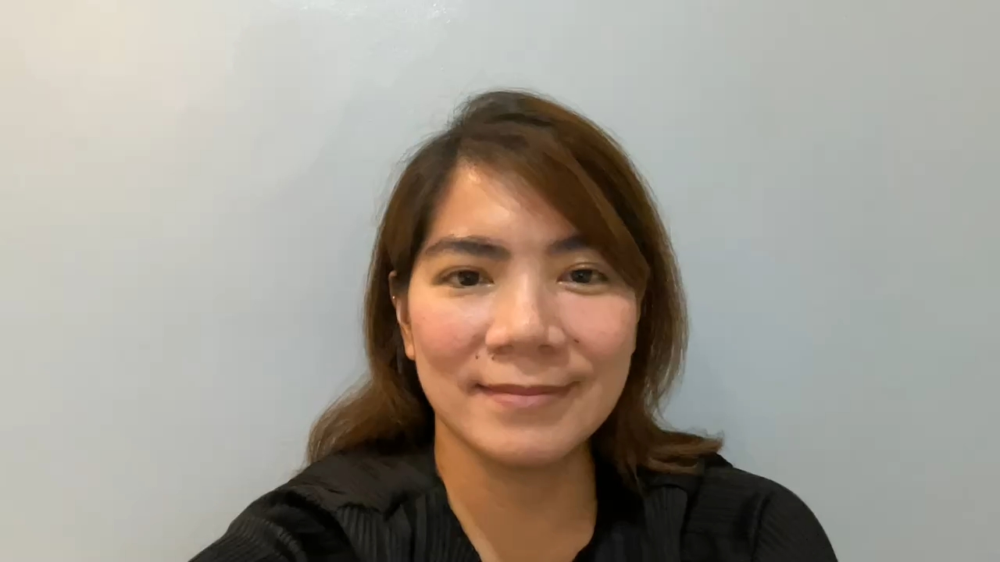
Angeli Merci Porto Philippines

Slide 21
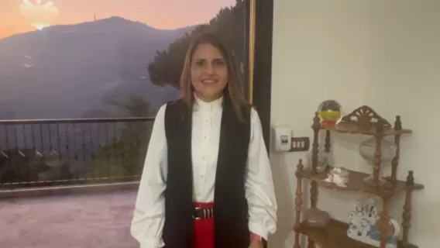
Maysaa Jafaar Lebanon

Slide 22
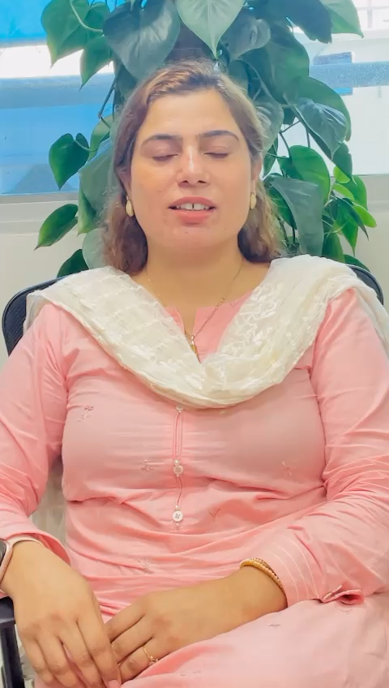
Afifa Baloch Pakistan

Slide 23
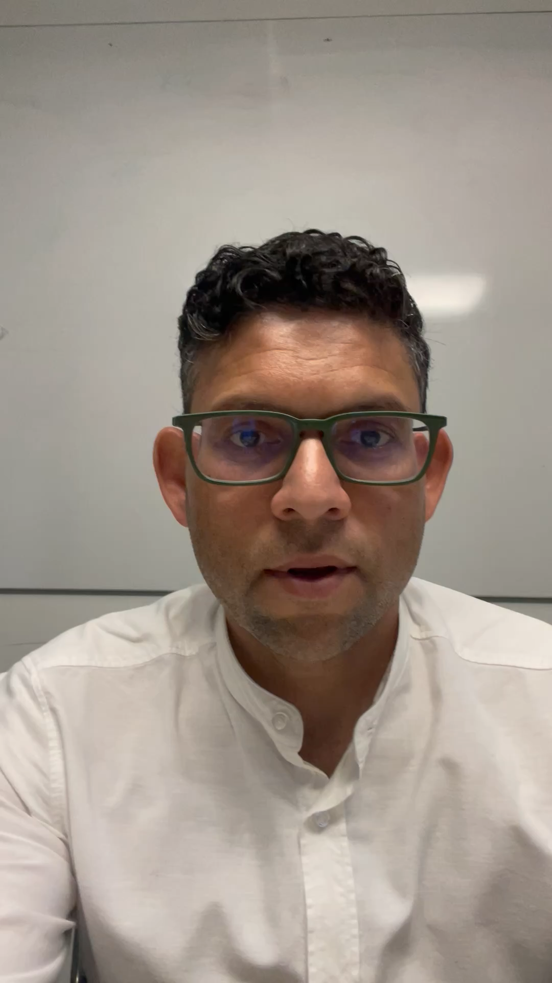
Ashfaq Chauhan Australia

Slide 24
In one word

Slide 25
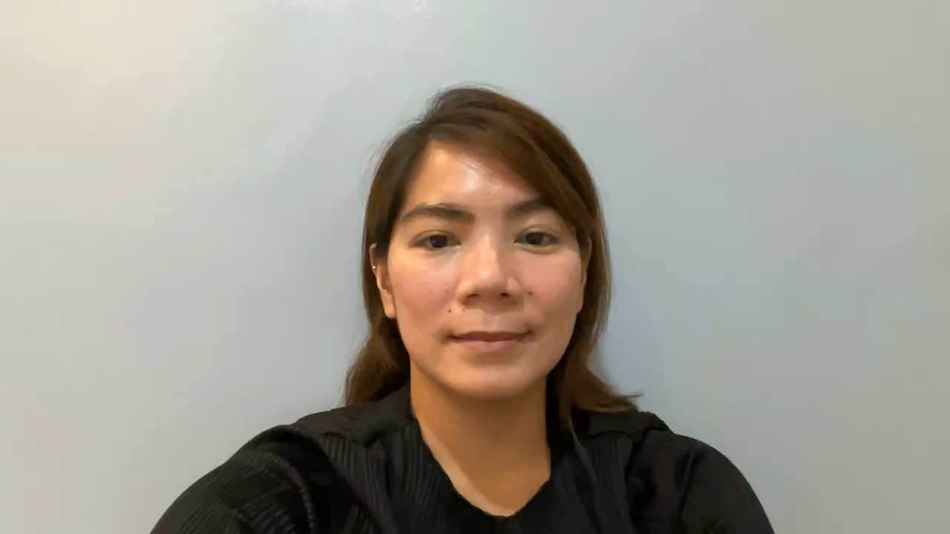
Angeli Merci Porto Philippines

Slide 26
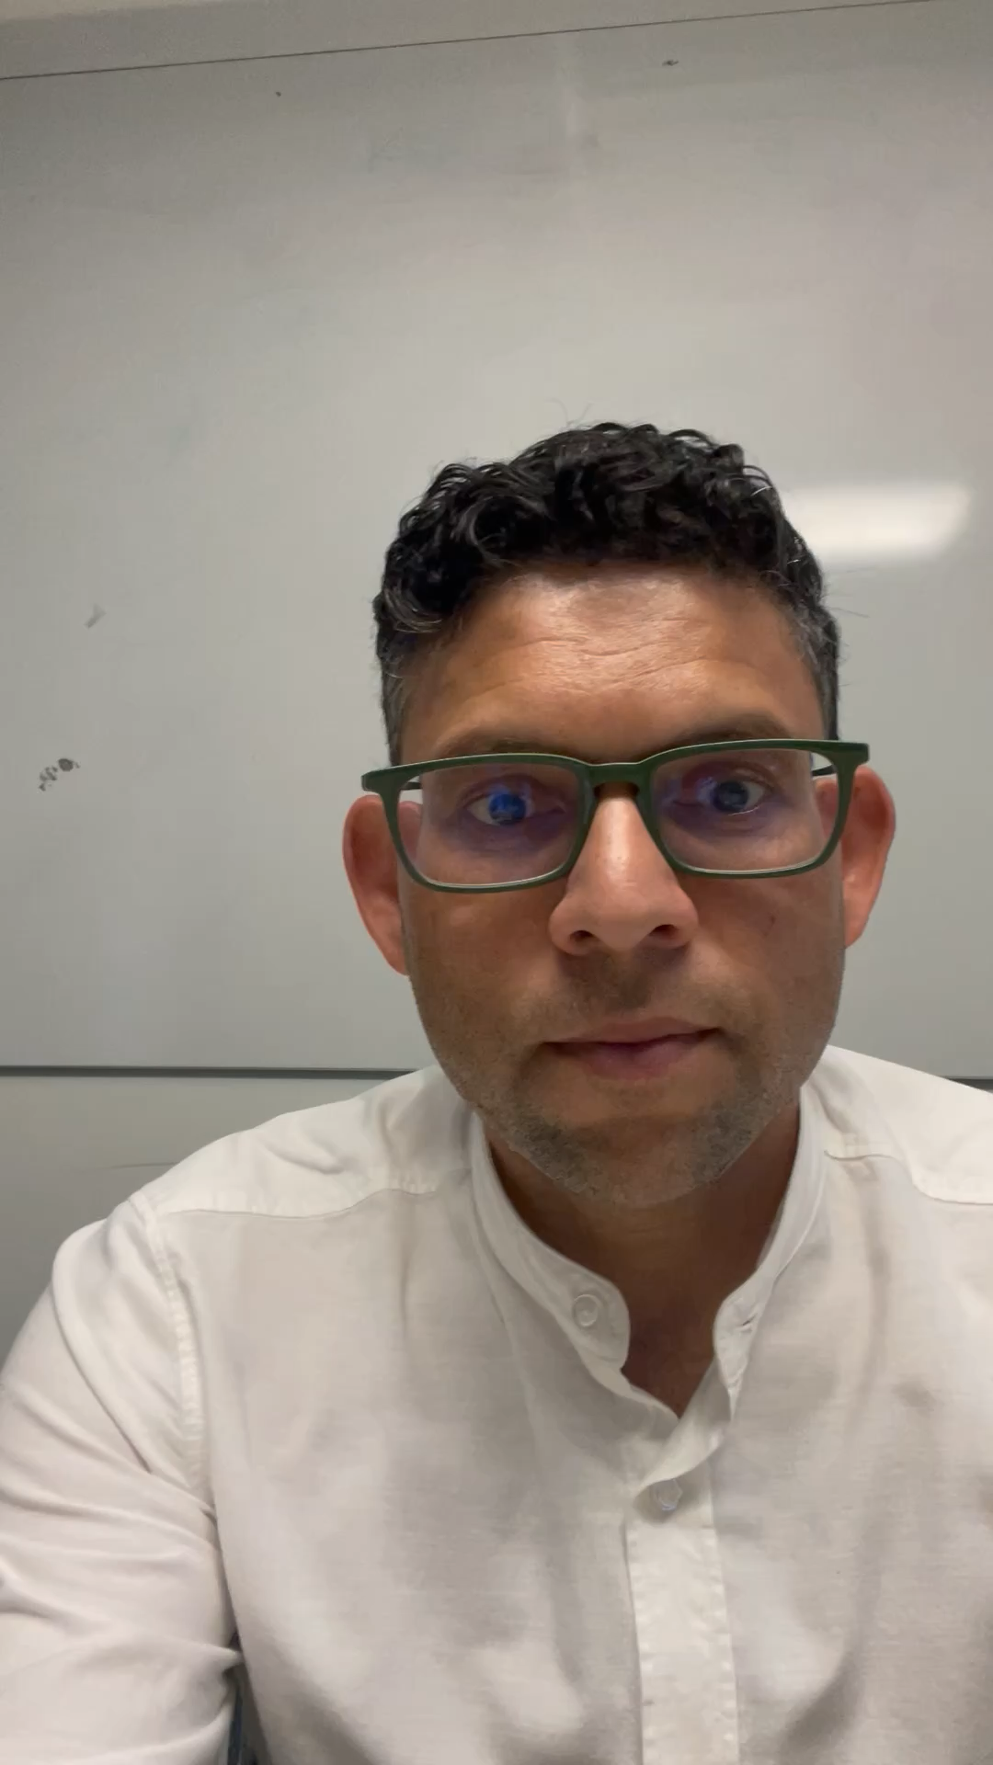
Ashfaq Chauhan Australia

Slide 27
With effective leadership
we can create a safer healthcare system with zero preventable harm
Thank You

