Slide 1

11th Annual World Patient Safety Science & Technology Summit
7 September 2024
Health Services Safety Investigations Body
Dr Ted Baker

Slide 2
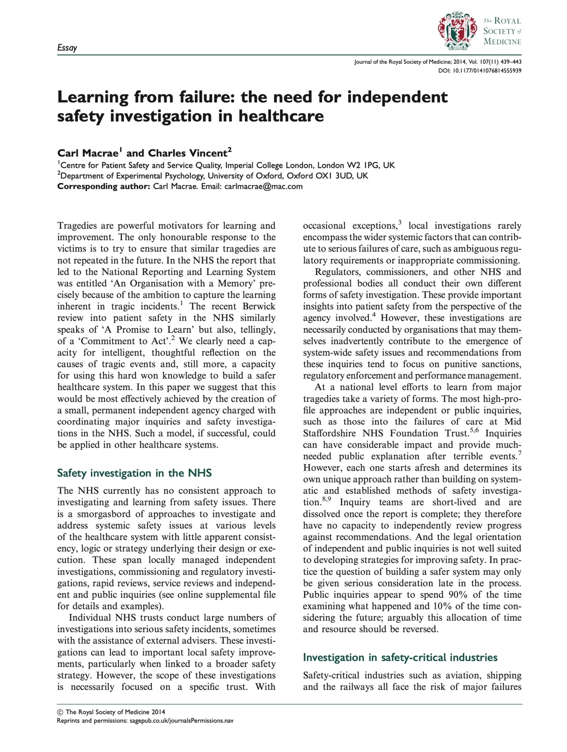
An independent, expert investigative body to rigorously investigate and improve safety across the healthcare system and actively develop and spread expertise
The work of such an agency could truly capture the widely shared ambition of learning from the past to improve the future
J R Soc Med 2014; 107: 439–443.
doi.org/10.1177/0141076814555939

Slide 3
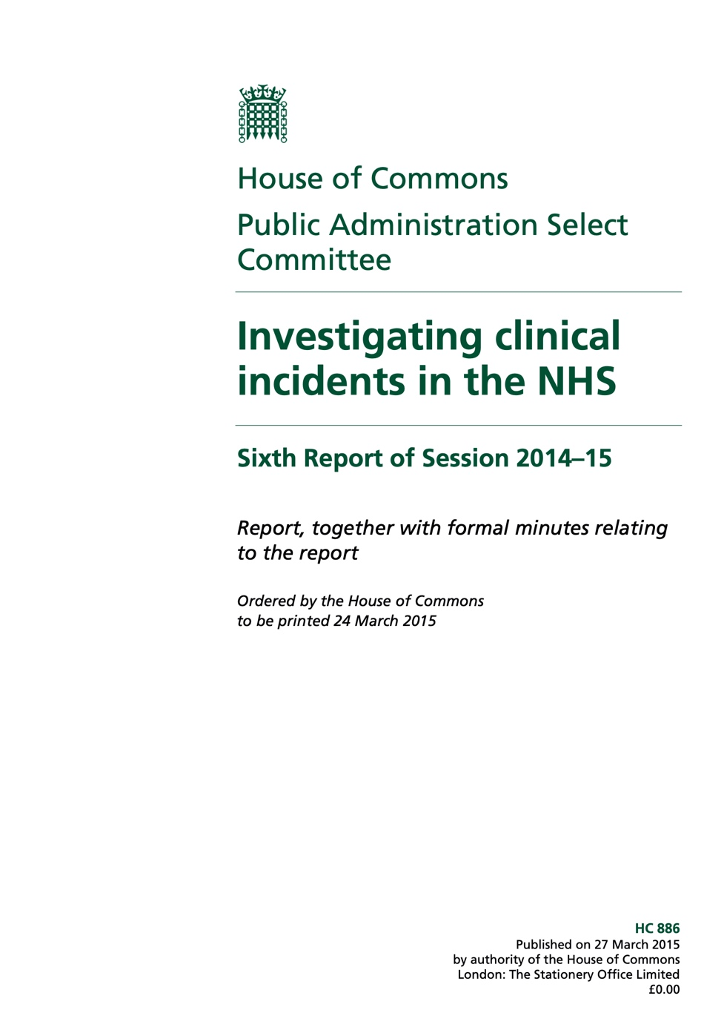
A new body that is permanent and independent to ensure a dispassionate and system-wide view of safety
To ensure a safe space for disclosure, witnesses should be given legal immunity for what they say
It must be an enabler and promoter of good investigatory practice
It must have its own substantial investigative capacity, so that it can demonstrate best practice
The sole objective of its investigations should be to prevent incidents and to improve patient safety, and not to apportion blame or liability
https://publications.parliament.uk/pa/cm201415/cmselect/cmpubadm/886/88602.htm

Slide 4

The Health Services Safety Investigations Body established as an independent body
To investigate incidents that occur in England during the provision of health care services and have or may have implications for the safety of patients
Its purpose is to identify risks to the safety of patients, and address those risks by facilitating the improvement of systems and practices of health care services
Health Services Safety Investigations Body (HSSIB) became a legal entity on 1 October 2023

Slide 5





Promote healthcare safety excellence and learning through investigation, education and collaboration and learning through investigation, education and
Independent safety investigations in health services
Do not apportion
blame or liability
Focus on system-level change
Professionalise the patient safety investigator role
5
Notes:
Established in 2017 as a new body to undertake independent safety investigations of patient safety incidents in NHS-funded care, in England. We work cooperatively on patient safety with NHS central bodies but are functionally separate and independent. Encourage improvement in patient safety and safety culture that’s been achieved in other safety critical industries.
HSIB’s purpose is to identify the safety risks, follow the evidence and develop effective safety recommendations. We do not apportion blame or liability. Model through investigations the values and behaviours that support transparency and blame-free learning.
Our purpose is to focus on identifying patient safety risks that exist at system level – that are consequences of misalignment between policy and regulation and the realities of caregiving at the frontline, and that can be observed recurring across the NHS.
4. Intend to professionalise the role of safety investigation, support NHSI national patient safety training curriculum and improving standards of local investigations.

Slide 6
What’s different?
We do not determine blame, criminal or civil liability, both in our reports and in our messaging about patient safety
We do not identify any individual or organisation involved in an incident or who has provided evidence
The information we hold is legally protected
We do not disclose evidence we collect as part of an investigation, or details of incidents we are considering for investigation
Our reports may not be used in civil, criminal or regulatory proceedings

Slide 7
We have new legal powers
To compel any individual to attend an interview or provide relevant information
To enter and inspect any premises in England
To remove or copy documents and information from IT systems, and we can seize equipment
Failure to comply, obstructing an investigator or supplying deliberately misleading information is an offence

Slide 8
What do we investigate?
Any person or organisation can refer cases to us. We also monitor a variety of patient safety reports and data. We judge what to investigate using published criteria.
We investigate only a very few incidents and avoid conflict with local investigations
We focus on safety incidents that have widespread implications and where our approach can add value
We want to understand major themes influencing safety (e.g. management of safety, fatigue, mental health care, the justice system, use of temporary staff, information technology)

Slide 9




Focus on system improvement not on human error
Wide ranging expertise from safety-critical industries supported by subject matter experts
Multidisciplinary and inclusive teams; patients, family and healthcare staff involvement
We make safety recommendations to reduce further risk of harm working with system to make sure they have impact
Transparent and collaborative to support learning, but provide safe space for individuals and organisations
9
Notes:
1. Expertise: Diverse experience of HSIB investigators and analysts - backgrounds in the NHS, aviation and military investigations, human factors and other safety critical industries. Investigations supported appropriately by Investigators receive introductory training in human factors and safety science in investigations at Cranfield University – world renowned in accident investigation
2. Multidisciplinary and inclusive: every investigation exposed to clinical and non-clinical perspectives during fieldwork and analysis, Investigations supported appropriately by subject matter advisors and experts by lived experience. Patient, family and staff involvement is central to our investigations.
3. No blame: We provide a confidential space for staff to tell us their experience of patient safety incidents, in knowledge that we are there to learn not blame. [NOTE: If appropriate for the audience, explain the difference between 'safe space' for national investigations as set in the 2016 Directions, and the limits on what we can protect under maternity investigations as set in the Maternity Directions 2018.]
4. Transparent & Collaborative : Safety recommendations are not enforced by HSIB – we are not a regulator. Seek to achieve change through a transparent and collaborative approach to accountability. NHS England/Improvement are leading the development of accountability mechanisms to ensure that HSIB recommendations are translated into meaningful change at system level.

Slide 10
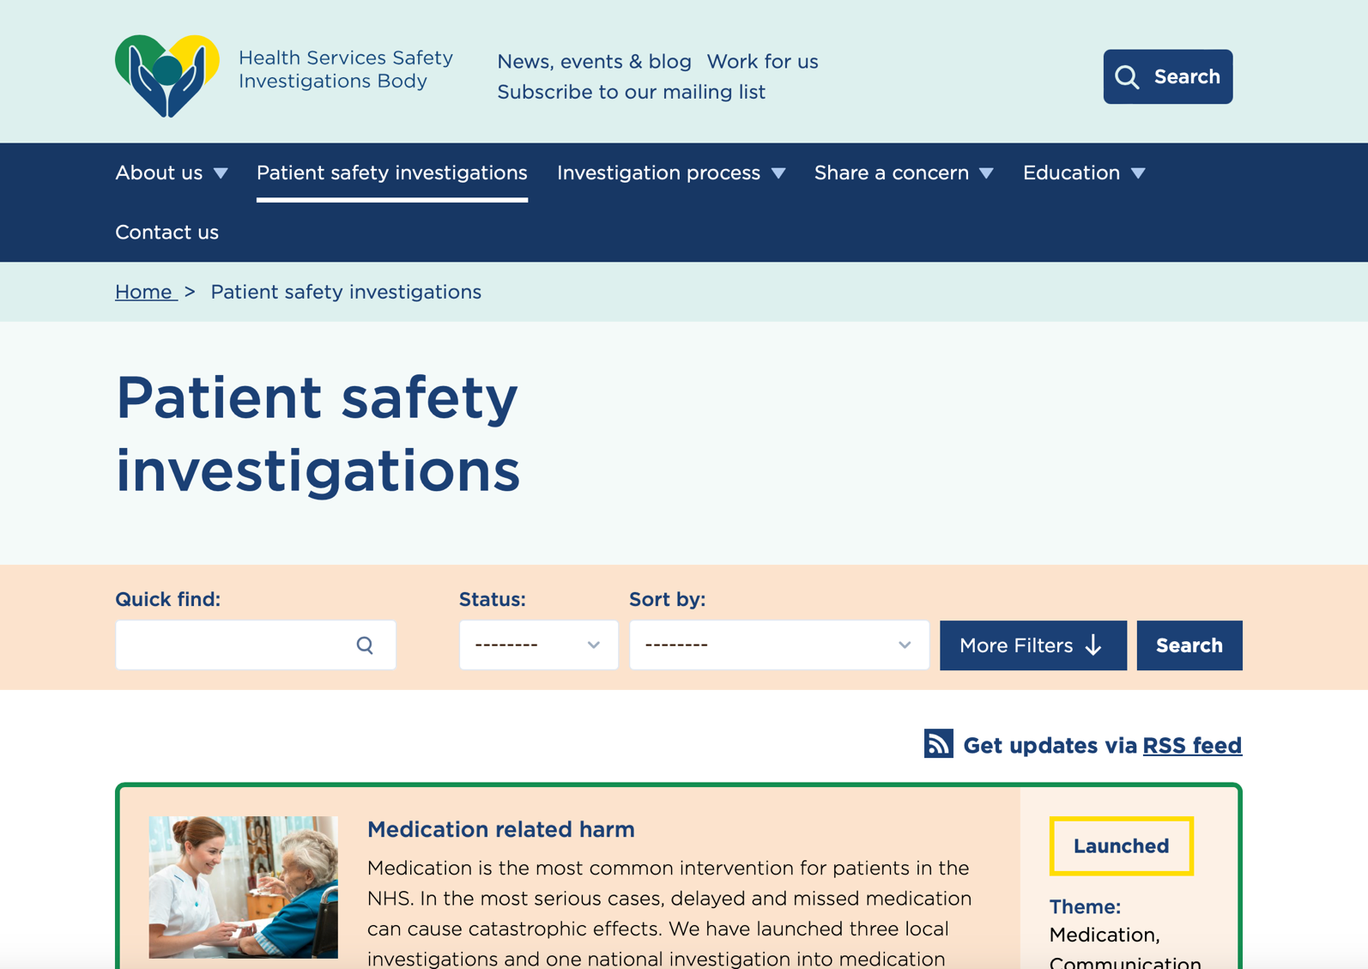
So far…
We have published 12 investigation reports making 32 safety recommendations and 27 safety observations. We have launched 14 further investigations
Examples of published reports:
Ambulatory infusion pumps
Advanced airway management
Delayed diagnosis in primary care
Patients with learning disabilities in acute hospitals
Nutrition management of acutely unwell patients
Observation of patients at risk of self-harm
Temporary staff and patient safety
Children with mental health needs on paediatric wards
www.hssib.org.uk/patient-safety-investigations/

Slide 11
Examples of our recommendations
Positive patient identification
Research into risk of misidentification during patient handovers between providers
Regulatory focus on protocols for safe transfers
Standardised approach to scanning for patient identification across whole system
Retained surgical swabs
Reassessment of reporting to remove focus on human error
Revise the process for checking swabs using human factors and user centred principles
Research into the use of technology to reduce dependence on human checks

Slide 12
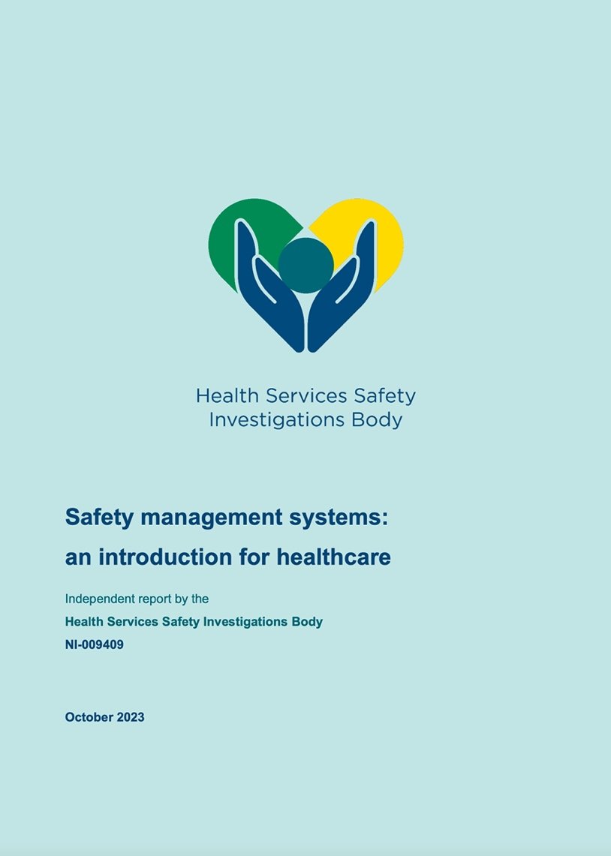
Managing safety in health services
Healthcare is provided by a variety of complex systems working together
Safety management is not coordinated
Accountability, priorities and learning are often unclear
Safety recommendations are often not implemented effectively
We recommended a national initiative to develop Safety Management Systems in healthcare, with the intention that they will become a regulatory requirement

Slide 13

www.hssib.org.uk

